Slide 1
Using the New US State Policy Index for Population Health Research
Milbank Quarterly Webinar
June 29, 2026
Notes:
Sign-in, All, 11:45 ET
Intro, Alan Cohen, 12 to 1:05
Presentation, Heller 12:05 to 12:15
Presentation, Brown 12:16 to 12:26
Discussant comments, Michener, 12:27-12:34
Panel Discussion moderated by Braveman: 12:35 to 12:50
Q&A from Audience 12:51 to 12:58 pm
Wrap-up, Alan, 12:59 to 1 pm

Slide 2
Panelists
Jennifer Karas Montez, PhD, Director of the Center for Aging and Policy Studies and University Professor, Maxwell School of Citizenship & Public Affairs, Syracuse University, lead author US State Policy Index for Population Health Analyses.
Iliya Gutin, PhD, Research Assistant Professor and Senior Research Associate in the Center for Policy Research, Maxwell School of Citizenship & Public Affairs, Syracuse University, lead author US State Policy Contexts and Mental Health Among Working-Age Adults.
Scott Burris, JD, James E. Beasley Professor of Law and Director of the Center for Public Health Law Research, Temple University Law School (discussant)
Alan Cohen, ScD, Editor, The Milbank Quarterly (moderator)

Slide 3

U.S. State Policy Index for Population Health Analyses
Jennifer Karas Montez, Iliya Gutin, & Shannon M. Monnat

Slide 4
01
Why we need an index
02
Select policies & create the index
03
Validate index
04
How to use it

Slide 5
The Problem
Differences in population health across geographic areas are large and growing
Differences appear partly linked to changes in states’ policy contexts
Existing measures of policy contexts are not ideal for studying the differences
Understanding the differences requires a new, “industry standard” policy index
Notes:
Policy context = the general orientation of policies, usually measured on a liberal to conservative continuum
Two existing policy indices Irregularly updated, difficult to interpret, and impossible to replicate

Slide 6
Why do we need a policy index?
Reality
  People “live more than one policy at a time” (Beckfield 2015)
Bundling
  Ideological alignment of policies
  Concurrent policy enactment
  Must consider policy co-occurrence for valid inferences (Matthay et al 2021)
Theory
  “many of the most ambitious theories focus not on individual policies or policy domains, but on the character of government policy as a whole” (Caughey & Warshaw 2016)

Slide 7
Our objectives
Create an annual state policy index that is:
  Valid for population health research
  Easily updated annually using publicly available data
Provide guidelines for the appropriate use of policy indices

Slide 8
01
Why we need an index
02
Select policies & create the index
03
Validate index
04
How to use it

Slide 9
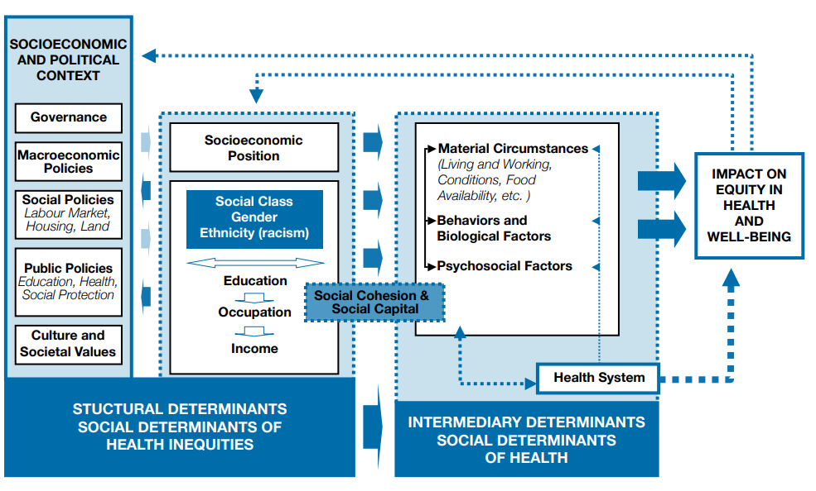
WHO Social Determinants of Health Framework
(Solar & Irwin 2010)
Span policy domains
Affect intermediators
Reliably measured
Available annually 1980+
Causal effects
Salient for working-age & less-educated adults

Slide 10
11 Policies
Temporary Assistance for Needy Families
Supplemental Nutrition Assistance Program
Minimum wage
Earned income tax credits
Right-to-work laws*
Labor-related preemption laws
Unemployment insurance
Paid sick leave*
Medicaid expansion*
Firearm safety laws
Tobacco taxes

Slide 11
Index Creation (~Grumbach [2018])
Get the 11 policies from the State Policy & Politics Database for 1980-2023
Normalize each policy from 0 to 1 across all years (0 = conservative, 1 = liberal)
For each state, sum the 11 policy scores for every calendar year
Normalize the summed scores across 1980-2023 from 0 to 1

Slide 12
01
Why we need an index
02
Select policies & create the index
03
Validate index
04
How to use it

Slide 13
Face Validity
Convergent Validity
Predictive Validity

Slide 14
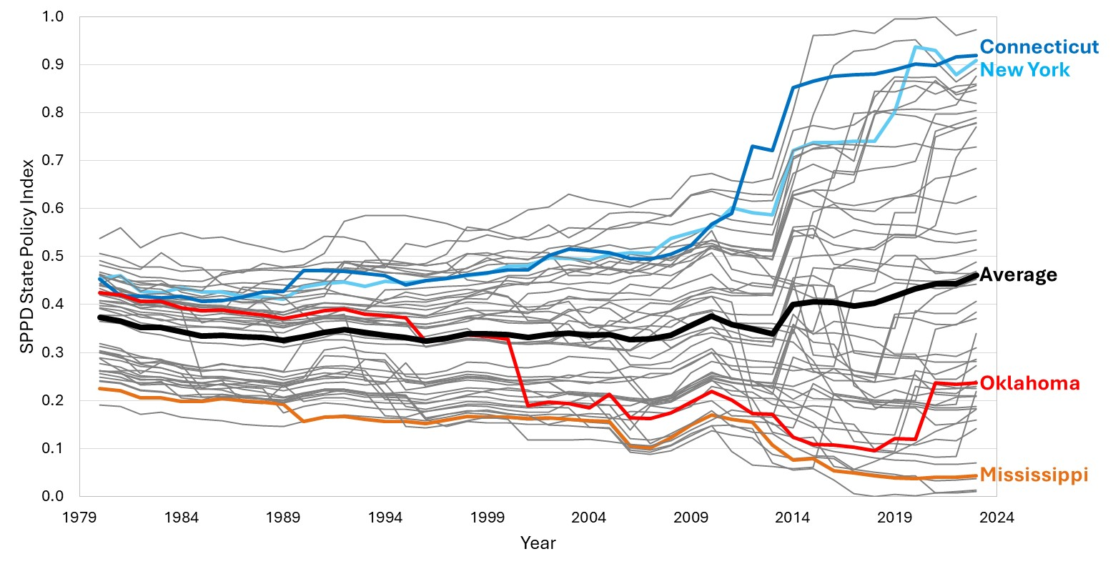
SPPD State Policy Index, 1980-2023
Notes:
“Face validity is a subjective assessment of whether a measurement tool, such as a survey or test, appears to measure what it claims to measure "at face value". Often referred to as the "eyeball test" of research, it is the simplest and most informal form of validity, relying on surface-level impressions rather than complex statistical analysis.”
Supporting face validity, the index is different between states for all years and grows increasingly different over time, especially after the 2010 midterms. There is also a noticeable divergence around 2014. To assess whether this is primarily a reflection of many states expanding Medicaid that year as part of the Affordable Care Act, we re-estimated the index, excluding the Medicaid expansion variable. The noticeable divergence around 2014 persists, but removing the Medicaid variable appears to provide larger and growing cross-state variation in the index well before 2014, suggesting even greater face validity. Also supporting face validity, both figures show divergence between states known to have grown more liberal or conservative over time. Specifically, the figures compare New York and Mississippi which were compared by Caughey and Warshaw¹⁶ and they compare Connecticut and Oklahoma as in studies using the Grumbach index.¹³

Slide 15
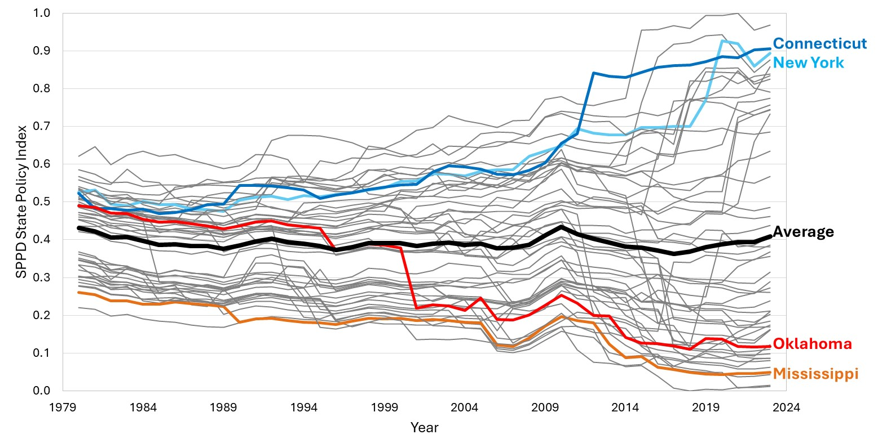
SPPD State Policy Index w/o Medicaid, 1980-2023

Slide 16
✓
Face Validity
Convergent Validity
Predictive Validity

Slide 17
SPPD State Policy Index & the Caughey and Warshaw Index
(correlation = 0.89)
Notes:
We assessed two types of criterion validity: convergent and predictive
If our index is valid, it should strongly correlate with an existing valid measure of state policy contexts.
Here we show the correlation between the two indices for the years they have in common, 1980-2020
The SPPD State Policy Index exhibits convergent validity, as it is strongly correlated with both existing policy indices. It has a strong and statistically significant 0.89 correlation (p<0.001) with the Caughey and Warshaw index for the years that the two indices have in common, which are 1980 to 2020. The positive association is depicted in Figure 3. The SPPD State Policy Index also has a strong and statistically significant 0.89 correlation (p<0.001) with the Grumbach index for the years they have in common, 1980 to 2014, as shown in Appendix Figure A3.

Slide 18
✓
Face Validity
Convergent Validity
Predictive Validity
✓

Slide 19
OLS coefficients predicting the change in county-level, age-standardized mortality rates for a one-unit change in each index
Notes:
The coefficient $β_{1}$ is the estimand of interest. It estimates the difference in a county’s sex-specific, age-adjusted mortality rate if their state’s policy index was 1 versus 0, net of county-level demographics. In other words, it estimates how much greater or smaller the county-level mortality rate may have been if their state had the maximum liberal score on the index versus the maximum conservative score.
Coefficients: -177, -155, -137, -113
***our policy index with just 11 policies predicts mortality just as well as the indices with 135 and 148 policies but with about 1/3-1/2 of the standard error***

Slide 20
✓
Face Validity
Convergent Validity
Predictive Validity
✓
✓

Slide 21
01
Why we need an index
02
Select policies & create the index
03
Validate index
04
How to use it

Slide 22
Whether an index or single policy is appropriate depends on a study’s aims
Is the aim to determine which policy best predicts population health?
Is the aim to assess how the general orientation of policies, or the character of state governments, predicts population health?
Is the aim to recommend a specific action to improve population health?
Notes:
A study does not need to be actionable to be valid, important, or informative.

Slide 23
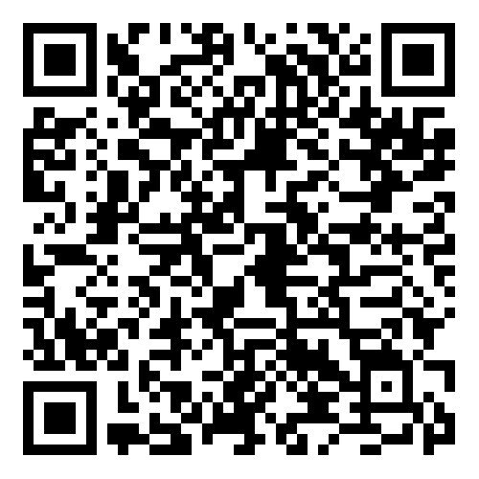
The SPPD, including the index, is available on ICPSR ➔
Research reported in this presentation was supported by the National Institute on Aging of the National Institutes of Health under Award Number R01AG082699.
The content is solely the responsibility of the authors and does not necessarily represent the official views of the National Institutes of Health.

Slide 24
MILBANK WEBINAR
June 2026
State Policy Contexts & Mental Health Among U.S. Working-Age Adults
How state policy environments shaped mental health
in recent decades (1993-2022)
CENTER FOR AGING & POLICY STUDIES SYRACUSE UNIVERSITY
Iliya Gutin · Shannon Monnat · Jennifer Karas Montez · Emily Wiemers · Douglas Wolf
Notes:
It's an honor to be part of this webinar — and many, many thanks to the organizers and to Milbank for putting this together.
I'm presenting work on behalf of Shannon Monnat, Jennifer Montez, Emily Wiemers, Doug Wolf, and myself, looking at the association between US state policy contexts and mental health among working-age adults in recent decades, including during the COVID-19 pandemic.

Slide 25
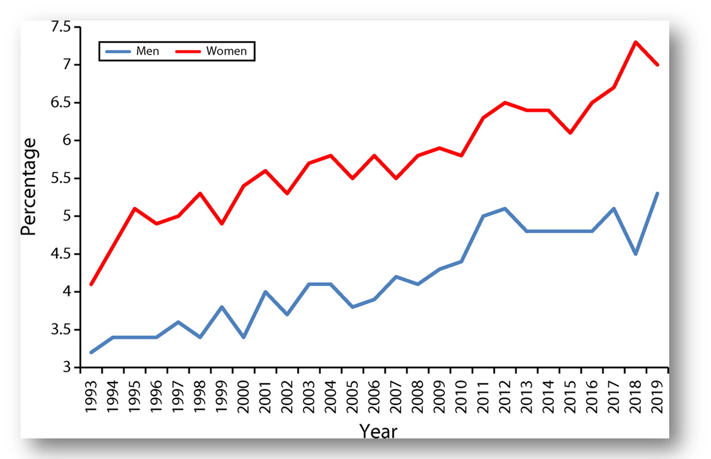
BACKGROUND — NATIONAL DECLINE
Mental health has been worsening for decades —
well before COVID-19
A large body of research documents a steady decline in mental health across the U.S. population.
The share of adults reporting “extreme distress,”
or poor mental health every day, roughly
doubled between 1993 and 2019.
Recent multi-survey evidence suggests the trend continued through — and was worsened by —
the onset of the pandemic.
Trends in extreme distress, 1993–2019.
Blanchflower & Oswald (2020)
Notes:
Speaking of which, despite the considerable focus on worsening mental health during the pandemic… [CLICK] multiple recent studies document a sizeable decline in US mental health over the past decades and, critically, prior to 2020.
Perhaps most notably, [CLICK] this includes a widely cited study published in the American Journal of Public Health documenting the DOUBLING of Americans reporting 'extreme distress' – or poor mental health EVERY day – between 1993 and 2019.
[CLICK] And there's good reason to think the trend continued through, and was worsened by, the pandemic, as evidenced by results from multiple national surveys.
So, clearly, declining mental health is yet ANOTHER dimension of worsening US population health that we should worry about…

Slide 26
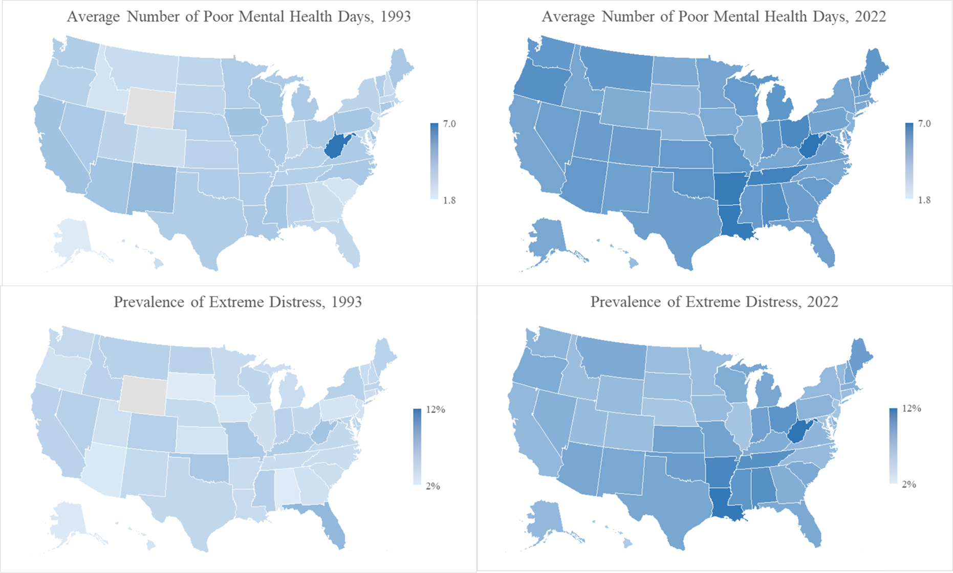
BACKGROUND — SUBNATIONAL VARIATION
National trends obscure variation across states
Mental health worsened almost everywhere — and geographic differences increased.
States are powerful structural determinants of health;
yet whether this decline varied across the country, and what role state policy contexts played, has gone largely unexamined.
We have lots of clues that policy matters for mental health —
but little direct proof.
Notes:
But, as this webinar intends to highlight, national trends often obscure considerable SUBNATIONAL variation — especially across U.S. states, given the central role they play in shaping health through various policy mechanisms and channels.
Here we show our own estimates for state-prevalence of both poor mental-health days and extreme distress, in 1993 and 2022, as there is actually surprisingly little descriptive evidence on this geographic variation, let alone analyses of this association, as I will discuss shortly.
Two things stand out here — namely, [CLICK] mental health worsened everywhere, AND geographic differences increased, with the South and Appalachia faring worst over this period.
This is entirely consistent with the notion that [CLICK] states are powerful structural determinants of health, leading to disparate outcomes among their residents.
Yet, when it comes to the ongoing national decline in mental health, the extent to which it has varied across states and, in turn, the role of state policy contexts therein, is largely unknown.
There are certainly a lot of [CLICK] CLUES and suggestive evidence that state policy matters for mental health – especially given the robust literature on state policies and PHYSICAL health and mortality, including outcomes like self-rated health, suicide, and substance-use mortality, which implicate poor mental health as a key intermediary pathway.
But the direct “proof” of this policy-mental health association is rather limited, and mostly confined to pandemic-specific policies.
Consequently, we ask two questions.

Slide 27
RESEARCH QUESTIONS
What is the association between state policy conservatism and poor mental health in
recent decades?
Did this association change during COVID-19 — and how does it compare with state COVID policies?
Notes:
First, [CLICK] what is the baseline association between increasingly conservative state policy contexts and poor mental health in recent decades; and second, [CLICK] whether that relationship was altered by COVID-19 — and how it compares to the effect of state COVID policies themselves.

Slide 28
DATA & MEASURES
Linking 5 million adults to their state policy context
OUTCOME
EXPOSURE
COVID POLICY
BRFSS · 1993–2022
State policy conservatism
Oxford GRT · 2020–2022
“Days of poor mental health in
the past 30 days.”
5+ million adults, ages 25–64 ,
across all states & years
A holistic summary of dozens of policies (Caughey & Warshaw),
with a 2-year lag.
Matched to interview month,
with a 1-month lag, standardized.
# of poor mental-health days
Physical-distancing stringency
CA
MN
WI
UT
MS
Extreme distress = 30 / 30 days
Economic support
← more liberal
more conservative →
METHODS
Within-state variation · state + year fixed effects · individual covariates · COVID-era dummy + monthly case rate
Notes:
To answer these questions, we integrate individual- and state-level data.
[CLICK] Our outcome, and key covariates, come from the Behavioral Risk Factor Surveillance System data from 1993–2022, which are the incredibly rare individual-level survey data with sufficiently large samples across all states and years, giving us over 5 million adults aged 25–64.
BRFSS asks how many days of poor mental health respondents had in the past month.
We use both that count and the aforementioned measure of 'extreme distress' — or 30 out of 30 days — in our models.
[CLICK] Our core exposure is state policy conservatism, which is a holistic, time-varying summary of dozens of policies that places states on a liberal-to-conservative spectrum in every year, as you can see in the small diagram.
We include a 2-year lag for this measure in our analyses, though results were robust to alternate specifications.
Finally, [CLICK] our state COVID policy measures come from the Oxford Government Response Tracker.
We include a measure of the monthly Stringency Index which gauges physical-distancing strictness, and an Economic Support Index for income support and debt relief.
Both measures are lagged one month and standardized.
As for the for the methods, [CLICK] we estimate results that leverage WITHIN-state variation by using state and year fixed effects, making sure to include individual covariates, a COVID-era dummy, and monthly case rates across different models.

Slide 29
DESCRIPTIVE CONTEXT
How much changed between 1993 and 2022
Poor mental-health days / month
Prevalence of extreme distress
5
7.4%
3
4%
→
→
across-state range: 2–4
→ 4–7
across-state range: 2–7%
→ 5.5–12%
In WV, LA, and AL, more than 1 in 10 adults
now report extreme distress.
Policy contexts have also pulled apart —
widening the gap between MS/AL/GA and MA/NY/CA.
Notes:
Before diving into the model results, it helps to get a sense of how much the core measures changed — which also frames the effect sizes that follow.
Back in 1993, mental health wasn't TOO bad.
We see about [CLICK] three poor mental-health days a month overall, ranging from two to four across states, and [CLICK] extreme distress averaged 4%, ranging 2 to 7%.
Thirty years later it's CONSIDERABLY worse — now up to [CLICK] five poor days a month nationally, ranging four to seven across states, while [CLICK] extreme distress is at 7.4%, ranging up to nearly twelve percent in some states.
[CLICK] Indeed, in West Virginia, Louisiana, and Alabama, more than one in ten adults now report extreme distress.
I didn’t include a separate figure for this in the interest of time – and I suspect it would have been redundant with Jennifer’s presentation – but, [CLICK] state policy conservatism has also pulled apart over these decades, further separating states like Mississippi, Alabama, and Georgia from Massachusetts, New York, and California.

Slide 30
RESULT 1 — BASELINE ASSOCIATION
More conservative policy → worse mental health
Change in # poor MH days per 1-SD conservatism
Most liberal → most conservative context (California vs. Mississippi)
Main model
0.26
1.7
more poor
mental health
days per month
+ Individual covariates
0.29
+ State economic context
0.30
against a mean of just ~4 days
+0.4pp
(mean ≈ 5.5%)
higher probability of extreme distress —
about the effect of a 4-point rise in unemployment.
Notes:
With all that in mind, I now turn to the main results… and the title kind of gives it away.
Namely, [CLICK] a one-unit increase in conservatism — which is effectively one standard deviation — corresponds to about a quarter-day more of poor mental health.
I know that sounds kind of small, but recall the mean is only about four days.
To try and make it more concrete – though recognizing that the differences in these state policy contexts measures are more obvious at the extremes – a one-unit change is roughly the gap between Wisconsin and Utah, or Wisconsin and Minnesota, in 2020… so it’s not exactly a “night and day” difference, if you will.
Indeed, extrapolating across the full spectrum, [CLICK] we predict about 1.7 more poor mental-health days if comparing the most liberal context, California, to the most conservative, Mississippi.
And, as the figure shows, this result is robust to numerous individual covariates, as well as the inclusion of measures of the state economic context.
Likewise, [CLICK] we find the same pattern for extreme distress — with about a 0.4 percentage-point higher probability of very poor mental health, which is comparable to the effect of a four-point rise in the state unemployment rate in our models.
Having established that baseline association, we asked whether it changed at all during the pandemic given the highly dynamic state policy environment during this time — thus, fitting a model with overall policy context, COVID policies, and an interaction between overall context and the pandemic's onset.

Slide 31
RESULT 2 — THE PANDEMIC
COVID-19 didn’t change the story
No change in the association
Change in # poor MH days — full model, 2020–2022
Overall policy context remained
a key determinant despite
rapid pandemic-era shifts.
Overall conservatism
0.28
…during COVID era
0.27
COVID stringency
0.10
Stringency hurt;
support didn’t offset
Economic support
0.01
Physical distancing wasn’t good
for mental health, and economic support did not counteract it.
Notes:
Once again, the title gives it away… as we observe [CLICK] NO change in the conservatism–mental-health relationship during COVID.
The association between the overall state context and mental health stayed essentially flat — and, while not a perfect one-to-one comparison, [CLICK] its magnitude appears somewhat larger than that of the COVID policies themselves.
That said, COVID policies weren't unimportant: [CLICK] greater stringency was associated with worse mental health, while more generous economic support showed no improvement — in the sense that it did not “offset” the costs of physical distancing, as seen in some other studies of COVID-era health and mortality.

Slide 32
TAKEAWAYS
More conservative policy contexts mean worse mental health,
whether measured as # of days or extreme distress.
It held through COVID-19: distancing hurt mental health and economic support didn’t offset it — but the overall context remained influential.
State policy is a fundamental determinant of health —
with mental health as a likely mechanism behind widening
mortality disparities.
Notes:
So, to bring it all together, and highlight the key takeaways.
First, and perhaps most critically, [CLICK] as state policy contexts become more conservative — across a broad range of policy domains — working-age adults’ mental health is worse, whether we measure poor mental-health days or extreme distress, or any of the other specifications we tried.
Second, [CLICK] this policy context—mental health association persisted through COVID.
That is, the overall policy context never “took a backseat,” even as COVID responses changed rapidly in ways that were almost orthogonal to the existing state environment, at least in some places.
Moreover, while distancing-related policies proved harmful for mental health, economic support policies did not offset these effects.
Third, and most substantively, [CLICK] this study reaffirms state policy context as a FUNDAMENTAL determinant of population health, building on a growing body of research – across multiple measures of the policy environment and a broad array of health outcomes – that speaks to this core point.
Among the many mechanisms underlying this fundamental relationship, we think these findings provide solid evidence of mental health as a key pathway underlying the observed links between policy contexts and many other health outcomes — and we look forward to work that explicitly examines its mediating role in widening mortality disparities among working-age adults.

Slide 33
MILBANK WEBINAR · 2026
Thank you!
Iliya Gutin
Research Assistant Professor
Center for Aging & Policy Studies · Syracuse University
igutin@syr.edu
Funded in part by grant U01DA055972 from the National Institute on Drug Abuse (NIDA), National Institutes of Health.
Notes:
And with that, I sincerely thank you for your attention and I look forward to your questions and feedback.

Slide 34
From Policies to Policy Contexts:
What is the exposure and how is it measured
Scott Burris
CENTER FOR PUBLIC HEALTH LAW RESEARCH
2026 CAPS-CPR Conference

Slide 35

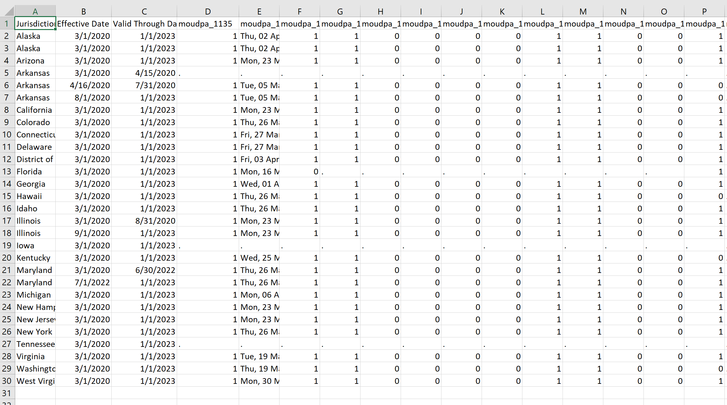
Measuring exposure via
“scientific legal mapping”
Notes:
Our goal is to make legal information available for research and to be shared widely with the public for use in practice. For research, the first step in that process is to create the data. And that means we need to turn the text of laws into numbers.

Slide 36
Accurate and transparent measurement of the apparent features of the legal text
Defining the scope
Collecting the law and creating the legal text
Coding the law
Publication and dissemination
Tracking and updating the law
Conducting background research
Developing coding questions
Quality control
Notes:
There is no justification for these deficiencies to persist. Proper legal measurement methods have been described in the literature.^{24,25} Since the launch of the Alcohol Policy Information System in 2003,²⁶ legal epidemiology researchers have worked to define and practice high standards of accurate, transparent legal measurement²⁷⁻²⁹ and to make properly documented and quality-controlled data available to researchers.³⁰⁻³² Policy measurement methods must ensure that all relevant policy texts are collected. All relevant features of the observable text, such as when it legally takes effect, who is covered by the rule, what implementation structures are mentioned, amounts of incentives or penalties, and so forth must be reliably recorded (coded), and should be selected based on explicit theory on the policy’s expected mechanism of effect. Likewise, secondary categorization (such as “stringency”) and indices should be transparently based on rigorous primary measurements of policy features. Re-use of rigorous open-source legal data is to be encouraged, but uncritically borrowing lists of laws distributed by industry, government or advocacy organizations is not acceptable as the basis for policy evaluation. Along with researchers, editors and peer reviewers must do a better job ensuring that these basic standards are adhered to. Development of an Equator Network reporting standard for policy measurement would be a good next step.

Slide 37
Take a look

Slide 38
A simple model of how law influences health
Changes in environments
Laws
Legal Practices
Health
Legal Practices
Changes in behavior
Notes:
Sure, this is a simplistic, positivist approach – but that’s a good thing for a conceptual interface in a complex field. We are interested first and foremost in what effects policies have. That’s our ultuimate question. But this clearly takes place in social space, so one can easily hang other kinds of questions on here

Slide 39
Policy effects research*
>legal drinking age
alcohol-involved crashes
road deaths
Life expectancy
* I am not able to address the crucial place of implementation and implementation research in these remarks/

Slide 40
Policy Sets
Harsher penalties for DUI
>legal drinking age
alcohol-involved crashes
road deaths
Life expectancy
Lower BAC

Slide 41
Policy Sets²
Road design standards
Auto design standards
Safety belt laws
Harsher penalties for DUI
>legal drinking age
<alcohol-involved crashes
<road deaths
Life expectancy
Lower BAC

Slide 42
Policy Sets³
Road design standards
Auto design standards
Safety belt laws
Harsher penalties for DUI
Norms re alcohol and driving
>legal drinking age
alcohol-involved crashes
road deaths
Life expectancy
Lower BAC

Slide 43
Policy Contexts
Harsher penalties for DUI
135 policies!
>legal drinking age
<alcohol-involved crashes
<road deaths
Life expectancy
Lower BAC

Slide 44
What were we measuring?
>legal drinking age
Precise, transparent measurements capturing important within-law variation
Inconsistently transparent categorization of laws without capturing important within-law variation

Slide 45
What are we measuring?
Changes in environments
Law-
making
>legal drinking age
Laws
Legal Practices
Health
Legal Practices
Changes in behavior
Notes:
Sure, this is a simplistic, positivist approach – but that’s a good thing for a conceptual interface in a complex field. We are interested first and foremost in what effects policies have. That’s our ultuimate question. But this clearly takes place in social space, so one can easily hang other kinds of questions on here

Slide 46
Progress!
Transparent and rigorous measurements of key features of law that can be used to understand specific impact mechanisms
Selected and validated to be useful for understanding how the general orientation of state policies predicts health outcomes.

Slide 47
Scott Burris scott.burris@temple.edu

Slide 48
Moderated Discussion and Q&A

Slide 49
Thank you for listening.

