Slide 1
Winning Public Trust Through Better Health Communication
Webinar February 4, 2026

Slide 2
About the Milbank Memorial Fund
The Milbank Memorial Fund is an endowed operating foundation that works to improve population health and health equity by collaborating with leaders and decision-makers and connecting them with experience and sound evidence.
We advance our mission by:
Identifying, informing, and inspiring current and future state health policy leaders to enhance their effectiveness;
Working with state health policy decision-makers to advance primary care transformation and affordable health care; and
Publishing evidence-based publications and The Milbank Quarterly, a peer-reviewed journal of population health and health policy.

Slide 3
Panelists
Joanne Kenen and Joshua Sharfstein, two authors of the new book Information Sick: How Journalism’s Decline and Misinformation’s Rise Are Harming Our Health—and What We Can Do About It.
Katelyn Jetelina, Your Local Epidemiologist
Puthiery Va, Director, Maine Center for Disease Control and Prevention
Sarah Willson, Director, Missouri Department of Health and Senior Services

Slide 4

Joanne Kenen
Lymari Morales
Joshua M. Sharfstein

Slide 5
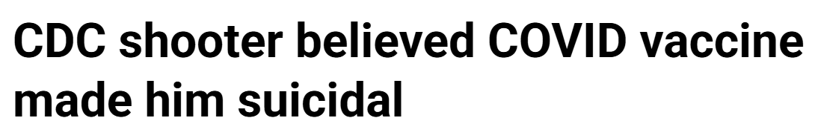
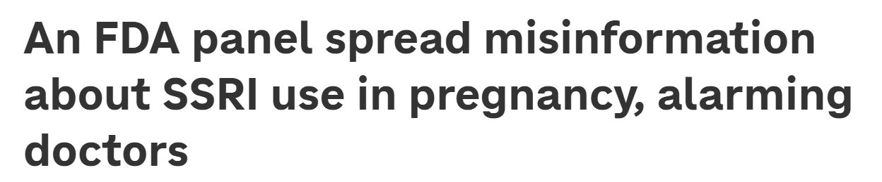
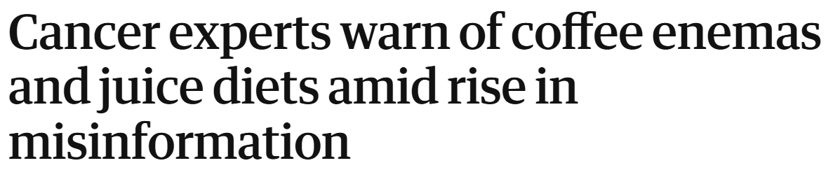

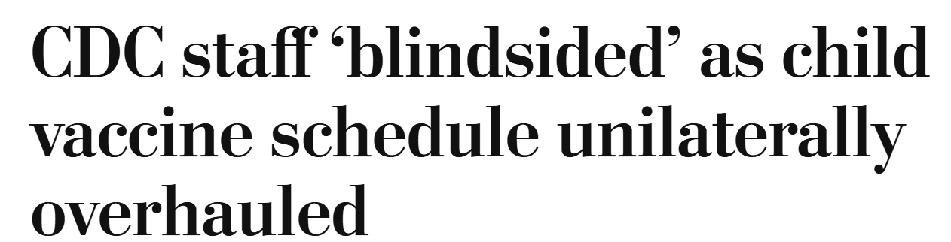
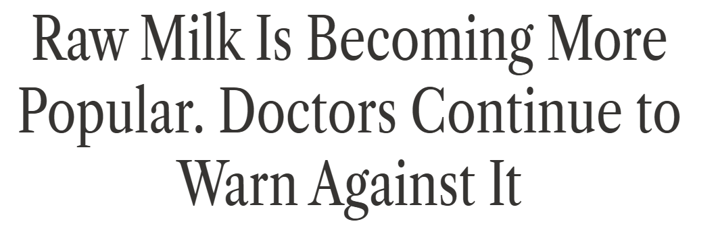
The Headlines, 2025

Slide 6
The Diagnosis
Information Sick
Individual: The inability to find and believe accurate information about critical health topics, leading to risky and dangerous decision making.
Society: The failure to support the institutions of journalism and science so that truthful scientific information can advance health and save lives.

Slide 7
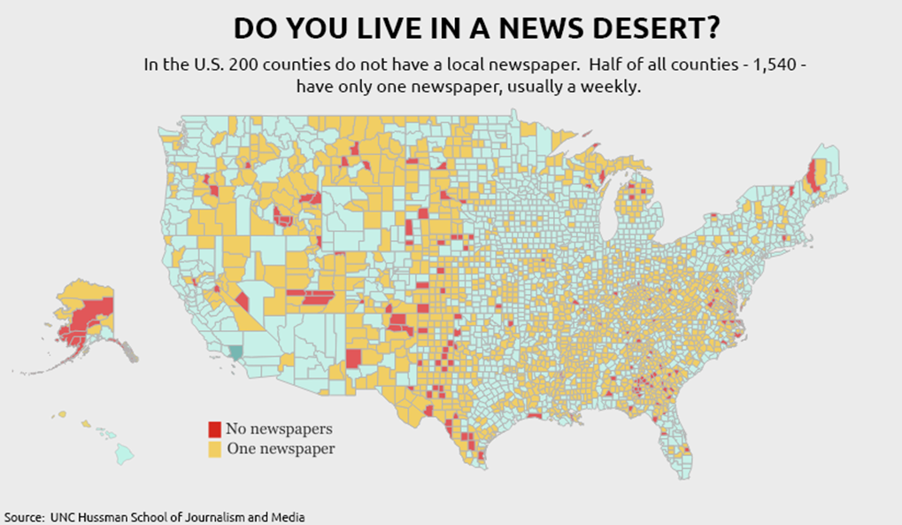
The Causes:
1) The Collapse of Local News

Slide 8
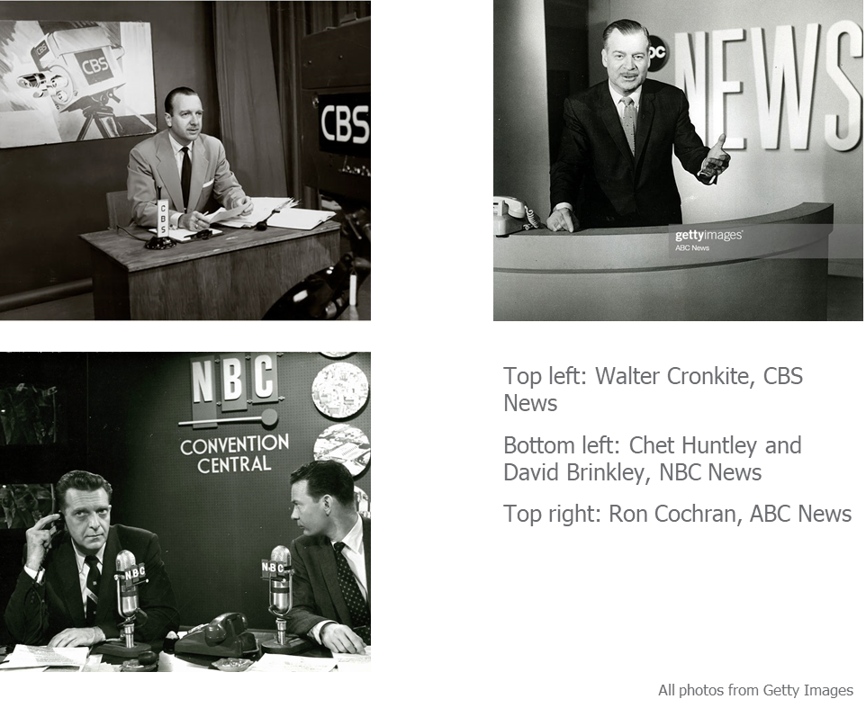
The Causes:
1) The Collapse of Local News
2) The Fracturing of National News

Slide 9
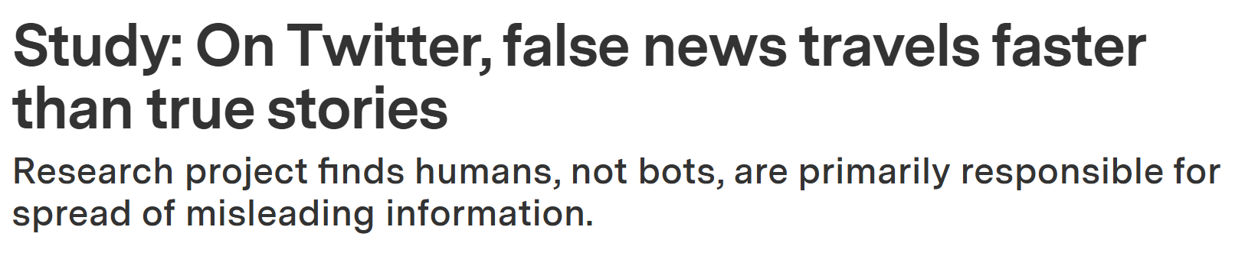
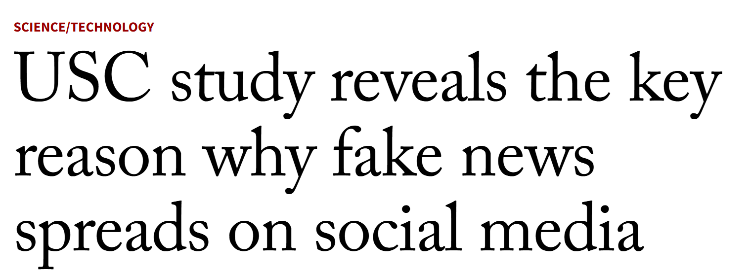
The Causes:
1) The Collapse of Local News
2) The Fracturing of National News
3) The Flood of Misinformation

Slide 10
The Treatment
Saving Local News
Reimagining National News
Spreading good information far and wide
More effective programmatic and policy responses to inaccurate and false information

Slide 11

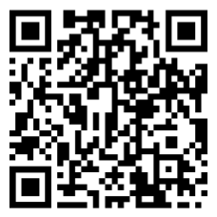
Discount Code:
HTWN

