Slide 1
Understanding the Structural Determinants of Health
Milbank Quarterly Webinar October 23, 2025
Notes:
Sign-in, All, 11:45 ET
Intro, Alan Cohen, 12 to 1:05
Presentation, Heller 12:05 to 12:15
Presentation, Brown 12:16 to 12:26
Discussant comments, Michener, 12:27-12:34
Panel Discussion moderated by Alan: 12:35 to 12:50
Q&A from Audience 12:51 to 12:58 pm
Wrap-up, Alan, 12:59 to 1 pm

Slide 2
Panelists
Jonathan Heller, Senior Health Equity Fellow, Population Health Institute, University of Wisconsin–Madison
Tyson Brown, Professor of Sociology and Medicine, Duke University
Jamila Michener, Associate Professor, Department of Government, Cornell University (discussant)

Slide 3
Keeping it Political and Powerful:
Defining the Structural Determinants of Health
Jonathan Heller, Marjory Givens, Sheri Johnson, David Kindig

Slide 4
Disclaimer
The views expressed are my own and do not represent the University of Wisconsin Madison.
Support for this work was provided by the Robert Wood Johnson Foundation. The views expressed here do not necessarily reflect the views of the Foundation.
The expertise of 35+ CHR&R team members is reflected in this content and highly valued.

Slide 5
–
Social determinants
depoliticized
WHO (2008): “The non-medical factors that influence health outcomes. They are the conditions in which people are born, grow, work, live, and age, and the wider set of forces and systems shaping the conditions of daily life. These forces and systems include economic policies and systems, development agendas, social norms, social policies and political systems.”
CDC (2010): “Conditions in the environments in which people are born, live, learn, work, play, worship, and age that affect a wide range of health, functioning, and quality-of-life outcomes and risks.”

Slide 6
Structural determinants of health definition
The StrDOH are:
The written and unwritten rules that create, maintain, or eliminate durable and hierarchical patterns of advantage between socially constructed groups in the conditions that affect health.
The manifestation of power relations in that people and groups with more power based on current social structures work to maintain their advantage by reinforcing or modifying these rules.
Keeping It Political and Powerful: Defining the Structural Determinants of Health. Milbank Quarterly. 2024

Slide 7
Values, beliefs, worldviews, culture and norms
Governance
Laws, policies, regulations and budgets
Institutional practices
Which written and unwritten rules?

Slide 8
Power
Rules

Slide 9
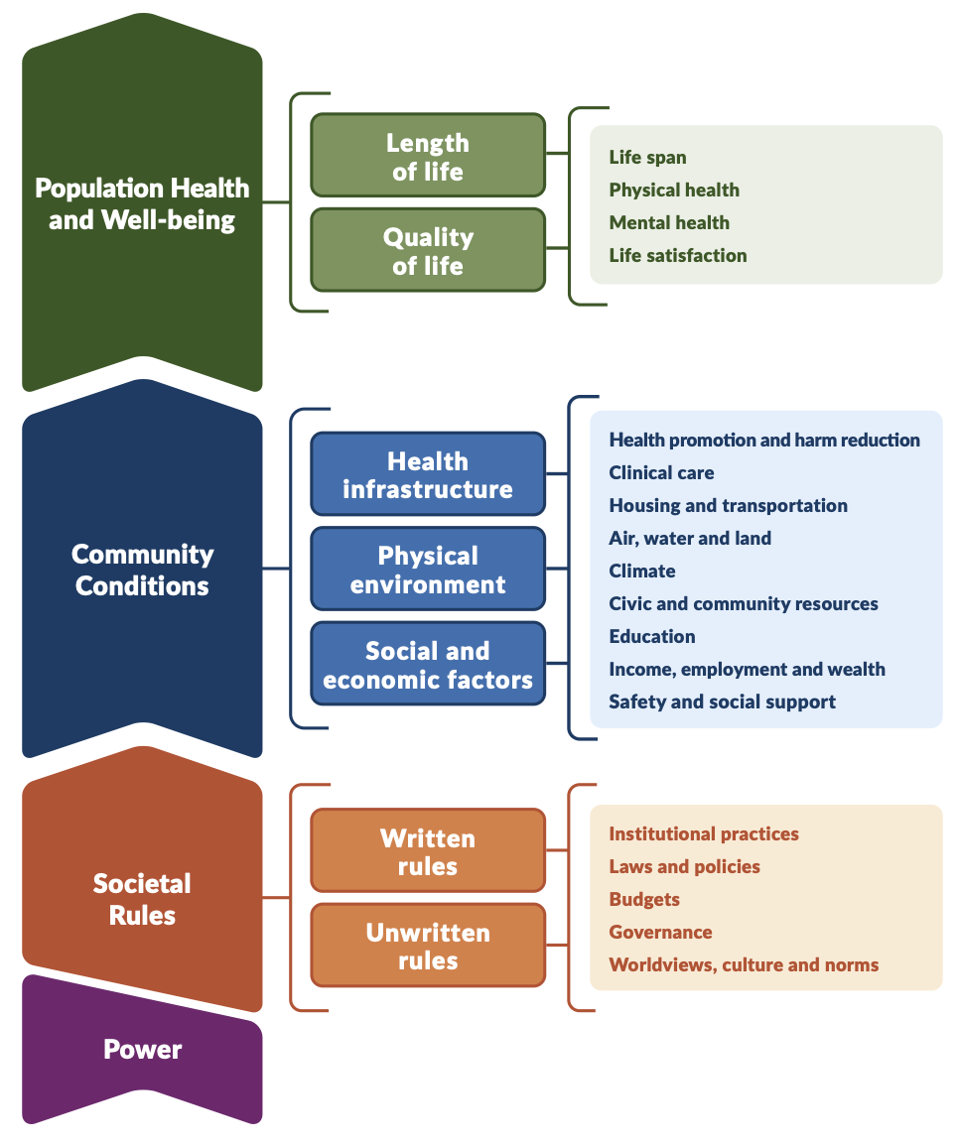
9

Slide 10
StrDOH enshrine and encode structural oppression
Structural Determinant | Structural Oppression
Values, beliefs, worldviews, culture, and norms
Governance
Laws, policies, regulations, and budgets
Institutional practices
Whiteness as superior
Men as superior
Try hard enough and you can make it
Weak enforcement of environmental regulations
Inadequate protection from gender-based violence
Those with wealth have more say
Limits on voter participation
Inadequate family leave
Regressive taxation
Over-policing
Gender-based pay discrimination
10
Misclassification of jobs

Slide 11

Harnessing Power for Equity and Justice
Power To, With, Within vs. Power Over
“Power is the ability to achieve a purpose. Whether or not it is good or bad depends upon the purpose.” – Dr. Martin Luther King, Jr.
Community power: “the ability of communities most impacted by structural inequity to develop, sustain, and grow an organized base of people who act together through democratic structures to set agendas, shift public discourse, influence who makes decisions, and cultivate ongoing relationships of mutual accountability with decision makers that change systems and advance health equity.” – Pastor et al. (2020)

Slide 12
Corporations profit & thrive
Communities get sick & suffer
Power:
Corporate / Community
Rules:
Exploit & Extract
BUILD COMMUNITY POWER & BREAK CORPORATE POWER
The economy serves people
Communities thrive
Power:
Corporate / Community
Rules:
Wellbeing-focused
12

Slide 13
Interventions into the
structural determinants of health
Change belief that housing is naturally a commodity to be owned, bought, and sold privately
Change belief that racial housing segregation occurs naturally or reflects only individual preferences
Build coalitions between groups advancing housing justice (organized residents, service providers, affordable housing developers, etc.), across racial, minoritized, and other dimensions of shared or imposed identity
Organize people facing housing issues
Change laws so corporate developers cannot donate to electoral campaigns
Change laws about land ownership so community residents have more control (than developers)
Change laws, policies, and practices to prevent segregation, displacement, and gentrification
Increasing impact on distribution of power
Require housing developments to include a minimum number of affordable units
Increase budgets for subsidized housing programs
Build more housing for low-income residents near hospitals
Change zoning to allow for construction of more multiunit housing to increase housing supply
Provide shelter for a person who is unhoused (address a health-related social need)
Provide services for a person who is unhoused
Interventions into the
social determinants of health
Keeping It Political and Powerful: Defining the Structural Determinants of Health. Milbank Quarterly. 2024

Slide 14
Notes:
Thank you! Looking forward to the discussion.

Slide 15
Reimagining the Data Infrastructure: Administrative Burden and Structural Oppression Data October 32, 2025 Milbank Quarterly Webinar: Understanding the Structural Determinants of Health
Tyson H. Brown, PhD
Professor of Sociology & Medicine
Duke University
tysonbrown.com
The views and opinions expressed in this presentation are my own and do not necessarily reflect those of Duke University

Slide 16

The Future of Social Determinants of Health: Looking Upstream to Structural Drivers Tyson H. Brown and Patricia Homan

Slide 17
SDOH: Structural Approach
Structural oppression undergirds unequal proximate social conditions—and health inequities
Structural Oppression
Social Conditions
Socioeconomic resources
Employment conditions
Housing & neighborhood conditions
Exposure to/threat of physical violence
Discrimination
Social networks & relationships
Educational & recreational opportunities
Insurance
Health Behaviors
Health
Structural racism
Structural sexism
Structural LGBTQ stigma
Structural xenophobia
Economic Inequality
Other forms of structural oppression & their intersections
Mental health
Physical health
Mortality
Psychosocial Factors
Stress
Self-esteem
Mastery
Perceived discrimination
Attitudes & expectations
Internalized stigma
Upstream
Downstream
Brown & Homan (2023)

Slide 18
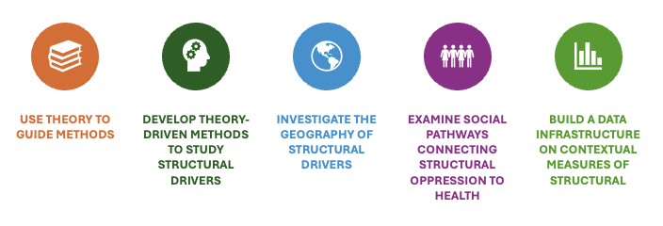
Advancing Structural Oppression Research
Brown & Homan (2023)

Slide 19
Administrative Burden and the Data Infrastructure
for Structural Determinants of Health
Administrative burden = costs imposed on individuals or organizations when interacting with government or policy systems
Three key components of Administrative Burden (Herd & Moynihan 2018)
Learning costs – figuring out what exists and how it works
Compliance costs – meeting procedural requirements
Psychological costs – frustration, uncertainty, discouragement
These burdens can shape research participation and capacity, and ultimately, policy outcomes.
Brown and Homan 2023; Brown, Homan and Ray 2025

Slide 20
Applying Administrative Burden to Structural Determinants Data
Learning costs:
Data are diffuse across agencies, nonprofits, academic teams, think tanks, and journalists.
No centralized repository or standardization.
High “search” costs just to find relevant data.
Compliance costs:
Access often requires navigating multiple portals, request processes, or FOIA.
Datasets have different formats, documentation quality, and geographies.
Significant preprocessing, cleaning, and linking are needed.
Psychological costs:
Uncertainty about data quality, completeness, or legal constraints.
Discouragement among researchers—especially early-career scholars or practitioners with limited resources

Slide 21
Consequences of Administrative Burden
Slows progress on empirical research on structural racism and other structural determinants.
Creates barriers to timely policy analysis and evidence-based decision-making.
Reproduces inequities in who can afford to do this work (e.g., well-resourced vs. under-resourced scholars or agencies).
Leads to undermeasurement and underaction on structural drivers of health inequities.
Brown and Homan 2023; Brown, Homan and Ray 2025

Slide 22
Reducing the Burden: National Data Infrastructure
Create a national, public data infrastructure on structural oppression.
1
Include novel, valid measures across multiple domains & spatiotemporal scales.
2
Enable easy linkage to health and demographic datasets.
3
Provide user-friendly tools: composite measures, codebooks, visualizations, archives.
4
Incentivize and fund data deposition and infrastructure development.
5
Sustain support through federal, state, and philanthropic investment.
6
Brown and Homan 2023

Slide 23
Closing Thoughts
Administrative burdens shape access to both resources and knowledge.
Barriers to data access = barriers to scientific discovery and policy innovation.
Lowering burdens broadens participation in research and decision-making.
Investing in infrastructure is an equity strategy
Brown and Homan 2023

Slide 24
Thank you!

Slide 25
Moderated Discussion and Q&A

Slide 26
Thank you for listening.

