Slide 1
Regulating Consumer Products to Improve Mental Health
Milbank Quarterly Webinar
July 25, 2025

Slide 2
Panelists
David Jernigan, Professor of Health Law, Policy & Management, Boston University School of Public Health
Beth McGinty, Livingston Farrand Professor of Population Health Sciences, Weill Cornell Medical College
Dana Moncrief, Director of the Center for Tobacco Prevention & Control in the Maryland Department of Health (discussant)
Magdalena Cerdá, Professor and Director of the Center for Opioid Epidemiology and Policy, Department of Population Health, New York University’s Grossman School of Medicine (moderator)

Slide 3
Alcohol Problems and Policies:
The states have the power, but will they use it?
Milbank Quarterly webinar
July 25, 2025
David H. Jernigan PhD
Professor, Boston University School of Public Health
Assistant Dean for Practice

Slide 4

Death and Disability from Alcohol Use: National Estimates
CDC estimates alcohol causes
deaths per year.
(causal factor in >200 disease and injury conditions)
40%
178,000
Binge drinking is responsible for more than 40% of deaths and 3/4 of the costs attributable to alcohol misuse.
Alcohol causes the death of 1 in 8 persons of working age (i.e. ages 18-64) each year.
Notes:
References:
Centers for Disease Control and Prevention. Alcohol-Related Disease Impact Software: Massachusetts. Centers for Disease Control and Prevention. 2024. Accessed April 12, 2024. Available at https://nccd.cdc.gov/DPH_ARDI/default/default.aspx.
Esser MB, Leung G, Sherk A, et al. Estimated Deaths Attributable to Excessive Alcohol Use Among US Adults Aged 20 to 64 Years, 2015 to 2019. JAMA Network Open. 2022;5(11):e2239485-e2239485. doi:10.1001/jamanetworkopen.2022.39485.
National Center for Chronic Disease Prevention and Health Promotion (NCCDPHP). Excessive Alcohol Use. https://www.cdc.gov/chronicdisease/resources/publications/factsheets/alcohol.htm

Slide 5
Post–National Prohibition Structure for Alcohol Regulation
Three pillars:
  Affordability – high taxes
  Availability – state control through ownership or licensing
  Attractiveness – industry self-imposed restraint on marketing
Divided jurisdiction – state have most of the powers
  Federal: Excise tax, packaging and labeling, import duties, production licensing (joint with states), advertising and marketing
  States: everything else

Slide 6
Affordability
Raising alcohol taxes
  The most cost-effective intervention
    $41 per life-year saved
    Compare to $2,979 per life-year saved for drink-driving countermeasures
  Endorsed by CDC’s Task Force on Community Preventive Services
  Estimates of effect – a 10% increase in alcohol prices will lead to:
    3% drop in beer consumption
    6% drop in wine consumption
    6.5% drop in spirits consumption
  Health benefits commensurate with size of drop in consumption

Slide 7
Source: Brewers Almanac, 2013, ATTTB, 2014, and Chaloupka calculations

Slide 8
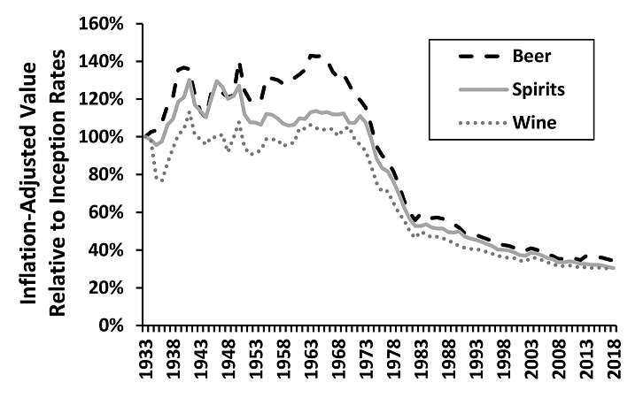
Affordability: State Alcohol Taxes
Until 1972, states tended to raise alcohol taxes to keep up with inflation
Stopped in 1972
Between 2003 and 2023, just 13 states increased their excise taxes on some category of alcoholic beverages
5 states raised ad valorem taxes, 4 states reduced them

Slide 9
Availability
Consistent findings in research literature show greater number of alcohol outlets per geography or population leads to:
  Lower prices
  More violent crime, sexually transmitted diseases, noise, injuries, property damage
  More underage drinking
State levers are numerous:
  Licensing/zoning/nuisance powers (often shared with locals)
    Constant pressure to increase numbers and types of places to get alcohol
  Hours/days of sale
    From 2002 to 2017, 16 states repealed bans on Sunday sales

Slide 10
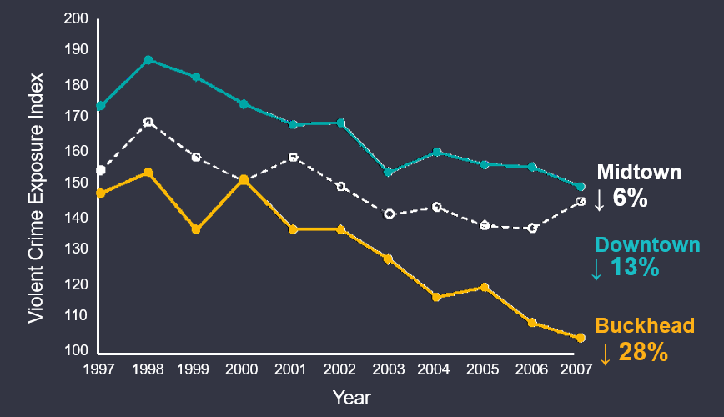
Evidence of Effectiveness
Atlanta, GA
A 3% reduction in alcohol outlets in the Buckhead neighborhood resulted in a 2-fold greater reduction in exposure to violent crime than in two other comparable neighborhoods.
Zhang, X., Hatcher, B., Clarkson, L., Holt, J., Bagchi, S., Kanny, D., & Brewer, R. D. (2015). Peer Reviewed: Changes in Density of On-Premises Alcohol Outlets and Impact on Violent Crime, Atlanta, Georgia, 1997–2007. Preventing chronic disease, 12.

Slide 11
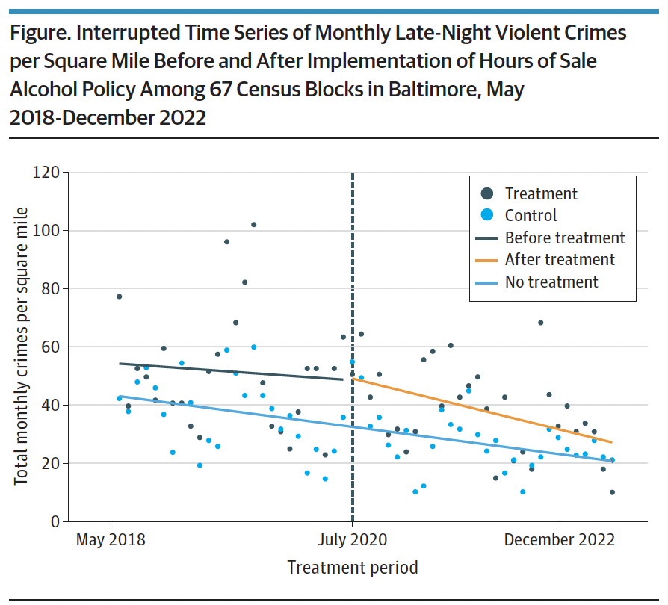
Evidence of Effectiveness
Baltimore, MD
A 7-hour reduction in alcohol sales hours (from 6 am to 2 am, to 9 am to 10 pm) in a single neighborhood was associated with an immediate 14% drop in violent crime in that neighborhood, and a 29% drop in all violent crime and a 48% drop in homicides in the neighborhood, compared to similar neighborhoods, over the next year.
Rosen EM, Trangenstein PJ, Fullem PL, Yeh JC, Jernigan DH, Xuan Z. Interrupted Time Series Analysis of Bar/Tavern Closing Hours and Violent Crime. JAMA Intern Med. Apr 1, 2024; doi:10.1001/jamainternmed.2024.0255.

Slide 12
Alcohol Availability and COVID-19 Pandemic
Almost every state declared alcohol sales “essential” – easier to buy alcohol than toilet paper
Availability expansions:
  Home delivery
  Carryout cocktails/curbside (drive-through) service
  Expansion of outdoor service (“parklets”)
Much of this made permanent post-pandemic
Alcohol-induced deaths up 25.7% between 2019 and 2020; increases highest for women, racial/ethnic minorities
Massachusetts has more places to buy alcohol than Dunkin’ Donuts

Slide 13
Attractiveness
Exposure to alcohol marketing plays a causal role in youth drinking behavior
Industry self-regulatory codes are ineffective
Algorithmic targeting makes marketing more efficient, less available to public health surveillance
Much of the authority lies at federal not state level
States – 8 areas of potential state action such as banning false and misleading advertising
  Best of the states (Virginia) had 5 best practices, 3 incompletes
  Much room for improvement
  No state action in counter-advertising (unlike tobacco)

Slide 14
Why Don’t States Act?
State costs of alcohol use last estimated in 2010:
  Ranged from $241 million in South Dakota to $14.5 billion in CA
  Median cost paid directly by states was $1.4 billion per year
Between 2002 and 2024, beer, wine and spirits industries spent $210 million lobbying state legislature
Alcohol consumption rises with income, making it the drug of choice of the people who write the laws and staff major media outlets

Slide 15
What Is to Be Done?
REFRAME:
  De-normalize both alcohol consumption and the alcohol industry
  Build support for choices not to drink and not to appease the industry
INFRASTRUCTURE:
  UK: Two national organizations devoted solely to alcohol policy, one with 36 full-time staff people, the second with 5 full-time staff people
  USA: One national organization with one staff person; contrast with tobacco (CTFK – 41 US-devoted staff; ANR 22 full-time staff)
  No foundation support for alcohol policy – none for past 20 years

Slide 16
What Is to Be Done?
Alcohol policy is a public health issue
Need for broader coalitions beyond the alcohol field – should be doable given the breadth of alcohol’s impact on health
Need to tackle the public health field’s own ambivalence about alcohol
If the people lead, perhaps the states will follow!

Slide 17
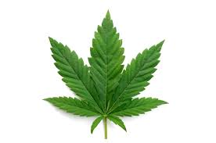

The impact of medical cannabis laws on cannabis & opioid use disorder treatment and overdose-related healthcare utilization among adults with chronic non-cancer pain
Beth McGinty
Livingston Farrand Professor
Chief, Division of Health Policy & Economics
Weill Cornell Medical College, New York, NY

Slide 18
Collaborators & Funding
Pradyhumna Wagle, Weill Cornell
Christie Lee Luo, Weill Cornell
Nicholas J. Seewald, UPenn Medicine
Elizabeth A. Stuart, Johns Hopkins University
Kayla N. Tormohlen, Weill Cornell
Funding: National Institute of Drug Abuse (NIDA) grant R01DA049789

Slide 19
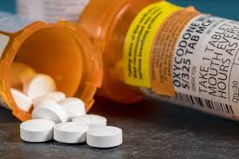
Motivation
State medical cannabis laws may lead people with chronic non-cancer pain to substitute cannabis in place of opioids for pain management…though longitudinal research shows no association between cannabis use and future prescription opioid use.
?
Campbell G, Hall WD, Peacock A, et al. Effect of cannabis use in people with chronic non-cancer pain prescribed opioids: findings from a 4-year prospective cohort study. Lancet Public Health. 2018;3:e341-e350. [PMID: 29976328] doi: 10.1016/S2468-2667(18)30110-5

Slide 20

Research Gap:
No studies have examined the impact of state medical cannabis laws on healthcare utilization for opioid use disorder and overdose among people with chronic non-cancer pain.
Studies using general population samples have suggested that medical cannabis laws may lead to reduced opioid use and overdose, but general population samples include people who:
Are using opioids for reasons other than chronic pain management, muddying the pain management substitution pathway
Are impacted by concurrent policies related to opioid prescribing for acute pain
Motivation

Slide 21

Design & Methods
Difference-in-differences design
  7 medical cannabis law states, 2012-2021
    FL, MD, MN, NH, NY, OK, PA
  17 comparison states over same period
    AL, GA, ID, IN, IA, KS, KY, MS, NE, NC, SC, SD, TN, TX, VA, WI, WY
Each medical cannabis law state had a unique 6-year (3 years pre/post law) study period, unique weighted comparison group (“synthetic control”)
Medicare fee-for-service claims data, 100% of adults <65 with chronic non-cancer pain (arthritis, low back pain, serious headache, fibromyalgia, neuropathic pain)
Outcomes: OUD & CUD treatment utilization overall; OUD & CUD treatment initiation; opioid & cannabis overdose utilization
State-specific augmented synthetic control analyses, “stacked” analysis using inverse-variance weighted average of state-specific estimates for average impact across states.
Study

Slide 22
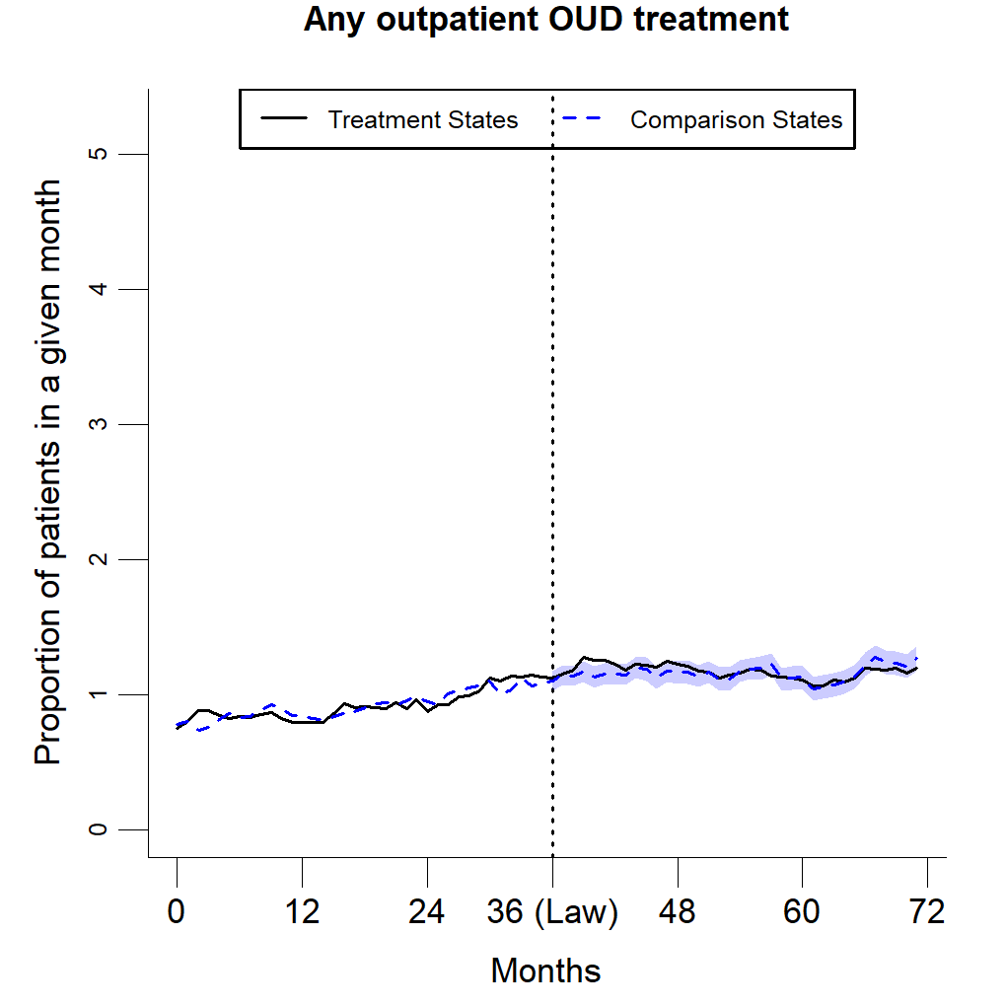
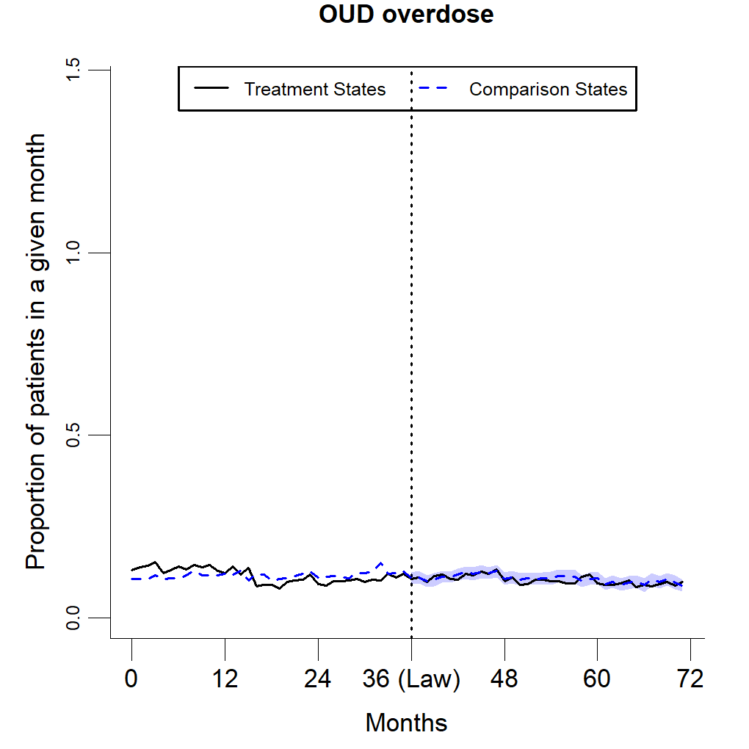
Findings — Opioids
We did not identify an impact of medical cannabis laws on healthcare utilization for opioid use disorder or opioid overdose among the Medicare beneficiaries age <65 with chronic non-cancer pain.
Study

Slide 23
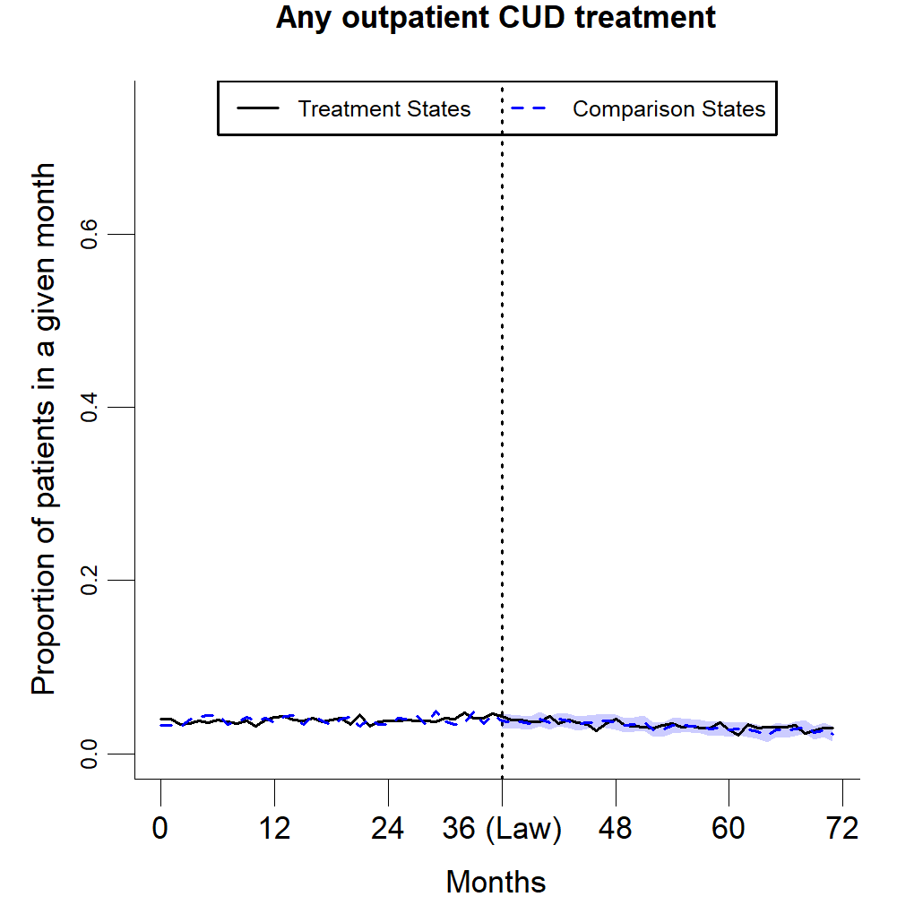
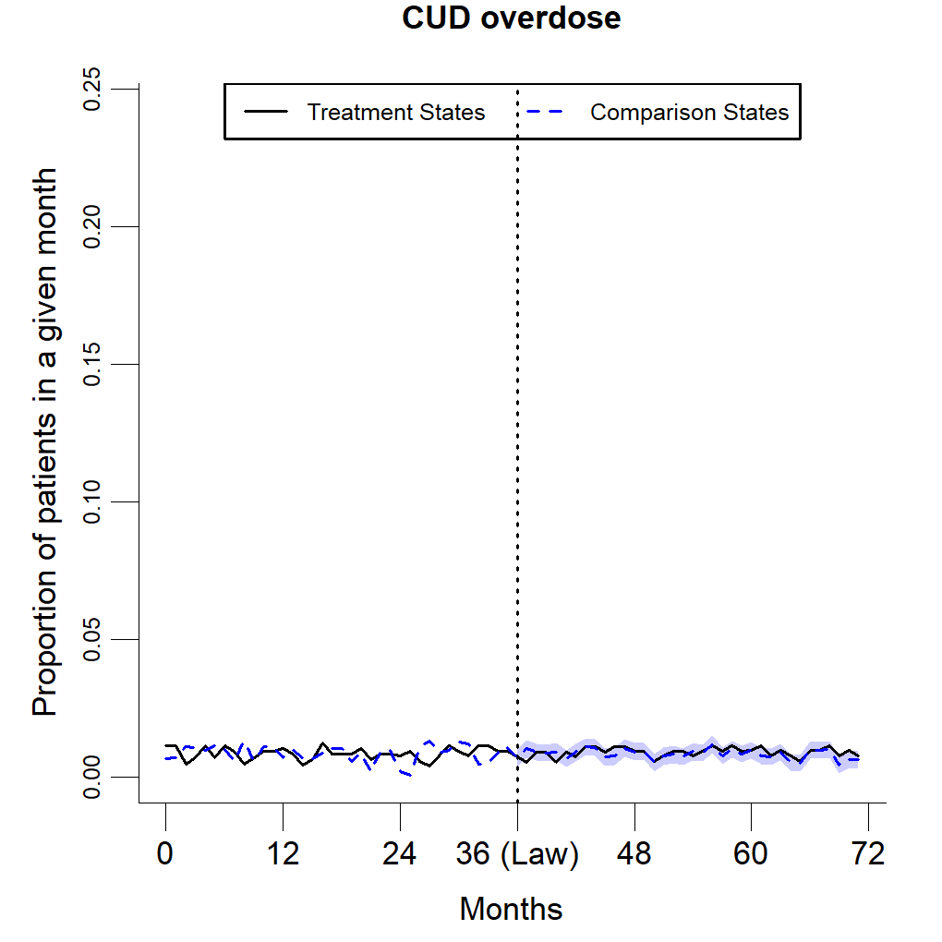
Findings — Cannabis
We also examined laws’ impact on cannabis use disorder and cannabis poisoning healthcare use. Again, no impact identified.
Study

Slide 24
Study
Limitations
Cannot observe cannabis use in claims
Cannot measure pain management in claims
Untestable assumption of parallel trends, unmeasured confounders (confidence improved, but not eliminated, with strong pre-period trend alignment in augmented synthetic control approach)
Finite number of states, limited power – though concerns mitigated by very narrow confidence intervals

Slide 25
Study
Conclusions
Results of prior studies suggesting that state medical cannabis laws reduce opioid use and overdose may be influenced by inclusion of people without chronic pain in the study sample.
Our findings do not identify either cannabis/opioid addiction or overdose-related harms or benefits of these laws.
More research to understand how cannabis, and laws allowing its use for medical purposes, impact chronic pain management is needed.
  Comprehensive studies examining impact on pain management, cannabis use, opioid use, and healthcare utilization and overdose outcomes.

Slide 26
Public Health Impacts of Adult-Use Cannabis Legalization in Maryland
Dana Moncrief, MHS, CHES (she/her)
Director, Center for Tobacco Prevention and Control
Maryland Department of Health

Slide 27
Mission and Vision
Mission
The mission of the Prevention and Health Promotion Administration is to protect, promote and improve the health and well-being of all Marylanders.
Vision
The Prevention and Health Promotion Administration envisions a future in which all Marylanders have equitable opportunities to live, thrive, and be healthy.
Notes:
brief overview of the law, our current programs, differences btwn MCA and MDH programs, and what happened during session? They are more of a policy based group, so I think that would be interesting.

Slide 28
Adult-Use Cannabis Legalization in Maryland
Policy Overview

Slide 29
Cannabis Legalization in Maryland
Policy Overview
Medical cannabis legalized
Legislation established a medical cannabis program and infrastructure within Maryland, including the Maryland Medical Cannabis Commission.
Adult-use cannabis legalized
July 1 - Adults 21+ can legally possess, purchase, and consume cannabis
August - 1st meeting of Cannabis Public Health Advisory Council
Threats to Public Health
HB 132/SB 215 - Cannabis - On-Site Consumption Establishments and Cannabis Events
HB 1377 - Cannabis - Advertising - Prohibited Locations (Equity in Cannabis Advertising Act)
2022
2024
2013-14
2023
2025
Adult use cannabis legislation passed
April 9 - HB 1 & HB 837 passed
Nov 8 - Ballot Amendment passed
Expanding Infrastructure & Education
HB 238 - Public Health - Clean Indoor Air Act - Revisions
Launched BeCannabisSmart campaign
Conducted 1st round lottery for social equity licenses

Slide 30
Cannabis Public Health Fund
Administered by MDH, Center for Tobacco Prevention and Control to address the health effects associated with adult-use legalization
  Using Cannabis Public Health Framework
Funds may be used to:
Support the Cannabis Public Health Advisory Council
Support data collection and research on the effects of cannabis legalization
Conduct education and public awareness campaigns
Support substance use disorder counseling and treatment
5% of tax revenue from adult-use sales (less other budget obligations) allocated to the fund annually
Cannabis sales tax increased from 9% → 12% (effective July 1, 2025)

Slide 31
Cannabis Public Health Advisory Council
Policy Overview
MDH provides administrative support
Membership
  7 ex-officio, 10 governor appointed
  Adding 2 new members (19 total) from Motor Vehicle Administration and Office of Social Equity (Oct 2025)
Workgroups: Data, Youth Mitigation, Provider Education
FY 25 Accomplishments
  Drafted comprehensive annual report
  Submitted testimony during legislative session
  Made recommendations to MDH for improved cannabis data collection on statewide surveys
Next meeting - Sept 17th, 4-6PM - see website

Slide 32





Policy Areas of Focus
Policy Overview
Smoke-Free Environments
Clean Indoor Air Act
Educate retailers and the public
As of 2024, no smoking or vaping of nicotine, cannabis or hemp
Youth Prevention
Promote BeCannabisSmart parent resources
Health education in schools
Collaborate with local coalitions and youth-serving community groups
Public Safety
Promote health communication campaigns
Collaborate with the Office of Food Protection to ensure safety of edible cannabis products
Partner with other state agencies (MCA, ATCC, MDot/MVA, etc.)
Update population-based surveys to include questions about cannabis use (YRBS/YTS, BRFSS, etc.)
Conduct relevant studies and share findings
Poison Center
Data and Surveillance

Slide 33
Cannabis Public Health Framework
Public Health Programs

Slide 34
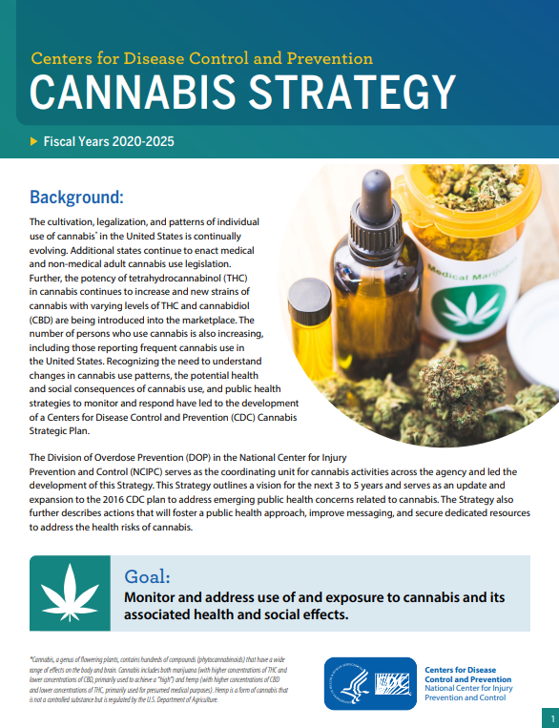
Cannabis Public Health Framework
Public Health Programs
Draws upon best practices and expertise from decades of tobacco prevention and control
Includes six strategic pillars to guide public health cannabis control efforts from Centers for Disease Control and Prevention (CDC):
  Monitor trends
  Advance research
  Build state and local capacity
  Support health systems and healthcare providers
  Partner with public safety, schools, and communities
  Improve public knowledge and awareness

Slide 35

Implementing the Framework
Public Health Programs
Improve Public Knowledge and Awareness
Media outreach [in partnership with MCA]
Statewide Campaign - BeCannabisSmart (Impaired Driving; Smoke-free Spaces; Safe Storage; Youth Prevention)
Build State/Local Capacity
Legal Resource Center for Public Health Policy-Cannabis (FY24-Present)
Funding for local health departments
  FY24 - Strategic Planning
  FY25 - Implementation
  FY26 - Youth cannabis youth prevention (+ priority populations)
Partner with Public Safety
Interagency workgroup (MCA, ATCC, MDH) - compliance/enforcement efforts
Retailer education - CIAA packets, ATCC communication, MCA resources

Slide 36
Partnerships

Slide 37
Current Partner Initiatives
Partnerships
Maryland Cannabis Administration
  Updated BeCannabisSmart with “Talk To Teens About Cannabis Use”; includes messages from healthcare providers and materials for parents/caregivers
  Partnership with MDH to develop campaigns - youth prevention campaign coming soon
  Enforcement - licensed dispensaries
Alcohol, Tobacco, and Cannabis Commission
  Operationalizing HB 12/SB 214 (2025) to better regulate THC products (includes Delta-8 and Delta-10 THC products)
  Identifying opportunities for retailer education
  Enforcement: unlicensed entities selling THC products
Local health departments - funding and technical assistance
Maryland State Department of Education - educating school staff; standards and
framework committee

Slide 38
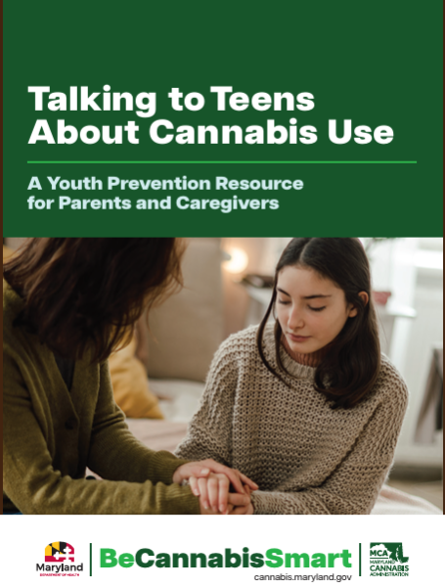
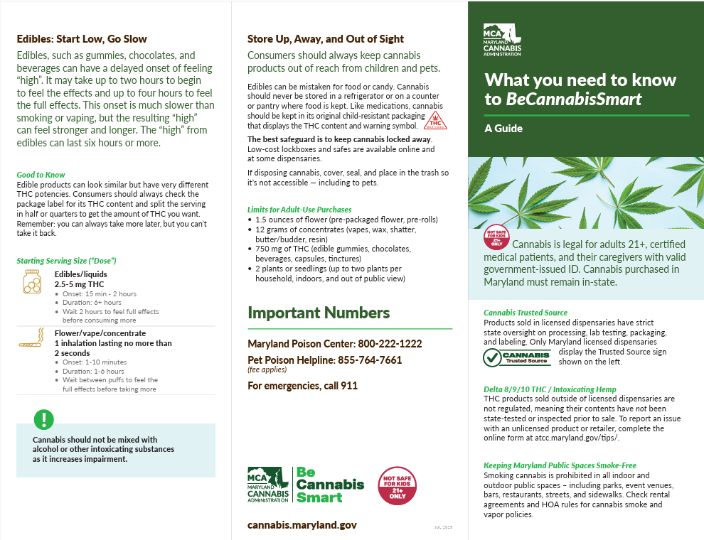
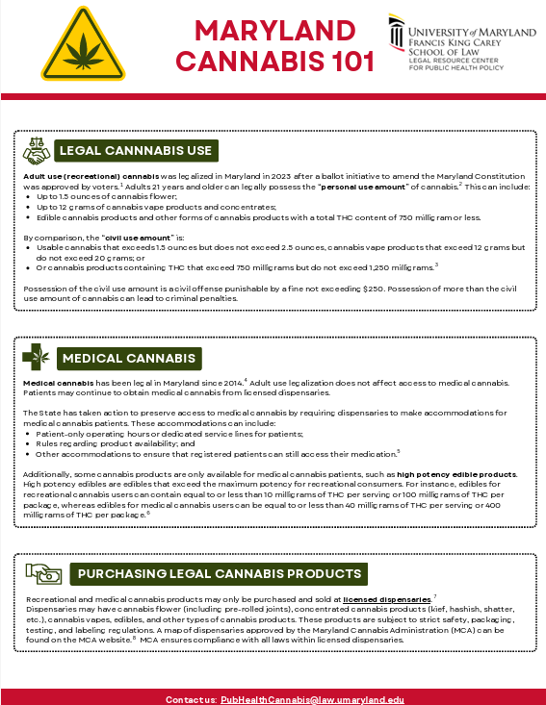
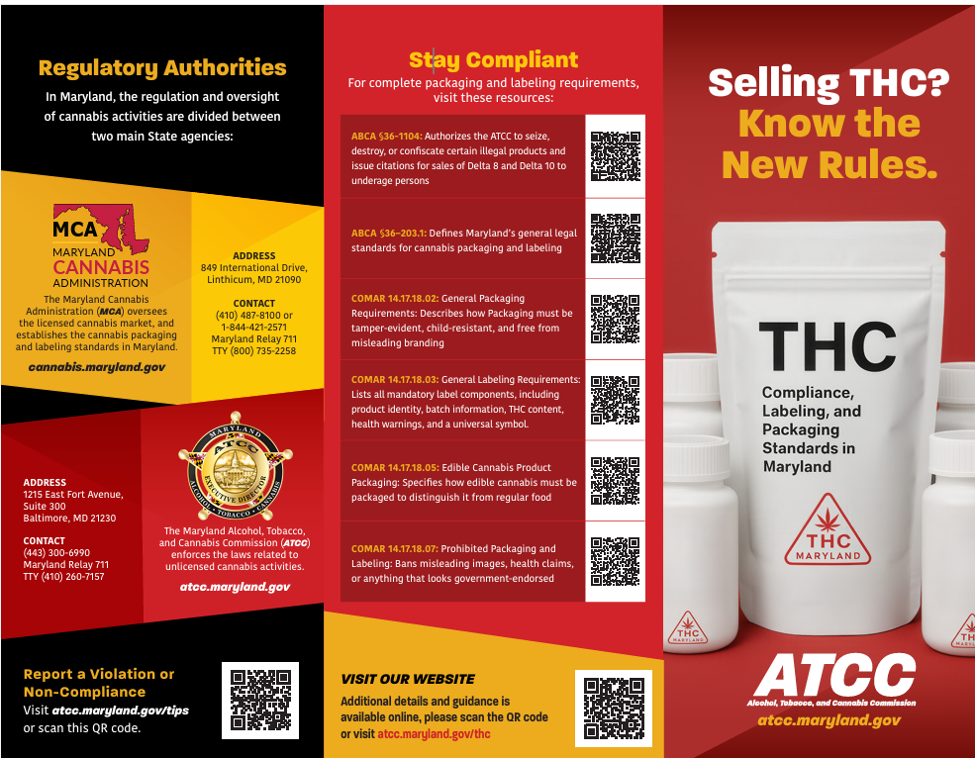
Partner Resources
Toolkit for Parents and Caregivers
(BeCannabisSmart)
Consumer Guide
(BeCannabisSmart)
Policy Factsheets
(Legal Resource Center)
Retailer Pamphlet
(ATCC)

Slide 39
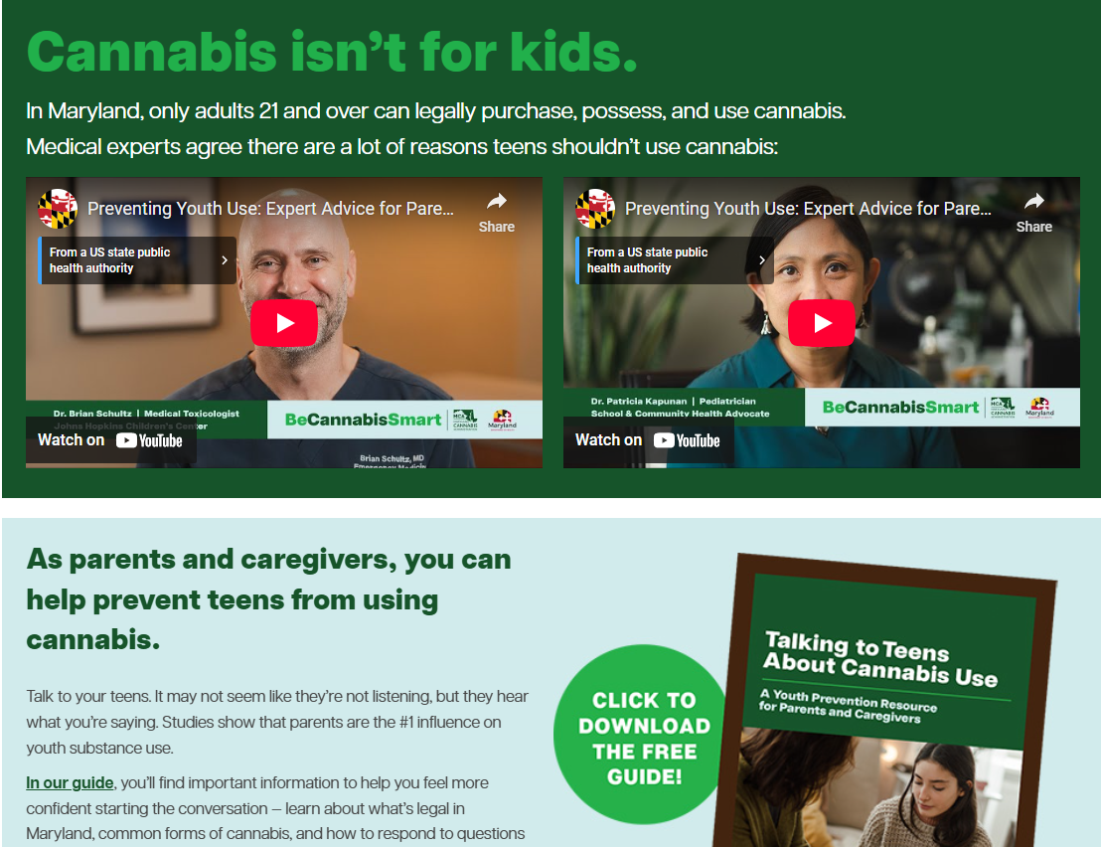
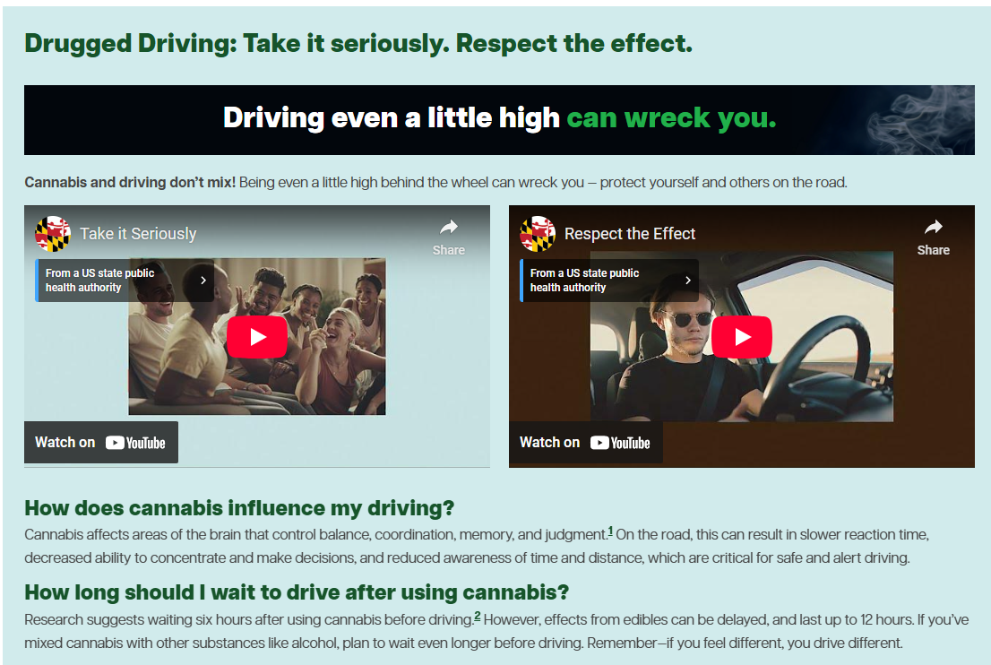

BeCannabisSmart Campaign - MCA/MDH
cannabis.maryland.gov/Pages/BeCannabisSmart.aspx

Slide 40
Looking Ahead
Monitor legislation impacting smoke-free places (i.e., on-site consumption establishments) and youth access
Legal Resource Center - provide technical assistance and resources
Continued funding to support:
  Media campaigns and public education efforts
  Local health departments and community-based organizations
  State/local capacity building
Engaging the Advisory Council
Refining data collection and surveillance sources and reporting
Strengthening partnerships - MVA, MSDE, MCH

Slide 41

Questions?
CONTACT:
Dana Moncrief, MHS, CHES (she/her)
Director, Center for Tobacco Prevention and Control
dana.moncrief@maryland.gov

Slide 42
Moderated Discussion and Q&A

Slide 43
Thank you for listening.

