Slide 1
Medicaid Prerelease and Transition Services
Milbank Quarterly Webinar
March 6, 2025

Slide 2
Panelists
Cameron Adams, Arizona Health Care Cost Containment System Administration (discussant)
Sanjay Basu, Waymark
Autumn Boylan, California Department of Health Care Services (discussant)
Harold Pollack, The University of Chicago (moderator)
Notes:
Develop publications – evidence and experience in the Milbank parlance
Disseminate

Slide 3
Medicaid pre-release and transition services coverage
Sanjay Basu MD PhD
sanjay.basu@waymarkcare.org

Slide 4
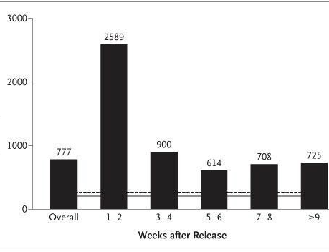
Context
Medicaid traditionally covers only community-based inpatient hospitalizations
Post-release mortality increases shortly after release, particularly in context of substance use
Mortality Rates among Former Inmates of the Washington State Department of Corrections during the Study Follow-up (Overall) and According to 2-Week Periods after Release from Prison.
Binswanger IA, Stern MF, Deyo RA, Heagerty PJ, Cheadle A, Elmore JG, Koepsell TD. Release from prison--a high risk of death for former inmates. N Engl J Med. 2007 Jan 11;356(2):157-65. doi: 10.1056/NEJMsa064115.

Slide 5
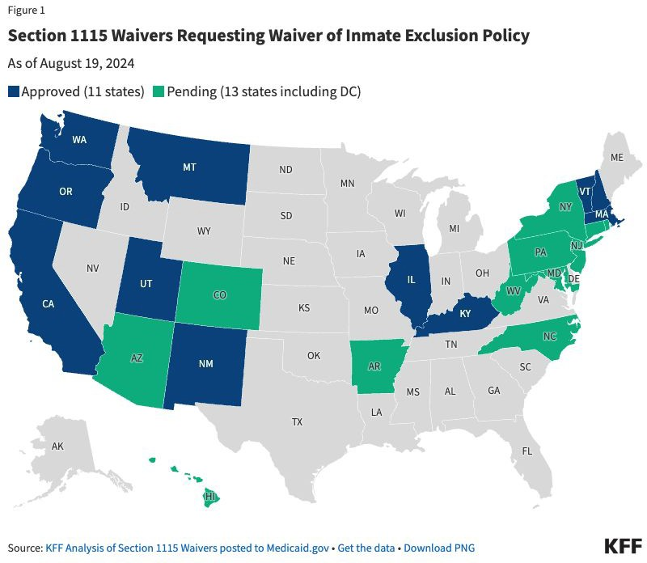

Slide 6
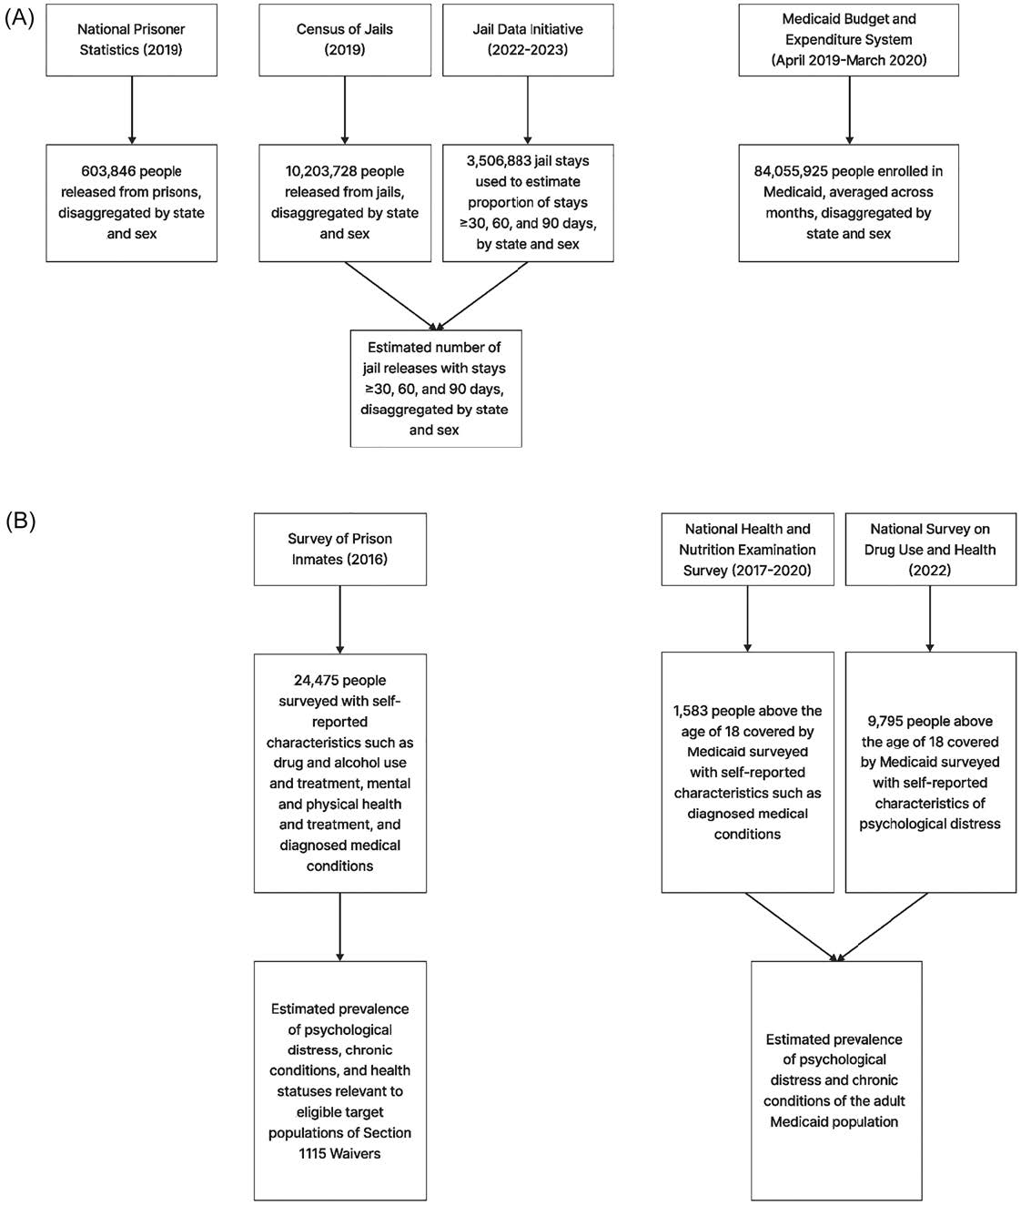
How many people might be eligible?
National Prisoner Statistics
Census of Jails
Jail Data Initiative
Disease/condition prevalence versus civilian population?
Survey of Prison Inmates
Civilian: NHANES, NSDUH

Slide 7
Approach
Eligibility:
Varied whether jail populations included, and for how long they were incarcerated (30-90d) before considered
Whether eligibility was conditional: e.g., behavioral health conditions, chronic conditions
Methods
Smoothed population size estimates
Omitted states with a combined jail and prison population reporting
Survey sample weighting

Slide 8
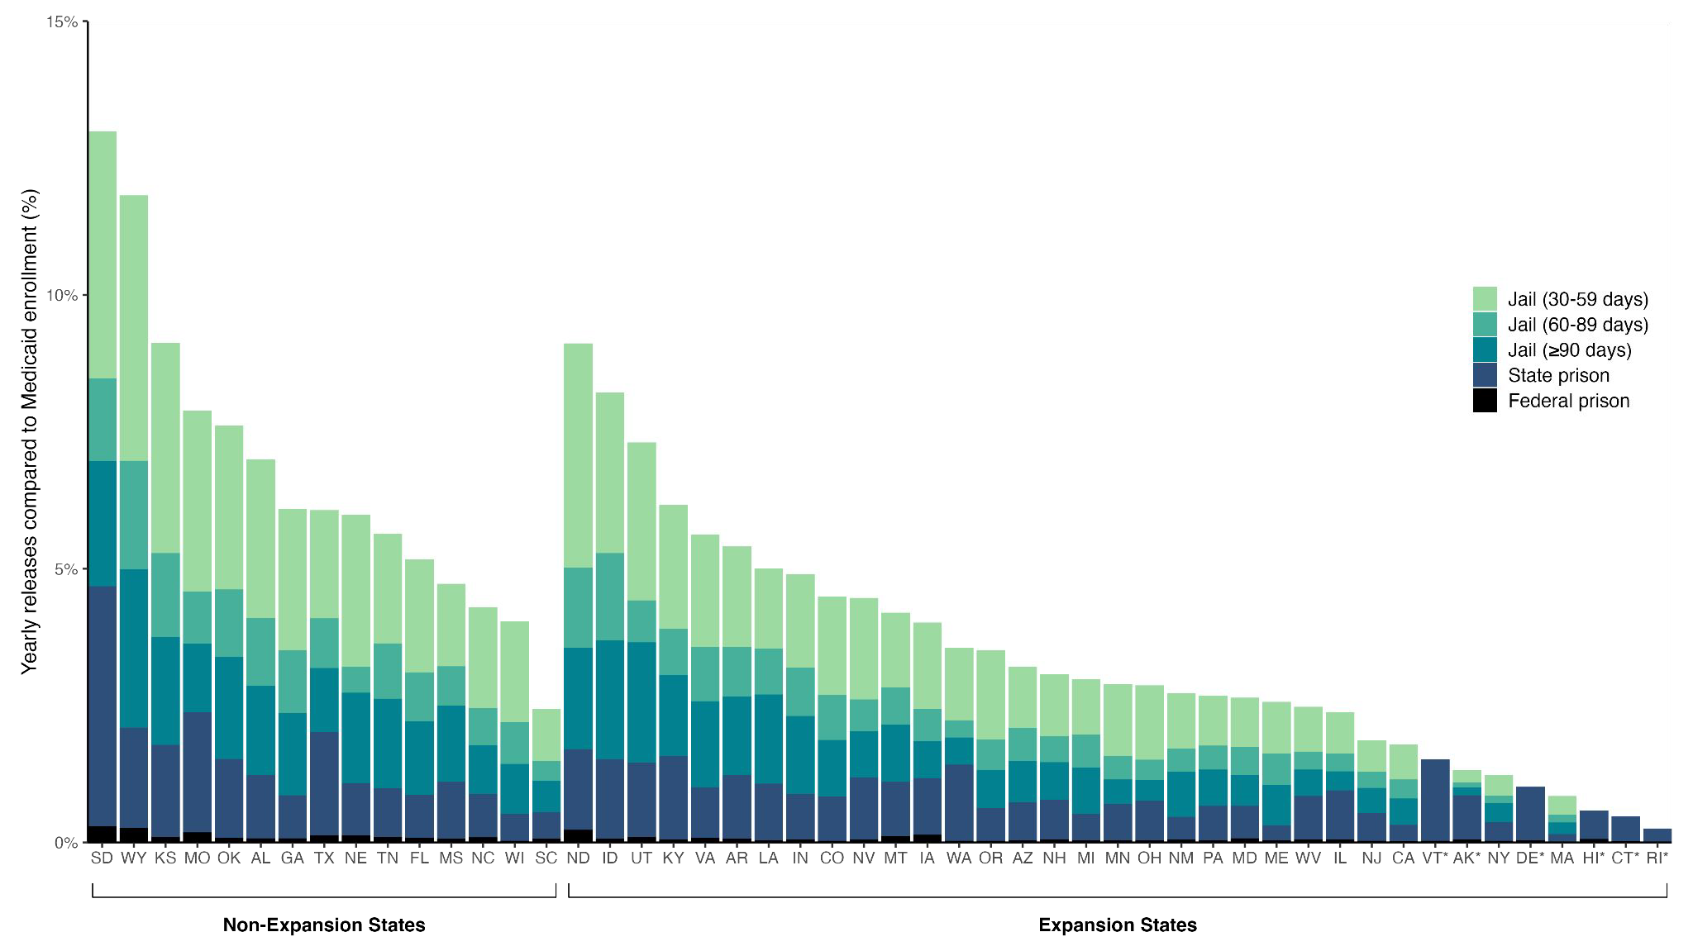
Findings
Prison and jail releases relative to civilian Medicaid enrollment by state. The plot shows stacked bar charts of the yearly releases who may be eligible to Medicaid, relative to the size of the existing Medicaid population, divided into categories of shorter and longer-term jail stays, and state versus federal prison releasees, further subdivided by states that have versus have not expanded Medicaid as of June 2024.
Chin ET, Liu YE, Ogbunu CB, Basu S. Population Health Implications of Medicaid Prerelease and Transition Services for Incarcerated Populations. Milbank Q. 2024 Dec;102(4):896-912.

Slide 9
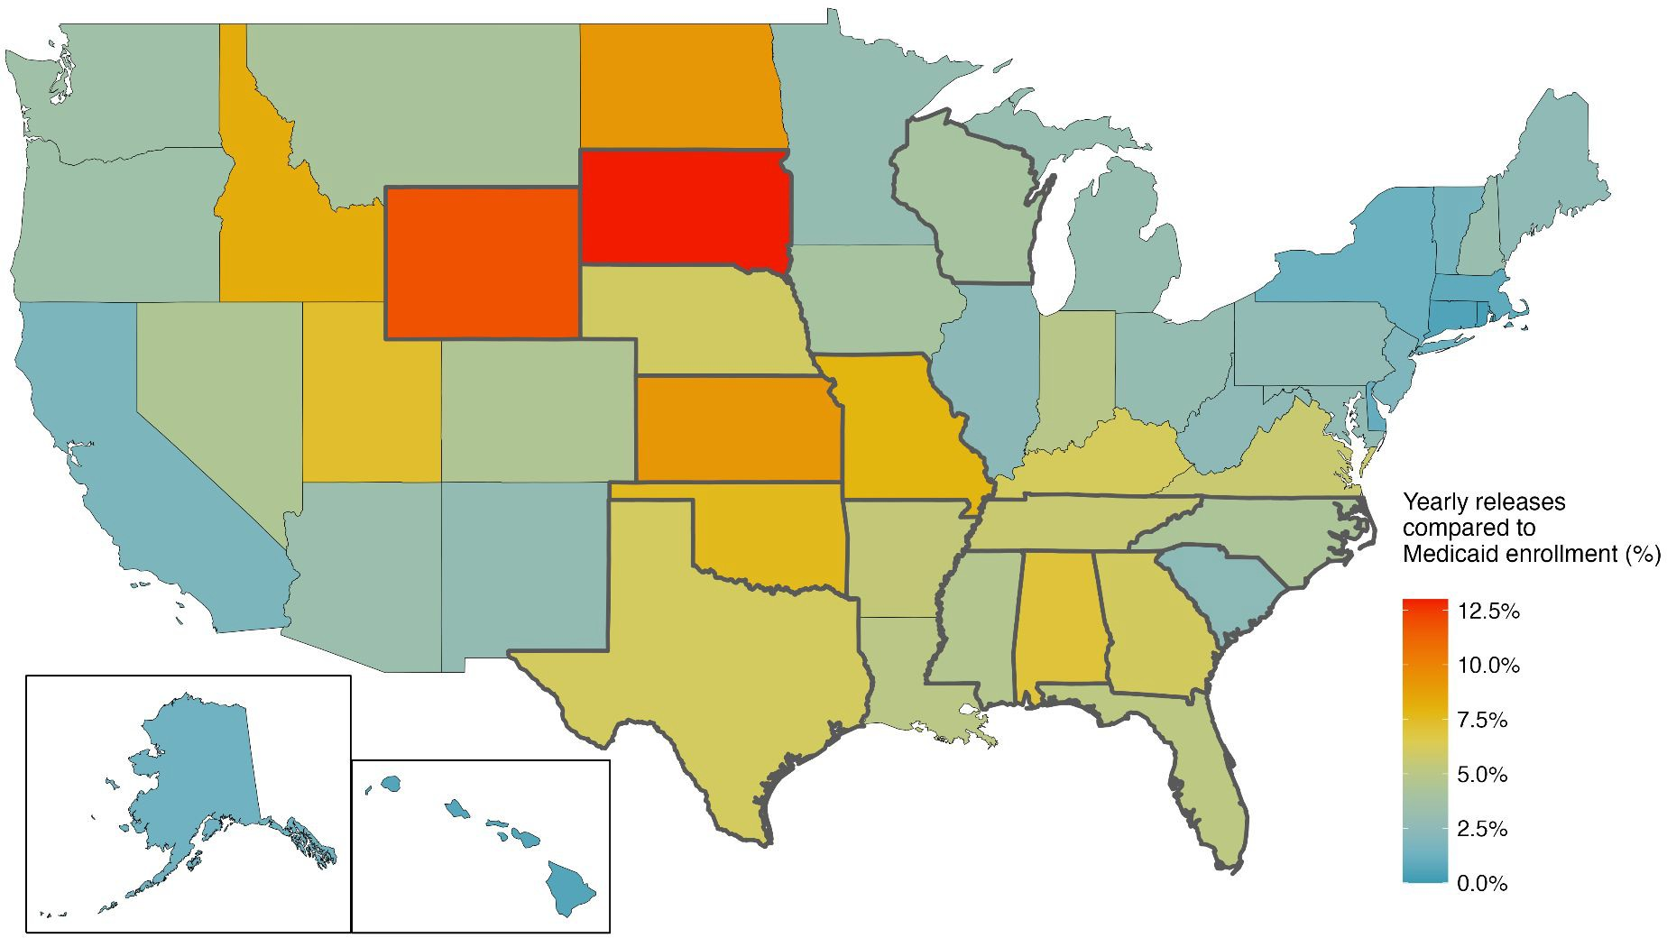
Findings
Prison and jail releases relative to civilian Medicaid enrollment by state. The plot shows stacked bar charts of the yearly releases who may be eligible to Medicaid, relative to the size of the existing Medicaid population, divided into categories of shorter and longer-term jail stays and state versus federal prison releases, further subdivided by states that have versus have not expanded Medicaid as of June 2024.
Chin ET, Liu YE, Ogbunu CB, Basu S. Population Health Implications of Medicaid Prerelease and Transition Services for Incarcerated Populations. Milbank Q. 2024 Dec;102(4):896-912.

Slide 10
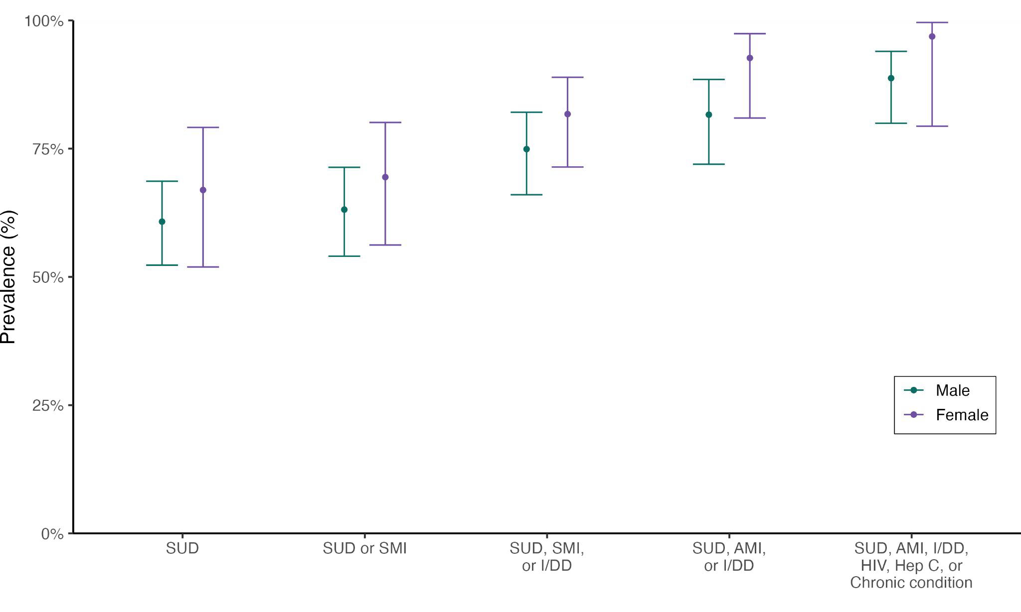
Findings
Prevalence of select health conditions among the incarcerated population. Health statuses include substance use disorder (SUD), severe mental illness (SMI), intellectual or developmental disorders (I/DD), any mental illness (AMI), or chronic conditions, and were selected based on eligibility considerations for state Medicaid waivers.
Chin ET, Liu YE, Ogbunu CB, Basu S. Population Health Implications of Medicaid Prerelease and Transition Services for Incarcerated Populations. Milbank Q. 2024 Dec;102(4):896-912.

Slide 11
Key points
Rural and smaller states would experience a disproportionately large proportion of their Medicaid populations to be eligible for pre-release and transition services if new Medicaid eligibility rules were broadly applied.
Self-reported psychological distress was notably higher among incarcerated individuals compared to those currently on Medicaid.
The prevalence of previously diagnosed chronic Hepatitis C and kidney disease were also much higher in the incarcerated population than the existing civilian Medicaid population.

Slide 12
So many caveats and limitations
Survey methodology variations: Inherent differences in survey methodologies and questions limit direct comparability of prevalence estimates.
Prison vs. jail populations: Notable differences between prison populations (assessed in the Survey of Prison Inmates) and jail populations (who often have different characteristics and disease prevalence).
Information bias: Differences in survey methodologies, participant recruitment, and data collection methods can introduce information bias.
Disease severity omission: Analysis does not capture disease severity; incarcerated populations may have more advanced stages of chronic diseases.
Outdated substance use data: Substance use prevalence is likely higher than reported due to continuing increases in opioid use since the surveys were conducted.
Take-up rate uncertainty: Limited research exists on enrollment take-up rates when people are enrolled prior to release, which may vary across states and subpopulations.
Incomplete data on newly covered populations: Significant information gaps regarding the volume and needs of populations newly covered under Medicaid-funded pre-release and transition services.
Fragmented health data: Historical data on health needs of incarcerated populations has been incomplete and fragmented.
System coordination challenges: Data collection and sharing among correctional facilities, state healthcare entities, health plans, and providers remains problematic.
Estimation accuracy: Estimations of population characteristics, disease prevalence, and potential Medicaid-eligible re-entry population may not fully capture nuanced needs.
Policy evolution impact: Evolving policies and practices as states implement new waivers may affect the applicability and accuracy of findings over time.
Medicaid expansion differences: Non-expansion states may have different eligible populations for justice-involved waivers compared to expansion states.

Slide 13
Acknowledgements
Thanks to Elizabeth Chin (Johns Hopkins), principal author, for the majority of work involved.
Co-authors: Brandon Ogbunu (Yale), Yiran Liu (Stanford)
Email if questions: sanjay.basu@waymarkcare.org

Slide 14
Moderated Discussion and Q&A

Slide 15
Thank you for listening

