Slide 1
What Legislators Need to Know About Hospital Spending and Health Care Affordability

Slide 2
Health Care Affordability Has Reached Crisis Levels
Catalina Hernandez, who has worked for Hyatt Regency Monterey for nearly 20 years, and her family faced $20,000 in hospital bills after her husband’s cancer surgery. Over the three years it took to pay the bill, her family had to limit groceries, basic household items, and maintenance for the car that she used to commute to work. – Testimony, California Department of Health Care Access Hearing, December 2023
Over 80% of employers support both hospital reforms and pharmacy benefit manager reforms. Interest in policy reform surged from 2022 to 2023, with the greatest gains for hospital rate regulation (up 20%), hospital price transparency (up 11%) and surprise billing regulation (up 7%). – National Alliance of Health Care Purchaser Coalitions’ 2023 Pulse of the Purchaser Survey

Slide 3
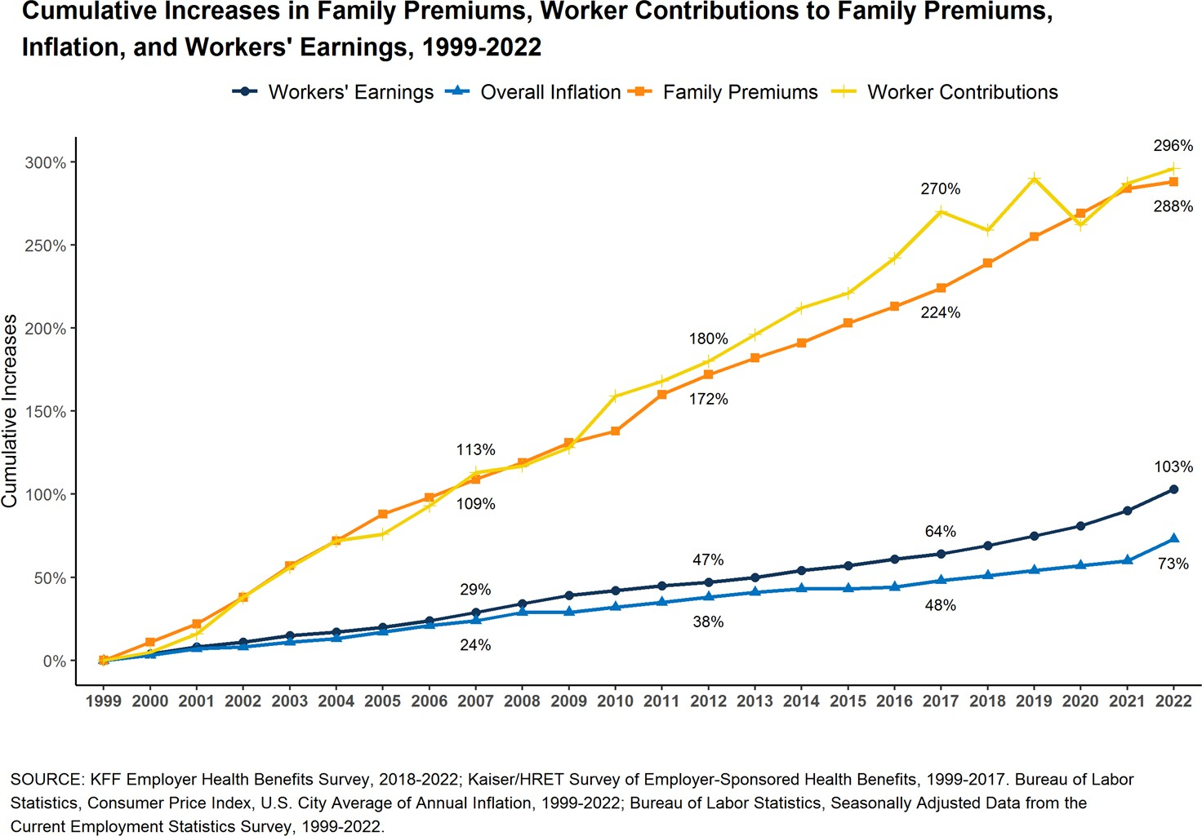
Health Care Growing Affordability Crisis
Health care costs have grown faster than the economy for decades
Rising costs burden pn states, employers, and families
COVID reinforced the need to rein in health care cost growth

Slide 4
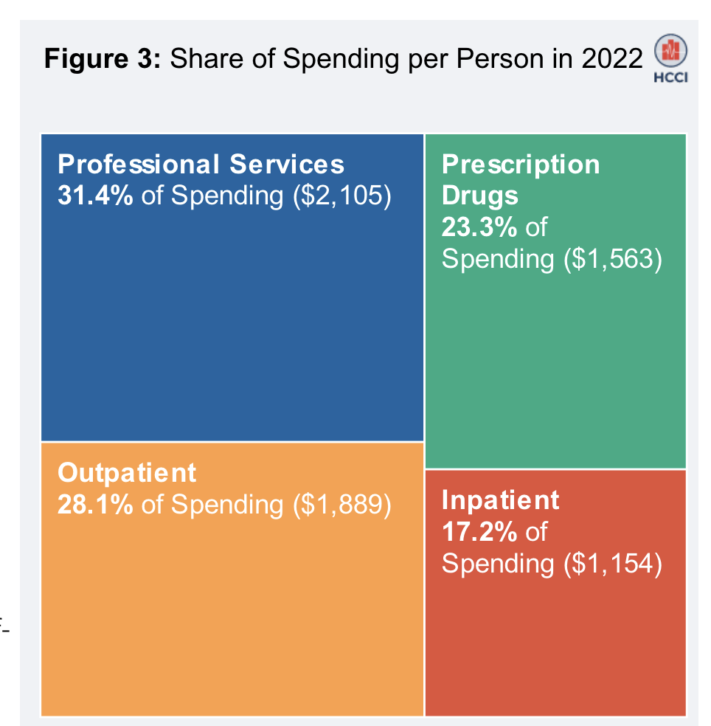
Hospital Spending Comprises the Largest Share of Per-Person US Health Care Spending

Slide 5
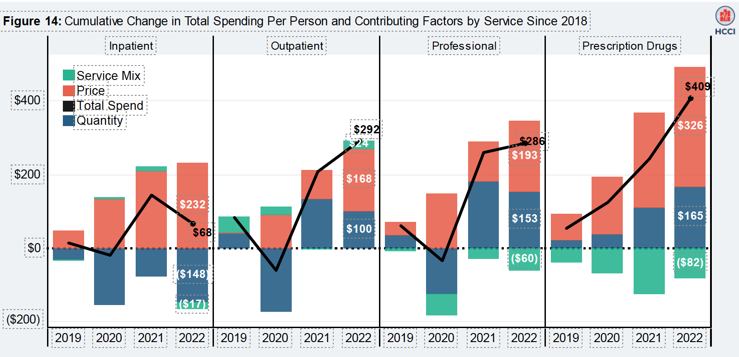
Price Driving Increased Spending by Service Category
HCCI

Slide 6
How Do We Know Hospital Spending Growth Contributes to States’ Overall Health Costs?
Cost driver analysis uses all-payer claims data to identify the major factors contributing to cost growth. This in turn can suggest policy opportunities to slow that growth.
States have identified hospital spending and prices as major contributors to cost growth using these analysis.

Slide 7
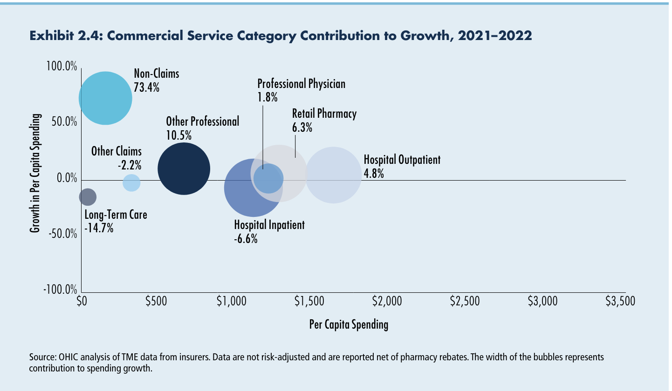
Cost Drivers Analysis by Service Category in Rhode Island Shows Hospital
Outpatient Spending Was the Leading Commercial Insurance Market Driver
Source: OHIC. 2024 Annual Report: Health Care Quality and Spending in Rhode Island.

Slide 8
Understanding Hospital Finances in Your State
Hospital financial analysis can:
  Identify hospitals that are performing better or worse regarding cost growth, community benefit spending, and more
  Inform implementation of policies like enhanced health care merger review or hospital cost/price growth caps
  Assess the potential impact of affordability policies on a hospital’s financial health

Slide 9
What Are the Best Public Data Sources for Hospital Financial Analysis?
The Guide profiles three publicly available data sources and considerations for use.
Hospital Financial Data Source Options
1
2
3
Medicare Cost Reports accessible via:
Audited Financial Statements
IRS Form 990 Filings
CMS Healthcare Provider Cost Reporting Information System (HCRIS)
National Academy for State Health Policy (NASHP) Hospital Cost Tool (HCT)
Source: Guide to Understanding Hospital Spending through Financial Analysis. Milbank Memorial Fund. April 2024.
Notes:
Each data source has strengths and weaknesses, depending on the type of analysis of interest. For each data source the Guide:
Discusses strengths, limitations, and considerations for use;
Summarizes key metrics and instructions for analysis; and
Provides analytic examples and suggested areas for additional analysis.

Slide 10
Interpreting Audited Financial Statements: Case Studies
Audited Financial Statements are useful for analyzing a comprehensive set of financial metrics at the health system level.
Case studies provided with the Guide draw data from the Audited Financial Statements of three actual health systems from different regions of the country.
Each case study summarizes the state of the health systems’ finances using eight key financial indicators of profitability, liquidity, and more, and comparing performance on those metrics to reference ranges.

Slide 11
Case Study: Health System A
Health System A’s profitability was very favorable compared to the reference range, as was its liquidity. Performance on these metrics is reinforced by its favorable debt capacity, which suggests that the entity was managing cash and debt well.
Its performance on the capital investment measure indicates that the health system made significant investments in its property, plant, and equipment.
Performance on the age of its facilities and financial burden were within the median range. The financial health of the system is also confirmed by the significant accumulation of unrestricted net assets of approximately $15 billion.
These findings suggest that it’s unlikely that state cost growth mitigation policies designed to slow the growth of hospital prices would threaten Health System A’s financial viability.

Slide 12
Policies to Target Rising Hospital Costs
Health care consolidation is contributing to rising hospital costs. Stronger market oversight legislation may include:
  Review and approval of proposed mergers involving hospitals
  Monitoring of conditions placed on approved transactions involving hospitals
Legislation to bring down commercial prices may include:
Hospital price caps or limits on commercial cost growth (Oregon)
Hospital budget review and payment policies may include:
  State review of hospital budgets (Vermont)
  State board that ensures that any changes to hospital budgets align with the state’s health care spending benchmarks (Delaware)

Slide 13
Call to Action for Legislators
Given that health care is increasing unaffordable — and that rising hospital spending is a major cost growth driver:
Failure to implement affordability policies will increase the health care cost burden on your state and its residents and employers and limit investment in other sectors like primary care and behavioral health
When deciding what evidence-informed actions to take, conduct financial analysis of your state health systems using the tools described

Slide 14
Read the guide and case studies at: milbank.org/cgt

