Slide 1
Considering the AHEAD Model: Lessons from States with Health Care Cost Growth and Primary Care Investment Targets
Peterson-Milbank Webinar
October 17, 2023

Slide 2
Speakers
Rachel Block, Program Officer, Milbank Memorial Fund (moderator)
Christina Crider, Deputy Division Director, Division of Multi-Payer Models, CMMI
Keanan Lane, Associate Director, Peterson Center on Health Care
Cory King, Health Insurance Commissioner, State of Rhode Island
Deidre Gifford, Executive Director, Connecticut Office of Health Strategy
Notes:
Balit Health provides TA to states as they set up and implement their programs. Comms support through Burness. Each state in a different place on the continuum.

Slide 3
States Advancing All-Payer Health Equity Approaches and Development (AHEAD) Model
State Financial Targets Overview
Center for Medicare and Medicaid Innovation
1

Slide 4
AHEAD Model At-A-Glance
Components
Strategies
The States Advancing All-Payer Health Equity Approaches and Development, or the AHEAD Model, is a flexible framework designed to improve health outcomes across multiple states.
Statewide Accountability Targets
Total Cost of Care Growth (Medicare & All-Payer)
Primary Care Investment (Medicare & All-Payer)
Equity and Population Health Outcomes via State Agreements with CMS
Cooperative Agreement Funding
Hospital Global Budgets (facility services)
Primary Care AHEAD
Strategies
Equity Integrated Across Model
All-Payer Approach
Behavioral Health Integration
Medicaid Alignment
Accelerating Existing State Innovations

Slide 5
Statewide Targets At-A-Glance
Participating states take on accountability for quality, costs, and outcomes for a defined sub-state region or statewide. These targets are memorialized in the State Agreement between the state and CMS.
Improve Population Health
Advance Health Equity
Medicare FFS Primary Care Investment Target
All-Payer Primary Care Investment Target
Statewide Quality and Equity Targets (Medicare FFS and All-Payer)
Curb Health Care Cost Growth
Medicare FFS Total Cost of Care Targets
All-Payer Cost Growth Targets
Targets are measured for residents within the defined region.
5

Slide 6
Medicare FFS TCOC Targets
AHEAD was developed in alignment with affordability and cost growth containment efforts underway in states across the nation, and the Medicare TCOC target holds states accountable for “bending the cost curve” for Medicare Part A and Part B expenditures of resident beneficiaries. By holding states accountable for cost growth, CMS hopes to support states in achieving a more affordable cost trajectory and increased long-term sustainability. CMS will work collaboratively with each state during the pre-implementation period to set state-specific Medicare FFS TCOC growth targets.
Medicare TCOC Growth and Savings to CMS Under the AHEAD Model
State Growth Absent Model
Savings
Growth
State Growth Under Model
Time

Slide 7
Elements of the Medicare FFS TCOC Expenditure Target
Trend Factor BY1
A negotiated savings component (SC) is subtracted from the trend factor (TF) for each year to create the growth factor (GF) for that year. That growth factor is annually compounded (multiplied by each past year’s value).
MINUS
Participants are accountable for meeting the annual Medicare FFS TCOC Expenditure target
SC BY1
EQUALS
Growth Factor BY1
Compounded
The compounded growth factor is applied to each baseline year
The baseline years are weighted
Trended BY1
BY1
CGF BY1
Trended BY2
Medicare FFS TCOC Expenditure Target
BY2
CGF BY2
Trended
Weighted
Trended BY3
BY3
CGF BY3
The target is based on 3 years of Medicare Parts A and B expenditure data (BY1, BY2 and BY3)
7

Slide 8
All-Payer Cost Growth Targets: Structure
Curb Health Care Cost Growth
All-Payer Cost Growth Targets
Each state will be accountable for meeting a target for all-payer TCOC growth, comprising Medicare, Medicaid, and commercial payers, on an annual basis.
Key Goal: Build on and expand existing state innovations and cross-state learnings.
States and conveners have made significant progress in the national space on cost growth target setting in recent years. Some states may enter the model with prior cost growth targets; others may enact new targets in order to participate in the model.
Award recipients beginning Model participation without all-payer cost growth targets will be encouraged to leverage the experience of early adopters and build on methodologies used in other existing state cost growth benchmarking programs. The Peterson-Milbank Program for Sustainable Healthcare Costs has been tracking these efforts and has additional resources for states.

Slide 9
All-Payer Cost Growth Targets: Requirements
Memorialization
All-payer cost growth targets (or, at minimum, the process to determine such a target) must be memorialized in state Executive Order, statute, or regulatory change 90 days before the start of PY1.
Duration
Targets must subsequently be sustained throughout the duration of the AHEAD performance period.
Execution
If the state misses its TCOC target, CMS will request a corrective action plan for the state, which may include public reporting on commercial cost growth in aggregate and by payer, among other actions to be taken by the state
Data Reporting
Data collection and reporting on all-payer cost growth must be shared with CMS and coordinated with data collection for the primary care investment target
The specific all-payer cost growth target and calculation methodology must be determined, at minimum, 90 days before the start of PY2.

Slide 10
Assessing Readiness for All-Payer Cost Growth Constraint in AHEAD Applications
Having an existing cost growth target is not a requirement to be an AHEAD model participant, but applicants should consider the feasibility of enacting legislation in accordance with the model milestones timeline.
States should demonstrate readiness and political will to establish the necessary governing bodies and execute the requirements described above as part of their NOFO application.
Technical assistance and learning supports will be available for states that are new to cost growth benchmarking.
Legislation or executive order that provides authority to establish targets must be enacted by the start of PY1; targets must be set by the start of PY2.

Slide 11
Primary Care Investment Targets
Medicare FFS Primary Care Investment Targets
All-Payer Primary Care Investment Targets
Methodologies and benchmarks determined by states and reviewed by CMS (may build on existing legislation and targets, if applicable)
Require All-Payer Primary Care Investment Target memorialized in Executive Order or legislation by the first performance year
Must continue for the duration of the AHEAD performance period
May use state-specific definition of primary care; states without existing targets are encouraged to use AHEAD Medicare FFS definition of primary care
Methodologies and benchmarks determined by CMS, based on current state spending
Annual targets are state-specific, improvement-focused
CMS and state will determine performance annually on specified target based on available data
State to recruit participants for Primary Care AHEAD and pursue activities to support primary care

Slide 12
AHEAD Primary Care Definition Approach: Medicare FFS Targets
Structure
“Narrow vs. broad” approach
State flexibility
Consists of specified list of HCPCS codes and non-claims-based-payments (NCPBs). HCPCS codes are selected via a cross-analysis of definitions used in existing state legislation and other primary care investment reports.
More primary care payments are coming through NCBPs. Given this, CMS will be including NCBPs in the calculation for Medicare FFS and providing states with a NCBP reporting template for all payers.
Use “meet in the middle” approach by filtering for specialty type “and” HCPCS codes type (rather than “or”), but keeps both definitions relatively broad (i.e., including some OBGYN and BH services). This allows targets/benchmarking to be based on a singular definition.
States may add additional services to their definition and/or NCBP reporting template, with justification and pending CMS approval. Targets will remain the same regardless of additions to the primary care definition.
Non-claims-based payment inclusion

Slide 13
Expectations for Measurement and Data Collection
State Responsibilities for Measurement of Primary Care Spending
States are required to collect primary care investment spending information from commercial payers and Medicare Advantage plans
State Medicaid Agencies must also report on primary care investment spending information
Reports for commercial and Medicaid payers must use CMS-supplied NCBP reporting template
The agency that is the recipient of the Cooperative Agreement funding award will be responsible for aggregating this spending information by payer and reporting it to CMS for combination with the Medicare FFS primary care spending data
CMS will work with states to ensure that primary care spending data is reported in a way that coordinates with the State Health Equity Plan (HEP) and engages the state’s governance structure

Slide 14
All-Payer and Medicare Primary Care Investment Targets Comparison
Goals for All-Payer Primary Care Investment Targets
Goals for Medicare FFS Primary Care Investment Targets
Bring Medicare FFS to the table for primary care investment efforts via Primary Care AHEAD Program
Build on existing state and national progress in the primary care investment space
Utilize CMS data to track Medicare FFS primary care investment in participating states
Include flexibility for states to adopt policies to their unique context
Leverage state tools for increasing payer accountability to increase primary care investment
Provide a standardized approach for defining primary care
Shared Goals
Increase primary care investment to strengthen the primary care system in participating states and regions
Encourage thoughtful, targeted, equity-focused investment tactics across payers
Build capacity for defining and measuring primary care spending

Slide 15
Peterson-Milbank Program for Sustainable Health Care Costs
Supports state-led efforts to make health care more affordable for everyone.
Five states—Connecticut, New Jersey, Oregon, Rhode Island, and Washington—are receiving direct support to collect spending data and analyze and address the underlying drivers of health care cost growth, using cost growth targets to advance affordability.

Slide 16
What is a cost growth target program?
Cost growth target:
A goal for how much total statewide health care spending should increase per year to make it affordable.
Working together, state leaders, health insurers, health care providers, businesses, and consumer advocates agree to these targets and commit to achieving them.
Cost growth target program:
Increases transparency by gathering, analyzing and reporting health care spending data
Holds industry accountable by measuring performance against the target and identifying cost drivers
Proposes shared solutions to make health care more affordable

Slide 17
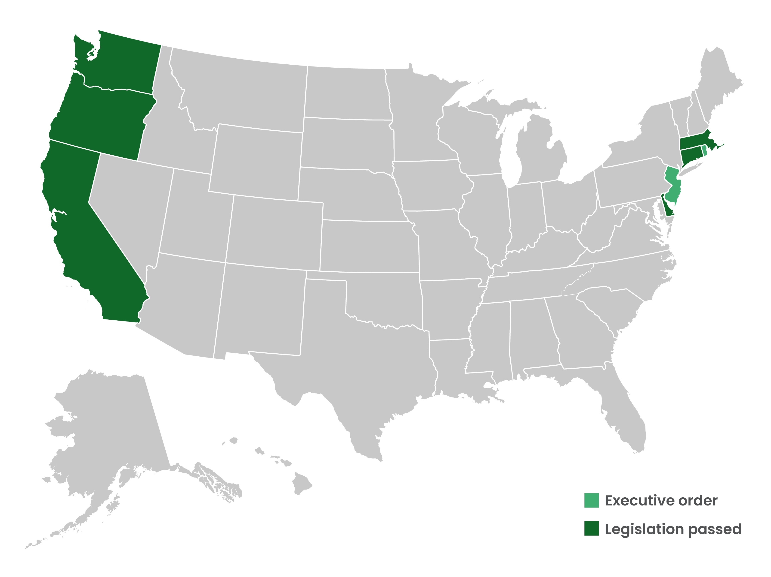
1 in 5 Americans Live in a State With a Cost Growth Target

Slide 18
A Playbook for Implementing a State Cost Growth Target
Playbook available at https://www.milbank.org/publications/making-health-care-more-affordable-a-playbook-for-implementing-a-state-cost-growth-target/

Slide 19
Thank you

