Slide 1
Making Health Care More Affordable
The State Health Care Cost Growth Target Playbook
Bailit Health

Slide 2
The Peterson-Milbank Program for Sustainable Health Care Costs
Working with the Peterson Center on Healthcare, the Milbank Memorial Fund, with Bailit Health, is providing technical assistance to Connecticut, New Jersey, Oregon, Rhode Island, and Washington over two years. These states have set targets for per-capita growth in total health care spending statewide, as well as identifying which factors are driving the most cost growth. This work is designed to inform accountability measures that will make health care more affordable for states, employers, especially small business, and households.

Slide 3
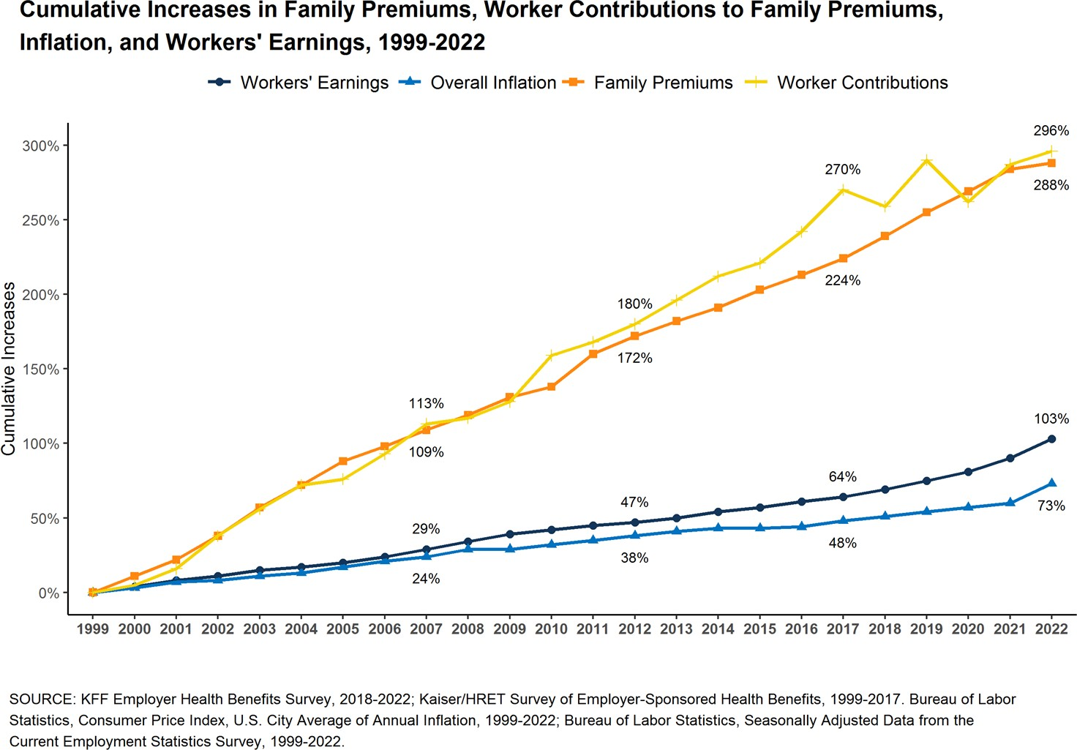
States Face a Growing Health Care Affordability Crisis
Health care costs have grown faster than the economy for decades
Rising costs burden states, employers, and families
COVID reinforced the need to rein in health care cost growth

Slide 4
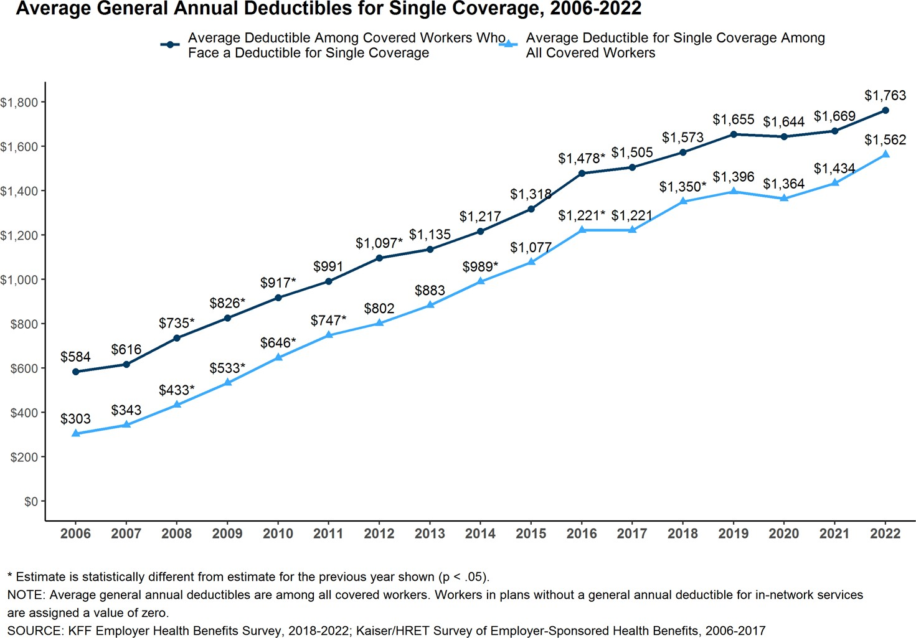
Fragmented solutions haven’t tamed the trends
Sector-specific solutions:
Lack a holistic understanding of health care spending and what is driving unsustainable increases
Shift, rather than decrease, costs
Are no match for health care consolidation, which drives up prices faster

Slide 5
A State-Led Solution: Health Care Cost Growth Target Programs

Slide 6
What is a cost growth target?
Cost growth target: An expectation of how much per capita total health care spending in the state should grow annually. A public-private approach to improving affordability that sets an annual target value for health care cost growth tied to the economy and/or income growth.
Cost growth target program: Establishes the infrastructure necessary to gather data, publishes spending performance against the target, analyzes the data, and proposes shared solutions to address drivers of health care costs.

Slide 7
Understanding cost growth targets
What it is
A series of practical steps to gain insight into statewide health care spending, informed by actual state experience
A forum for all stakeholders to identify issues and discuss solutions
An opportunity to develop a complete picture and drill down to speciﬁc causes and impacts of spending growth.
A approach designed for long-term use and impact
What it is not
A one size-ﬁts-all approach that every state should implement in the same way.
A government-run system. Addressing health cost growth is a shared responsibility for government and industry.
An excuse to cut beneﬁts and services

Slide 8
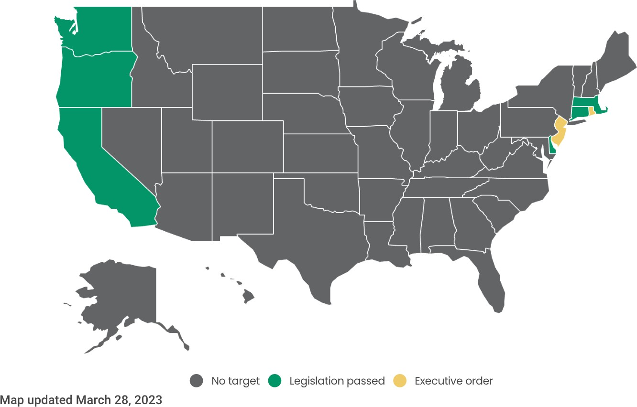
What states have cost growth targets?

Slide 9
How can you create a cost growth target program?
The Playbook for Implementing a Cost Growth Target includes:
A roadmap for program design and implementation for states.
Concrete steps, practical tools, best practice strategies, and insights to guide states through the work.

Slide 10
Six Activities and Steps to Implement a Health Care Cost Growth Target

Slide 11
Overview of Implementation

Slide 12
1. Program Planning, Development & Sustainability
Approaches to Authorizing a Cost Growth Target Program
Determine the appropriate vehicle for authorizing the program
Seek participation from all sectors to guide policy and program administration
Build a core program management team
Lay the foundation for future sustainability

Slide 13
2. Public-Private Stakeholder Engagement
Explain the health care cost growth targets
Identify goals for stakeholder engagement
Develop a strategic communications plan
Establishing the Target Methodology & Value
Identify a target methodology and calculate the value
Determine the target duration and any adjustments to the methodology or value
Monitor the conditions that might call for revisiting the target methodology or value

Slide 14
4. Measuring Performance Against the Target

Slide 15
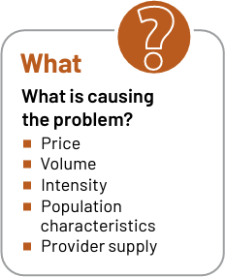
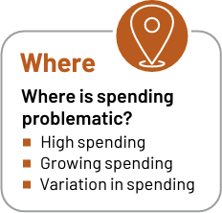
5. Understanding the Drivers for Spending Growth
6. Accountability & Action to Slow Spending Growth
Consider accountability mechanisms for meeting the target
Build the structure to hold entities accountable
Pursue strategies to mitigate cost growth and help meet the target

Slide 16
Oregon's Cost Growth Target

Slide 17
Oregon's Accountability Measures to Slow Cost Growth
Market Oversight
In 2021, Oregon passed a bill directing the Oregon Health Authority (OHA), which administers the state’s target program, to also oversee “material change transactions,” which include mergers, affiliations, and acquisitions of a certain size. The framework for OHA’s review includes the impact of such transactions on the state’s ability to achieve its target.

Slide 18
For more information
Visit the Peterson-Milbank Program for Sustainable Health Care Costs website
Read the complete Playbook for Implementing a State Health Care Cost Growth Target

