Slide 1
Using Data to Identify Priorities
Peterson-Milbank Program for Sustainable Health Care Costs
February 3, 2023

Slide 2
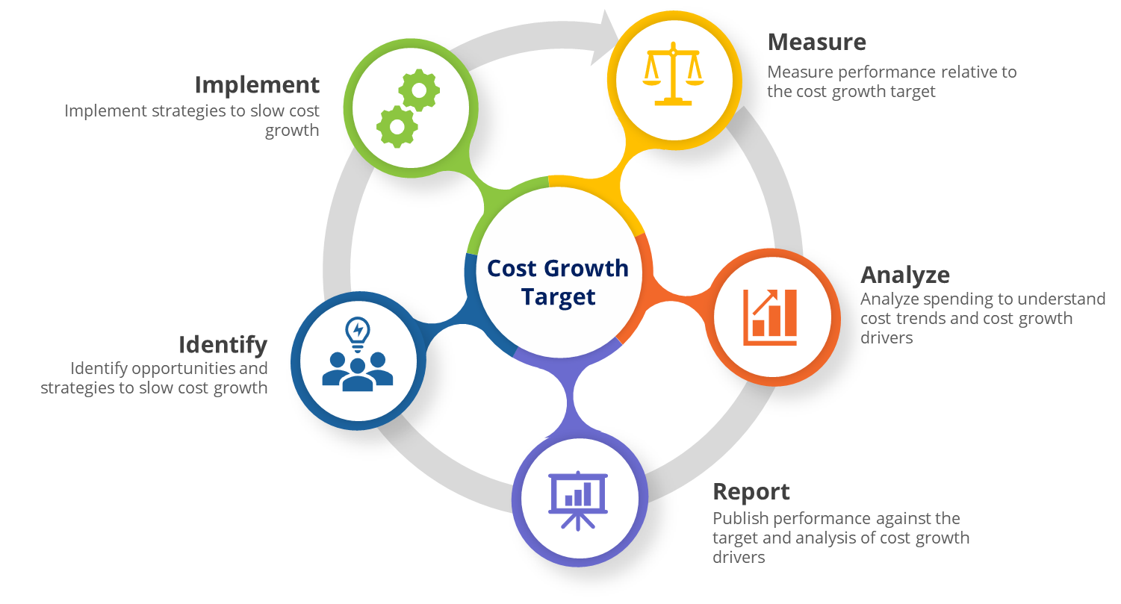
How might we use analysis to drive action?
We often focus on the what and how for each individual component
E.g., how do we calculate and measure cost growth performance?
Today, we’ll hear how states are building analytic capacity
But, also about the tactics for using these analyses to drive stakeholder engagement, buy-in, and action
Cost growth target logic model and process

Slide 3
How might we effectively use analysis to drive action?
Today’s session
Sarah Bartelmann | How Oregon’s findings are supporting opportunities to address pharmacy cost growth
Malinda Southard | Nevada’s analysis with state employees and Medicaid claims and their findings on pharmaceutical prices
Cory King | New Rhode Island dashboards that help the state drill down into drivers of health care costs
Q&A with state participants
Sample discussion questions
What role does analytics play in your state's stakeholder engagement and policymaking process?
When in the analytics process (e.g., design, review of initial findings, final results) is stakeholder engagement beneficial?
How can states use specific tactics to leverage analysis for decision-making and consensus?

Slide 4
Using Data to Identify Priorities: work in progress at Oregon’s Cost Growth Target Program
February 3, 2023 | Sarah Bartelmann
Notes:
Short description of notable details (i.e. answer the “what” -- motivation, data source, entity conducting analysis)
1-2 slides with most important findings
Explanation about the significance of the findings, including what next steps the analysis may support
Description of the role of stakeholder engagement in the analysis (e.g., how were findings shared with stakeholder leaders?)
Reflections / next steps (e.g., recommendations / tactics for other states to leverage analytics for action)

Slide 5
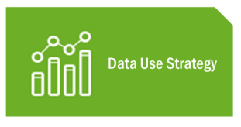
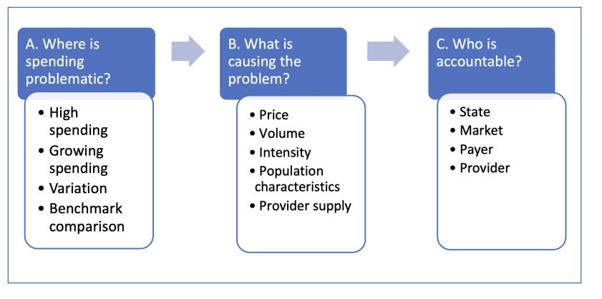
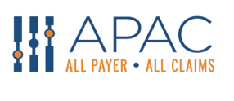
Inputs
Cost Growth Target Logic Model
Committee recommended goals & principles for analysis
Framework for Data Use Strategy Analyses
Resources
Amazing in-house analyst team!
Oregon’s APCD database
Notes:
Short description of notable details (i.e. answer the “what” -- motivation, data source, entity conducting analysis)

Slide 6
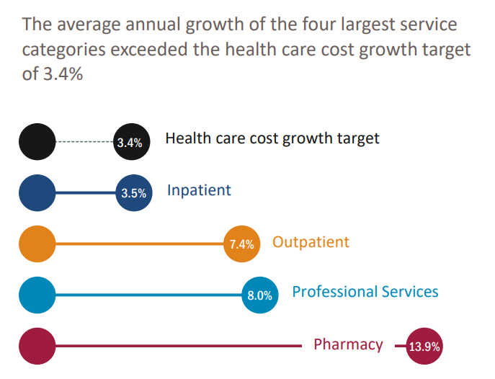
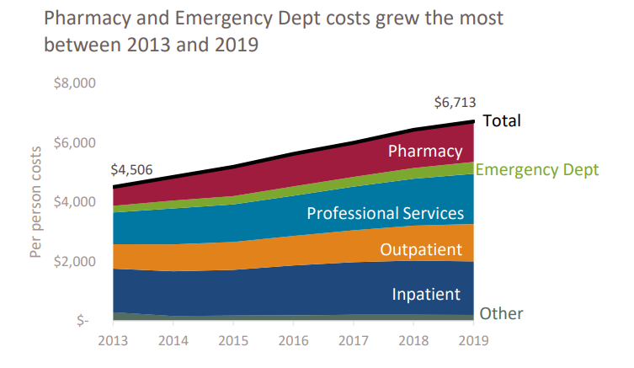
Initial analysis of health care cost growth: we assumed hospital spending would be the #1 driver
Initial analysis
https://www.oregon.gov/oha/HPA/HP/Cost%20Growth%20Target%20documents/Oregon-Health-Care-Cost-Trends-Report-2013-2019-FINAL.pdf
Notes:
1-2 slides with most important findings
Explanation about the significance of the findings, including what next steps the analysis may support

Slide 7
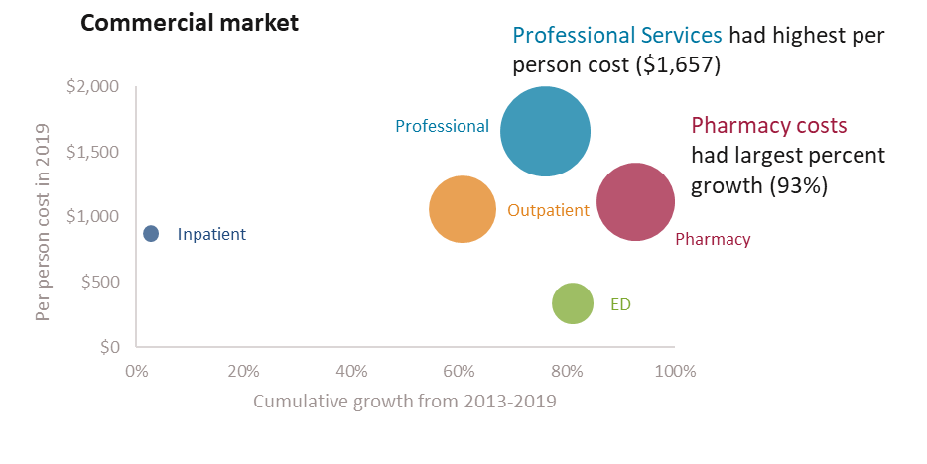
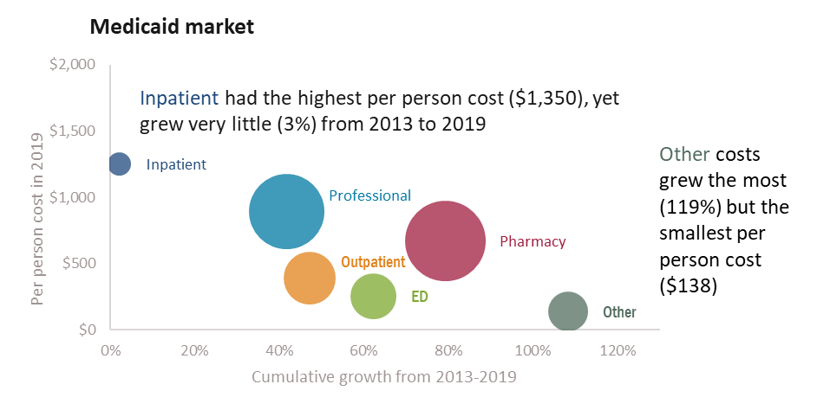
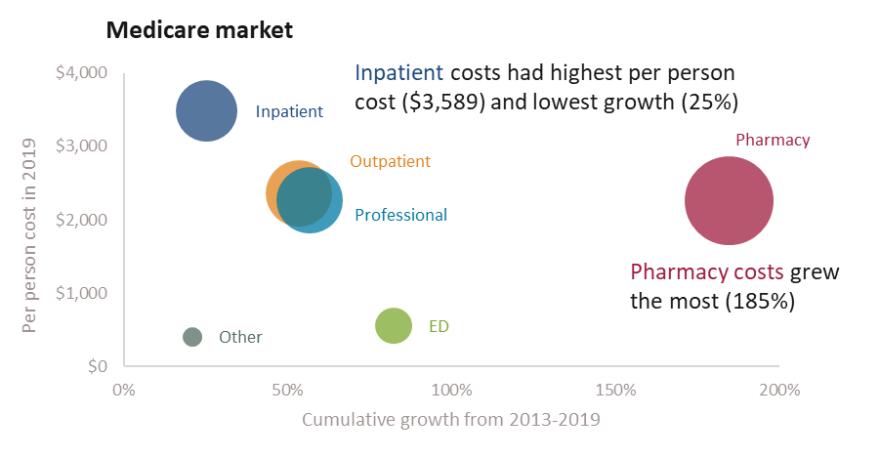
Pharmacy costs were a main driver of Oregon cost growth between 2013 - 2019, in all 3 markets
Pharmacy cost analysis does not take pharmacy rebates into account.

Slide 8
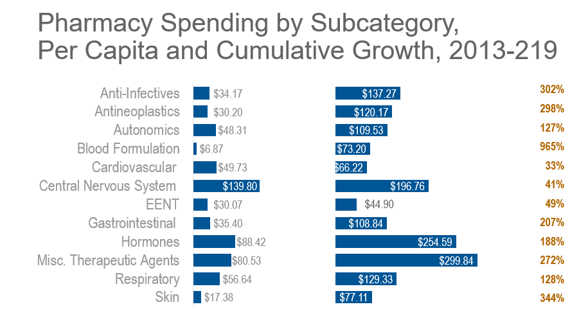
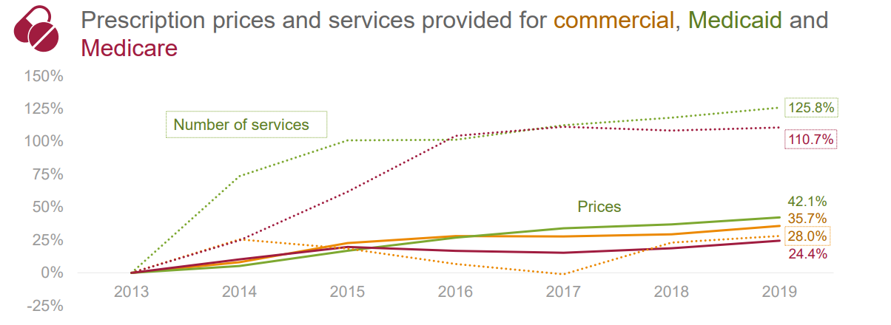
The CGT Advisory Committee asked for more details on pharmacy spending
Price and utilization analysis, by market
Subcategory analysis
Notes:
Supplemented this with presentations and data from Oregon’s Prescription Drug Price Transparency Program

Slide 9
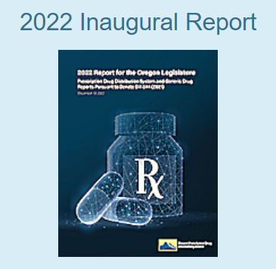
The Advisory Committee voted in January 2023 to endorse the recommendations made by Oregon’s Prescription Drug Affordability Board
https://dfr.oregon.gov/pdab/Documents/reports/PDAB-Report-2022.pdf
These recommendations will be included in an upcoming bill in Oregon’s legislative session.
Notes:
Implement Upper Payment Limits
Require PBMs and group purchasing to report aggregated rebates and other payments from manufacturers annually to the Drug Price Transparency program.
Require all manufacturers to report annually on all patient assistance programs they maintain or fund
Expand drug spending reporting to all state regulated health insurance carriers in Oregon
Require patient advocacy groups to disclose their industry funding sources.

Slide 10
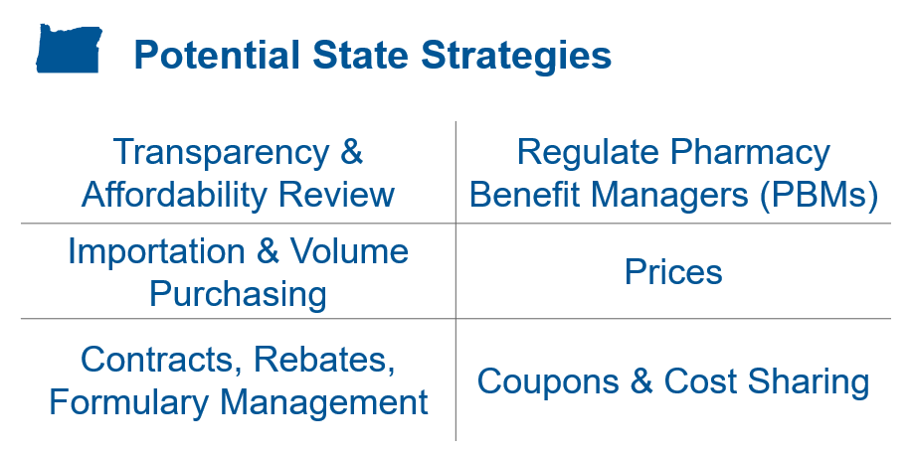
The Advisory Committee is considering additional opportunities to address pharmacy cost growth
Sept 2022 – initial overview of potential strategies
Feb 2023 – survey to prioritize strategies
March – Nov 2023 – consideration of strategies additional analysis may be requested
Dec 2023 – Committee recommendations
Notes:
Regulating PBMs is a hot topic for Oregon’s 2023 legislative session

Slide 11
We are considering additional analyses to support the Committee’s conversation this year, including:
An analysis of patient cost sharing for retail pharmacy, including by pharmacy subcategory and specific drugs
An analysis of medical pharmacy spending
Exploring claims-based analyses of practices like whitebagging and brownbagging
Using cost growth target program data submissions to better understand the impact of pharmacy rebates, and reporting pharmacy spending gross and net of rebates
Notes:
In partnership with Prescription Drug Price Transparency Program, PDAB, and our OHA pharmacy team / ArrayRx, drug utilization review, etc.

Slide 12
For More Information
For More Information
Email:
HealthCare.CostTarget@oha.oregon.gov
sarah.e.bartelmann@oha.oregon.gov
Website:
https://www.oregon.gov/oha/HPA/HP/Pages/Sustainable-Health-Care-Cost-Growth-Target.aspx

Slide 13
Patient Protection Commission
Nevada Health Care Cost Driver Analyses
Peterson-Milbank State Virtual Meeting
Malinda Southard, Executive Director
February 3, 2023

Slide 14
Summary of Nevada Cost Driver Analysis Strategy
While Nevada has legislation directing the development of an APCD, the APCD is not yet developed.
As a result, Nevada completed initial cost driver analyses using claim data from Medicaid and the Public Employees Benefits Program (PEBP).
Nevada is using PEBP data as a proxy for the commercial market. This is reasonable because of the size of the population (53,955 covered lives in 2021). Still, it should be noted that public employee populations tend to be older and hence sicker than the commercial market as a whole.
Notes:
Background info – 54k covered lives is a “decent” size population. And HAVE to use it because can’t pull data from APCD!

Slide 15
Summary of Nevada Cost Driver Analysis Strategy
Initial “Phase 1” analyses for 2016-2020 were completed in April 2022, and updated in December 2022 to include 2021 data.
During 2022, Medicaid and PEBP performed “Phase 2” “drill down” analyses to better understand what has been driving cost growth.
Today we will briefly review analyses from the Nevada PEBP and Medicaid Phase 1 and 2 analyses, and how Nevada has used and will use these analyses with its Patient Protection Commission to inform cost growth mitigation strategy development.

Slide 16
Overall Cost Growth Trends
Average annual rate of PMPM spending growth
Average annual PMPM spending growth was much higher in PEBP than in Medicaid.
The average annual trends for PEBP and Medicaid include the unusual dip in utilization in 2020 due to COVID, and the 2021 rebound in PEBP across all service categories except for ancillary.
Note –
Medicaid experienced a continued decrease in PMPM utilization in 2021 due primarily to the significant increases in Medicaid membership as a result of the federal pause on eligibility redeterminations (under the Public Health Emergency). The 2021 membership includes individuals who have subsequently acquired health care coverage elsewhere, such as through their employers, but have maintained Medicaid enrollment.
PEBP (2018-2021) | Medicaid (2017-2021) | Medicaid (2019-2021)
4.2% | 1% | -1%
Notes:
Sources: PEBP report (p. 7) and Medicaid phase 1 update (spreadsheet)
Broke out Medicaid trends because of unusual dip in Medicaid trends due to PHE, and is pulling down the 2017-2021 trend. Huge ballooning of the covered population, a bunch were getting services using commercial insurance but were included in denominator.

Slide 17
Leading Cost Growth Drivers for PEBP
By looking at service category, we can better understand where spending is growing fastest for PEBP: professional and pharmacy.
*Prescription drug rebates have not significantly impacted recent trends in overall pharmacy spend.
Service category | Absolute PMPM Spend (2021) | 2018-2021 Avg. % Change
Inpatient hospital | $154.69 | 3.9%
Outpatient hospital | $135.07 | 1.9%
Professional | $95.47 | 6.4%
Ancillary | $10.39 | 6.2%
Pharmacy (gross) | $125.22 | 9.0%
Pharmacy (net of rebates)* | $100.67 | 8.3%
Notes:
Source: PEBP report (pp. 19 & 46)
Methodology for service categories:
Inpatient – all claims where point of service (POS) represents an inpatient facility, such as Inpatient Hospital, Skilled Nursing Facility, Inpatient Psychiatric Facility or Inpatient Rehab Facility
Outpatient – all claims where POS represents an outpatient facility, such as emergency room, urgent care, outpatient hospital or ambulatory surgical center
Ancillary – all claims where POS represents home, hospice or ambulance
Professional – all other claims, include those where POS represents an office or clinic
Of note, prescription drug rebates do not appear to have had a significant impact on recent trends in overall pharmacy spend. (move back up to slide)
Professional is defined a little differently from Segal for PEBP = any prof spending associated with a hospital service, they put into HOSPITAL. This is professional spend in non-hospital settings = is unusual.
Pharmacy is #1 and is RETAIL pharmacy – at CVS, Walgreens, mail order – is NOT drugs administered by a doctor or in a clinic where they have to inject the patient. They measured a “unit” of pharmacy as one claim.
While the 8-9% rates aren’t even as high as in some other states….

Slide 18
PEBP Pharmacy Spend Drill Down
To better understand what is driving growth in pharmacy spend, the analysis looked at spending trends for different types of prescription drugs.
Prescription drug PMPM costs (net of rebates)
Drug type | Allowed PMPM (2021) | Allowed PMPM Average Trend (2018-2021)
Generic | $16.42 | -3.3%
Brand | $26.67 | 12.5%
Specialty | $57.81 | 11.3%
Total | $100.67 | 8.3%
Notes:
Source: PEBP report (p. 50)
Also just for PEBP – because the PMPM for PEBP was so much more than for Medicaid, just focused on PEBP for the following slides.
Break down trend by drug type – seeing highest growth in brand and specialty (same as in other states)
Preferable to use net of rebates data when we have that available.
“allowed” includes both the amount the insurer paid and patient obligation.
1 here is overall trend, next slide is utilization, next slide is price.

Slide 19
PEBP Pharmacy Spend Drill Down: Utilization
The analysis then looked at the separate roles of change in utilization and in payment per service unit (“price”) within each type of prescription drug.
Utilization (days of therapy/ 1,000 lives)
Drug type | Days of Therapy (2021) | Average Annual Trend (2018-2021)
Generic | 324,618 (88.4% of total) | 4.6%
Brand | 37,458 (10.2% of total) | -1.7%
Specialty | 5,146 (1.4% of total) | 7.9%
Total | 367,221 | 3.9%
Notes:
First we look at utilization here (price is next slide).
Volume of generics is very high in comparison to specialty – specialty are super expensive and so a growth here is a problem
Generics comprised such a high amount of utilization but a low amount of overall trend

Slide 20
PEBP Pharmacy Spend Drill Down: Price
Price (allowed per day of therapy)
Drug type | Allowed amount (2021) | Average Annual Trend (2018-2021)
Generic | $0.61 | -7.6%
Brand | $13.32 | 12%
Specialty | $157.29 | 4.8%
Total | $4.10 | 4.8%
Notes:
Source: PEBP report (p. 52)
Note, these prescription drug costs do not reflect the value of manufacturer rebates.
Brand and specialty are high
Specialty had significant decrease in 2021 which is impacting overall trend – regardless, brand and specialty are still increasing in price

Slide 21
PEBP Pharmacy Spend Drill Down Takeaways
In recent years, growth in commercial pharmacy spending has been driven by increases in both price and utilization, with price growth contributing slightly more.
In 2021, generic drugs represented 88% of total days of therapy, but only 13% of total spending.
Price growth for brand and specialty drugs has been driving spending growth.
This includes both year-over-year high rates of price growth, plus new specialty drugs being introduced at very high prices.
Notes:
But only xx percent of spending

Slide 22
Consideration of Pharmacy Strategies
Based on the April 2022 cost driver findings, the PPC is currently considering strategies to address pharmaceutical prices for PEBP and the broader commercial market.
NASHP has modeled the impact of international reference pricing and will be presenting on reference pricing and PBM regulation strategies at the PPC’s next meeting.
Updated analyses with data through 2021 will be presented to the PPC in March to further inform consideration of pharmacy cost growth mitigation strategies.
Notes:
Key message – how using data to inform policy work to slow spending growth.
Nevada having access to Bailit health and analytics resources is a HUGE benefit – emphasizes the importance of this program!

Slide 23
Rhode Island Health Care Cost Trends Cost Driver Analysis Demonstration
Peterson-Milbank State Virtual Meeting
Cory King, Acting Health Insurance Commissioner
February 3, 2023

Slide 24
Rhode Island’s Cost Driver Analysis Strategy
Rhode Island began analysis of APCD data in the first year of its cost growth target program (2019).
From 2019-2021, a series of ad hoc analyses gave insight into factors influencing health care spending in the state in the commercial, Medicaid and Medicare markets.
During 2022, Rhode Island developed an internal-facing set of interactive dashboard reports that support “drill-down” analysis and can be updated each year.
Today we will briefly review a sample of analyses the dashboard affords Rhode Island, and how it can inform cost growth mitigation strategy development.

Slide 25
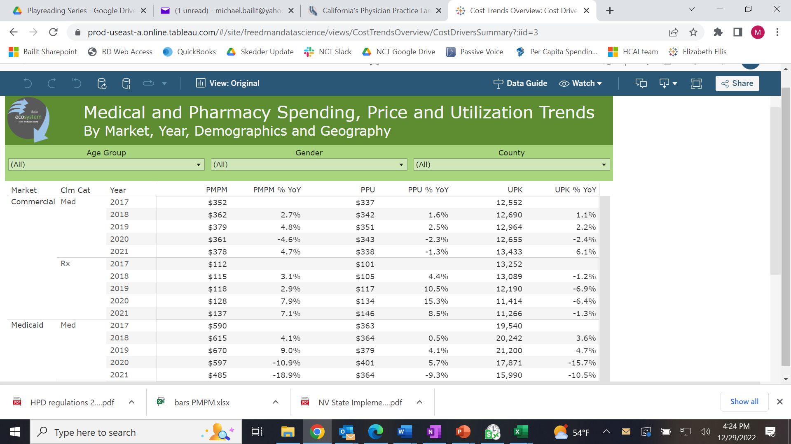
Cost Drivers Summary
This report provides a high-level view of five-year spending trends by market.
Importantly, it looks at the separate roles of utilization and payment per service unit (“price”).
Notes:
PPU = payment per unit
UPK = units per 1000
For pharmacy, a unit is defined as a 30-day equivalent fill.

Slide 26
Cost Drivers by Service Category
By looking at service category, we can better understand where spending is growing fastest.
Retail pharmacy, long-term care and other claims are currently the other assessed service categories.

Slide 27
Drilling Down
Based on the service category-level findings within a market, Rhode Island can decide where to drill down to better understand what is driving cost growth.
Because it is clear that retail pharmacy was the most significant cost driver in the commercial market between 2017 and 2021, we chose to focus analysis here to better understand the source of that growth.

Slide 28
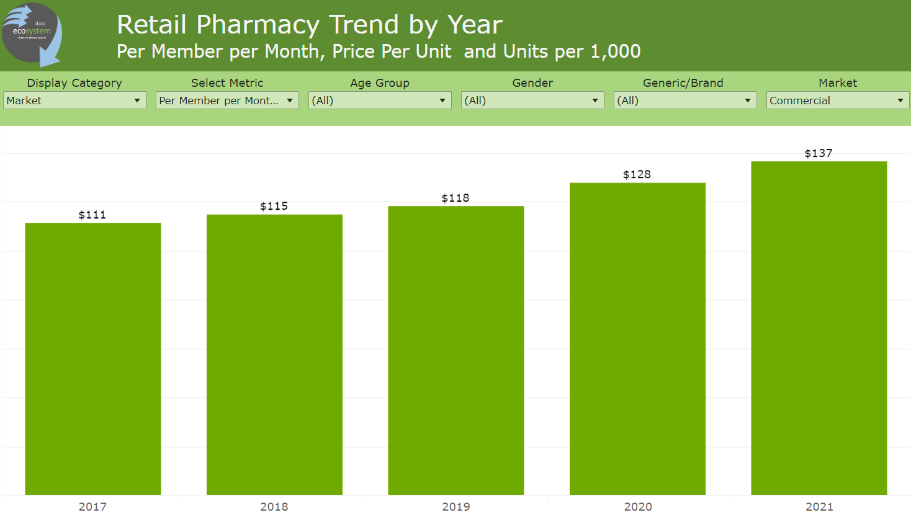
Pharmacy Spending
When we look at retail Rx PMPM spending, we see an avg annual increase of 5.4%
When we isolate brand drug spending, however, a different picture appears…

Slide 29
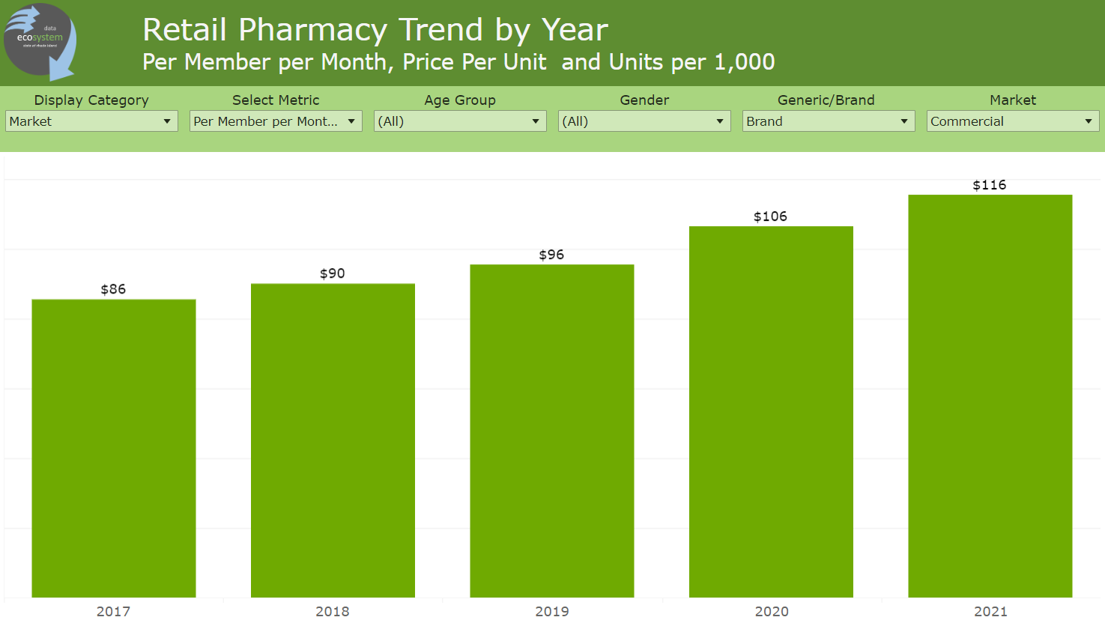
Pharmacy Spending: Brand Drugs Only
Brand drug trend averaged 7.8% per year from 2017-21.
This is approximately three times the rate of median household income growth.

Slide 30
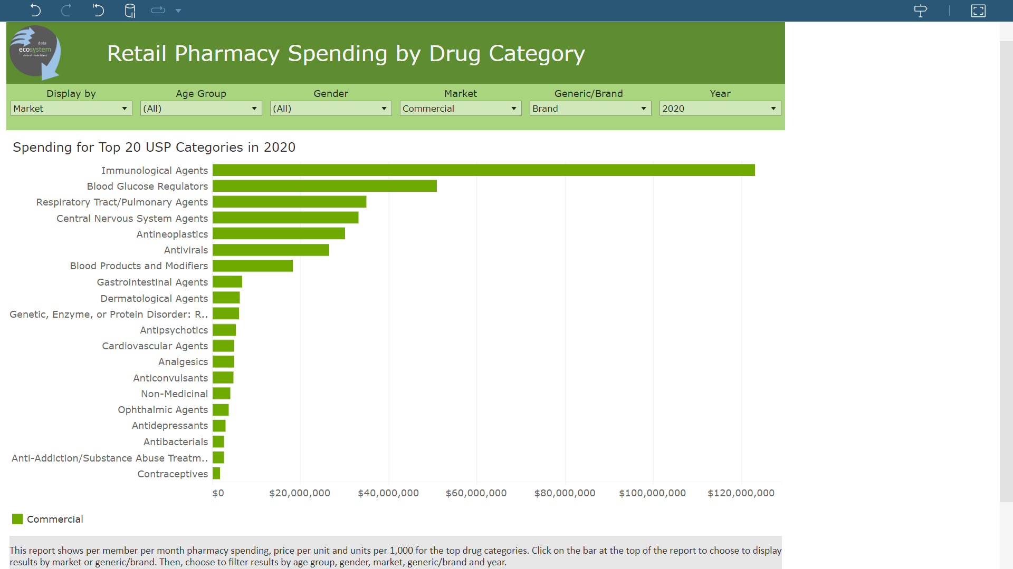
Where was brand drug spending highest?
We can look at brand drug spending for the most recent two years to see where spending was highest by drug category.
Seven categories accounted for almost all 2020 spending; immunological agents was by far #1 with $123M.

Slide 31
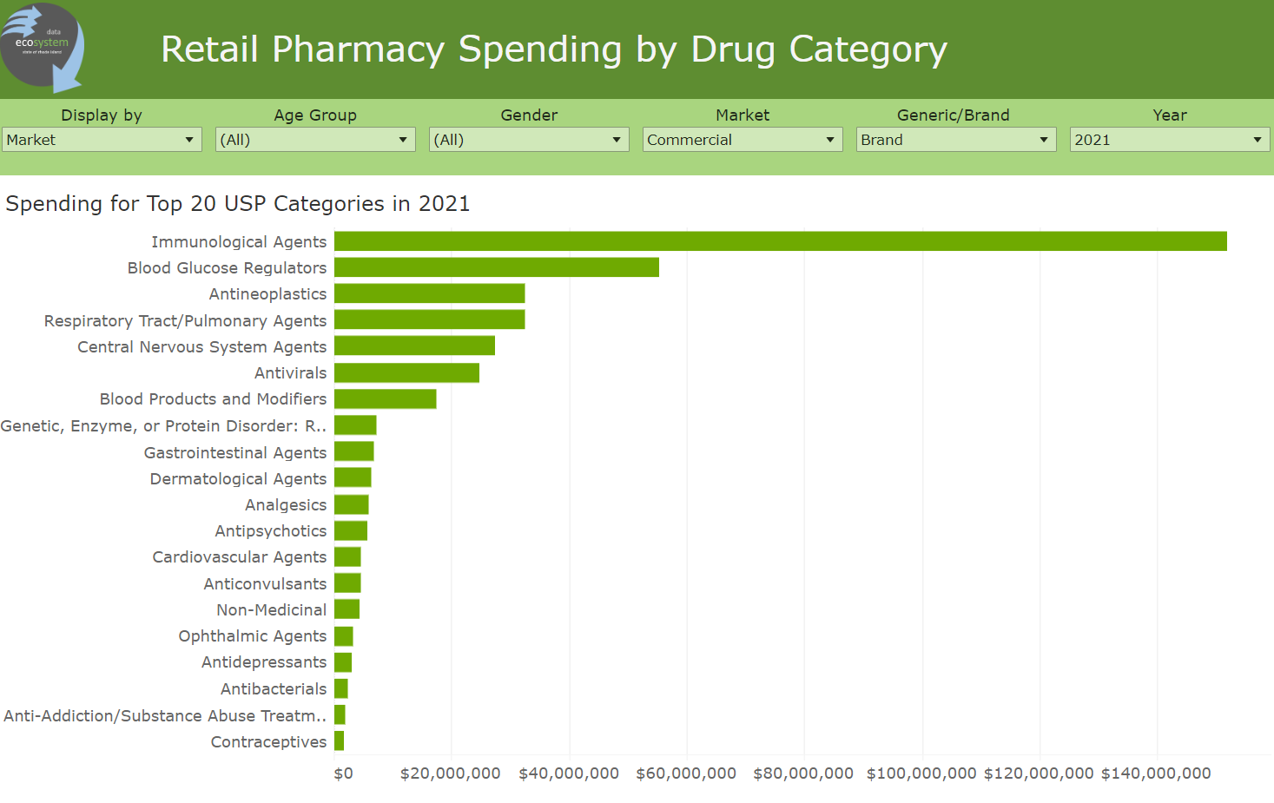
Where was brand drug spending highest?
While the distribution changed some across categories in 2021, the same categories accounted for most spending; immunological agents was again by far #1, but now $152M.

Slide 32
A closer look at these drug categories…
Drug Class | 2017 Spend | 2021 Spend | 2017-21 Spend Growth
Immunological Agents | $74M | $153M | 107%
Blood Glucose Regulators | $39M | $56M | 44%
Respiratory Tract / Pulmonary Agents | $27M | $45M | 67%
Antineoplastics | $21M | $40M | 90%
What is going on here?
Average annual increases in spending of 11% to 27%.
Commercial enrollment during this time period declined, so these increases are even higher on a PMPM basis.

Slide 33
A closer look at these drug categories…
Drug Class
2021 Spend
2017 PPU
2021 PPU
Units/1000
Units/1000
Cost Driver
Immunological Agents
$153M
$1842
$629
116
675
Volume (up 481%)
Blood Glucose Regulators
$56M
$188
$226
645
702
PPU (up 20%), Volume (up 9%)
Respiratory Tract /
$45M
$99
$123
888
821
PPU (up 24%)
Pulmonary Agents
Antineoplastics
$40M
$606
$835
129
120
PPU (up 38%)
What is going on here?
Increased Payment per Unit (PPU) appears to be the primary cost driver. Utilization is declining for two categories and up slightly for a third.
The enormous volume increase for Immunological Agents warrants investigation.

Slide 34
What happened with immunological agents?
How did volume jump 481% and price drop by almost two-thirds?
COVID-19 vaccines caused this phenomenon.
The combined 2021 utilization was 587 per 1000, with an average payment per dose of $41. (There were no such vaccines in 2017!)
If we remove COVID-19 vaccines, payment per unit grew significantly for this drug category.

Slide 35
A closer look at these brand drugs…
Drug Class | Drug | 2021 Spend | % of Drug Category Brand Spend | Cumulative % of Drug Category Brand Spend
Immunological Agents | Humira (cf) Pen | $34M | 22%
 | Stelara | $21M | 14%
 | Enbrel Sureclick | $10M | 7% | 42%
Blood Glucose Regulators | Trulicity | $9M | 16%
 | Jardiance | $7M | 13%
 | Januvia | $4M | 7%
 | Ozempic | $4M | 7% | 43%

Slide 36
A closer look at these brand drugs…
Drug Class | Drug | 2021 Spend | % of Drug Category Brand Spend | Cumulative % of Drug Category Brand Spend
Respiratory Tract / Pulmonary Agents | Trikafta | $7M | 16%
 | Symbicort | $3M | 7%
 | Advair Diskus | $3M | 7%
 | Xolair | $2M | 4%
 | Breo Ellipta | $2M | 4% | 38%
Antineoplastics | Revlimid | $11M | 28%
 | Ibrance | $7M | 18%
 | Imbruvica | $5M | 13%
 | Sprycel | $4M | 10% | 68%

Slide 37
Now let’s look even closer at spend on leading immunological agent brand drugs
Drug
2017 PPU & units/1000
2021 PPU & units/1000
PPU
Δ
2017
-
21
Units/K
Δ
2017
-
21
Humira (
cf
) Pen
Not on the market
$6,801 15
20% (since 2019)
66% (since 2019)
Stelara
$10,515 2
$15,231 4
45% (11% per
yr
)
200%
Enbrel
Sureclick
$4,472 7
$5,909 6
32% (8% per
yr
)
-
14%
Humira Pen
$4,996 14
$6,304 3
26% (7% per
yr
)
-
79%
What is going on here?
Very high prices per unit for this category of drugs
High annual price increases, especially for drugs with growing market share

Slide 38
Now let’s look even closer at spend on leading respiratory tract / pulmonary agents brand drugs
Drug
2017 PPU & units/1000
2021 PPU & units/1000
PPU
Δ
2017
-
21
Units/K
Δ
2017
-
21
Trikafta
Not on the market
$23,025 2
-
3% (since 2019)
New to mkt in 2019
Symbicort
$291 31
$330 30
13% (3% per
yr
)
-
3%
Advair
Diskus
$353 27
$382 26
8% (2% per
yr
)
-
4%
Xolair
$2,660 2
$2,425 3
-
9%
50%
Breo
Ellipta
$313 10
$355 21
13% (3% per
yr
)
110%
What is going on here?
A new drug to treat cystic fibrosis with a very high price point – 69x higher than the second highest revenue drug in the category – pushed up spending while other prices were flat or even declining.
Notes:
https://www.fda.gov/news-events/press-announcements/fda-approves-new-breakthrough-therapy-cystic-fibrosis

Slide 39
So what have we learned?
While prior year policy initiatives have effectively restrained hospital spending growth, retail pharmacy pushes commercial spending up year over year.
This brief data analysis demonstrates that prices of relatively small number of brand name drugs have been a significant contributor to this trend. These drugs have contributed to price growth in two different ways.
Market introduction at extremely high prices.
Average annual price increases at unaffordable rates.
Rhode Island’s next challenge will be to devise a way to address this significant cost driver. Our challenge, is shared by other states in this respect…

Slide 40
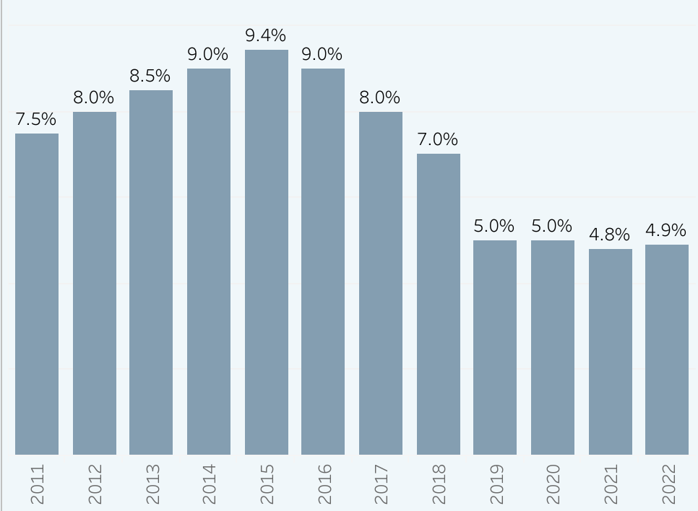
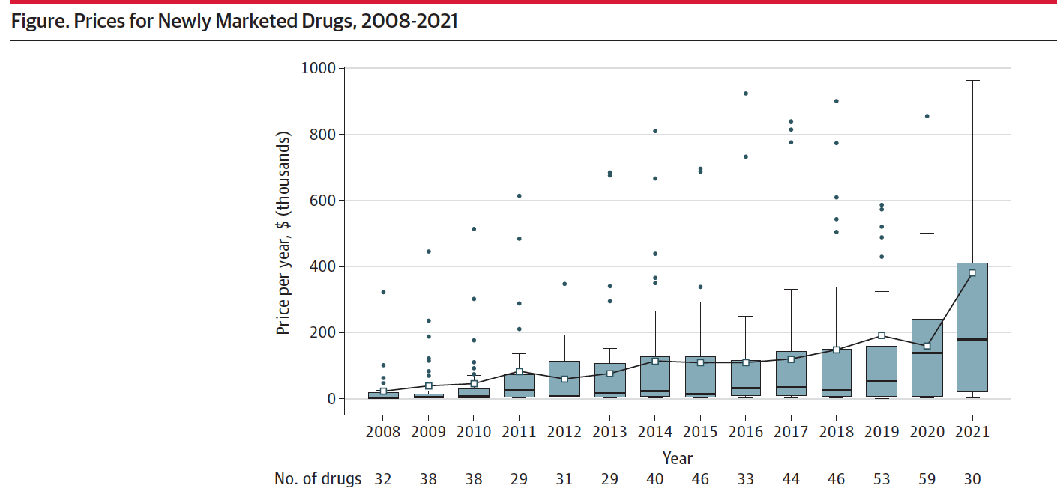
National Trends Reflect RI Findings:
Price Increases Moderate, Launch Prices Rise
Median Percentage WAC Increase on Brand-name Drugs
Average Launch Prices Increased by 20% per year
Source: National Academy for State Health Policy

