Slide 1
Rhode Island Health Care Cost Trends Steering Committee
October 26, 2020

Slide 2
Agenda
Welcome
Brief project funding update
Highlights from Brown’s analyses of pharmacy spending, review of policy options and recommendations for action
Value-based payment
Upcoming Steering Committee meetings
Agendas/workplan
2021 meeting frequency
Public comment
Next steps and wrap-up

Slide 3
Brief project funding update

Slide 4
Brief project funding update
During our August meeting, we shared that the state budget was in flux due to the pandemic and that project staff were discussing continency plans with the Peterson Foundation, but limited funding would result in a decrease in the project’s scope.
The Governor’s proposed funding mechanism via an assessment has had hearings in both the House and Senate. The State FY 21 budget may be voted on in November of 2020, amid uncertainty associated with revenues and deficits.
We are grateful that a few weeks ago, the Peterson Foundation approved a revised project scope and budget for project funding until August of 2021.
The RI Foundation has also agreed to fund the development of a communications strategy for both internal and public stakeholder engagement.

Slide 5
Highlights from Brown’s analyses of pharmacy spending, review of policy options, and recommendations for action
Note for the Steering Committee: This presentation includes the full materials shared for the 10/23 public meeting. Only a subset of these slides will be presented during the Steering Committee meeting.

Slide 6
Agenda
Drug Costs: Retail Pharmacy and Medical Pharmacy Costs
Pharmaceutical Costs as Drivers of Total Cost
Pharmaceutical Costs as Drivers of Cost Trends
Utilization vs Price
Retail Pharmacy Costs: Deeper Dive
Medical Pharmacy Costs: Deeper Dive
Conclusions

Slide 7
Retail and Medical Pharmacy Costs

Slide 8
Pharmacy Costs
“Retail Pharmacy” costs or spend: refers to prescription medicines purchased in retail pharmacies
“Medical pharmacy” costs or spend: refers to prescriptions administered in providers’ offices and hospitals
Less appreciated by many as a part of the overall drug spend
Appears in claims files as part of “Professional Services”
Identified by “J Codes”
Growing rapidly

Slide 9
Drivers of Total Cost

Slide 10
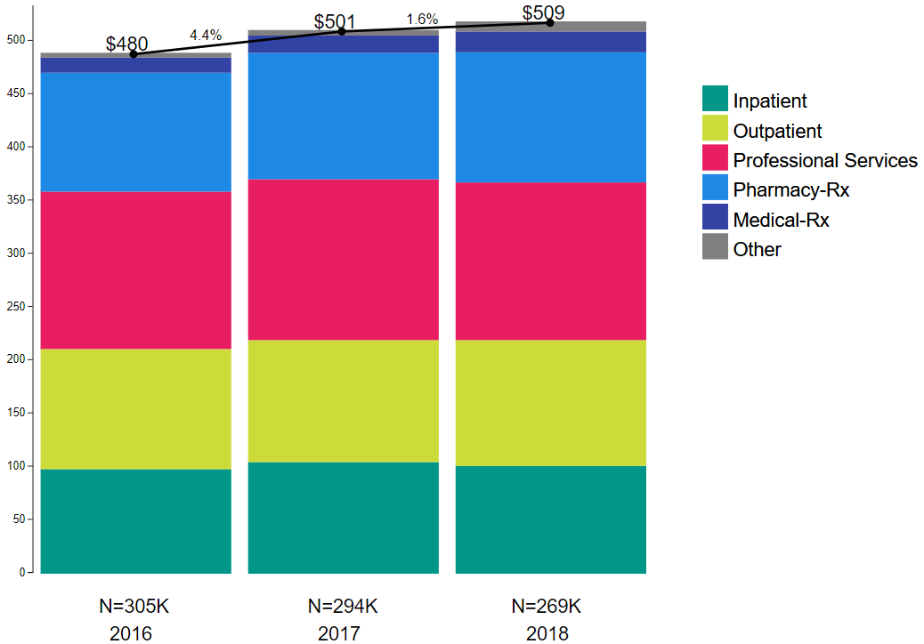
Total PMPM:
Commercial Insurance
Note: these numbers are similar – but not identical – to the aggregate numbers you saw presented earlier.

Slide 11
% PMPM: Commercial Insurance
Retail Pharmacy + Medical Pharmacy = significant and growing fraction of total PMPM

Slide 12
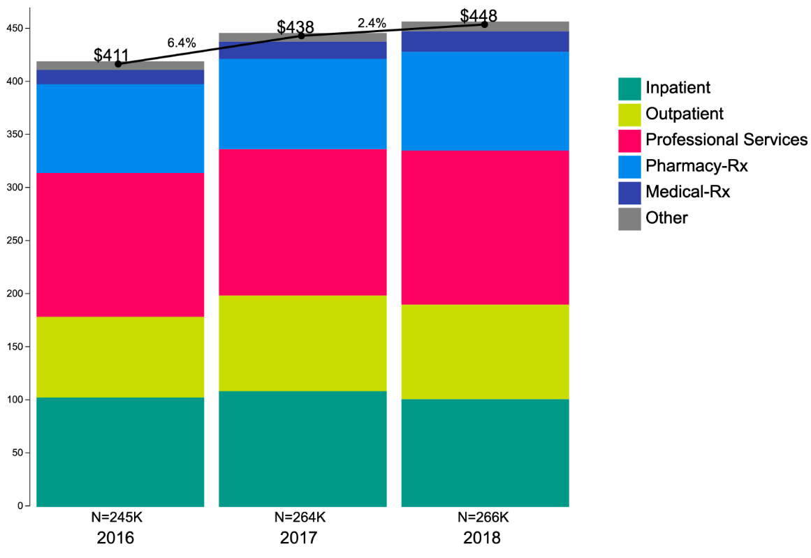
Total PMPM:
Medicaid MCO
Note: these numbers are similar – but not identical – to the aggregate numbers you saw presented earlier.

Slide 13
% PMPM: Medicaid MCO
Retail Pharmacy + Medical Pharmacy = significant and growing fraction of total PMPM

Slide 14
Drivers of Total Cost Trend

Slide 15
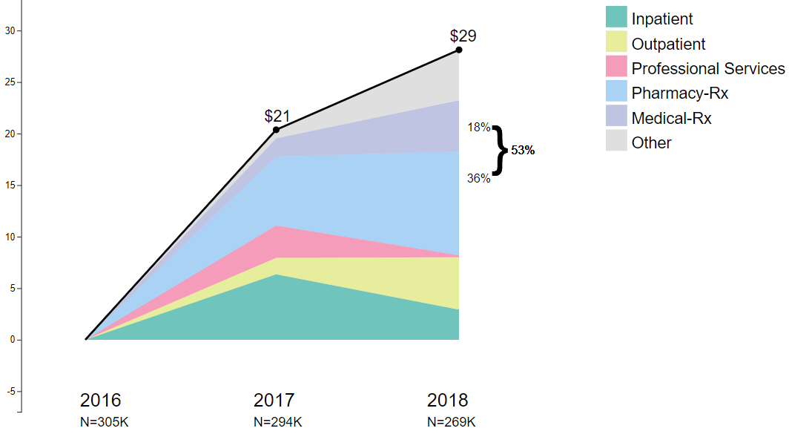
Cumulative Change in PMPM ($) since 2016
Drivers of Trend:
Commercial Insurance
53% of cost increase = retail & medical pharmacy

Slide 16
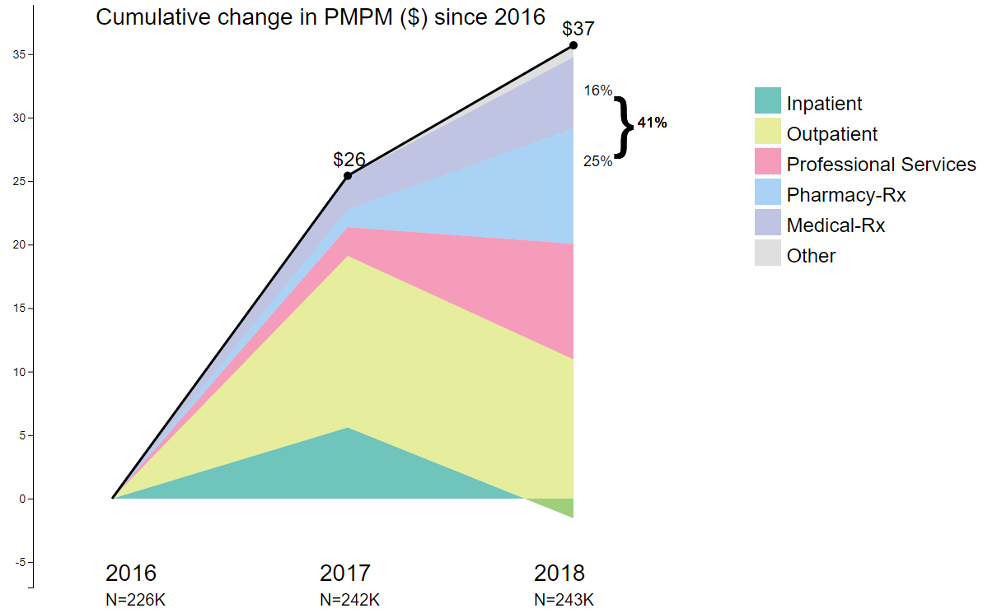
Cumulative Change in PMPM ($) since 2016
Drivers of Trend:
Medicaid MCO
41% of cost increase = retail & medical pharmacy

Slide 17
Utilization vs. Price

Slide 18
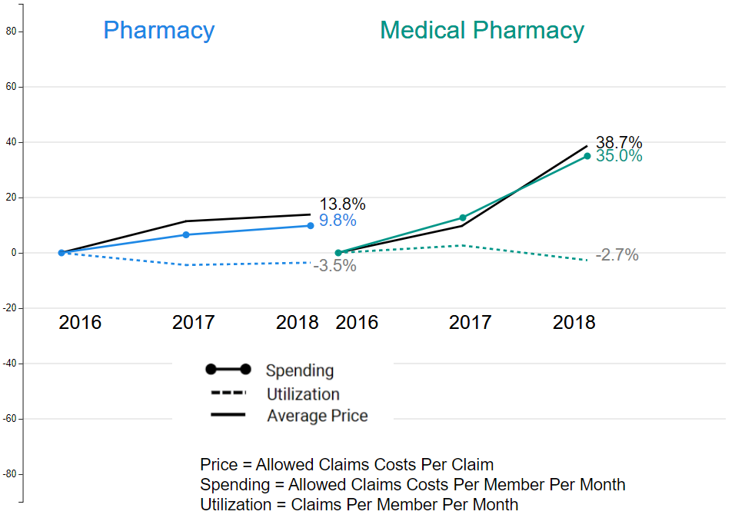
Commercial: Utilization vs. Price

Slide 19
Commercial: Utilization vs. Price
Cost increases driven by price, particularly in medical pharmacy, where utilization actually trended downward 2017-18

Slide 20
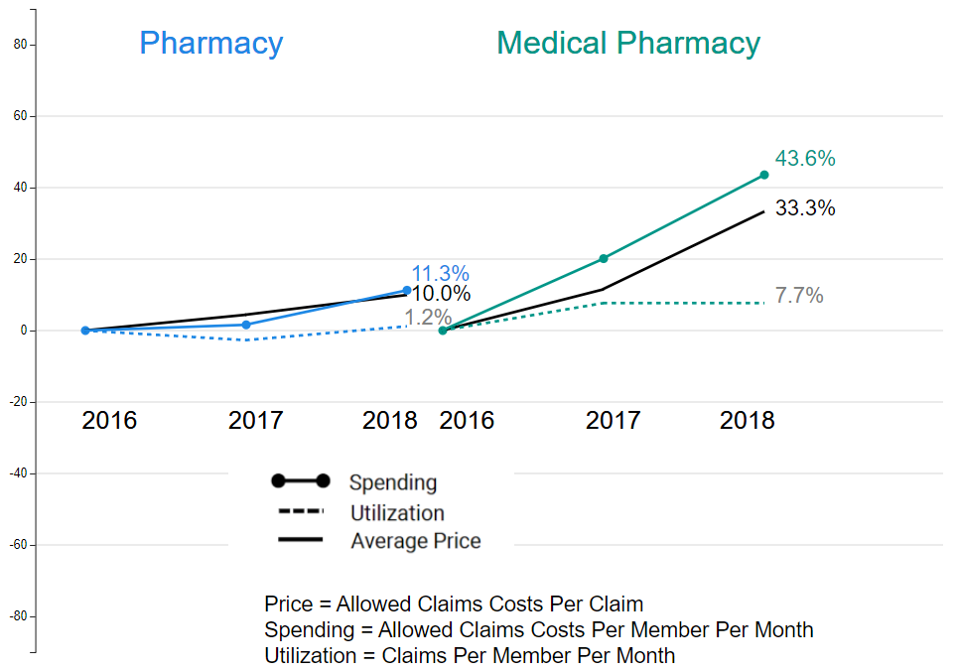
Medicaid MCO: Utilization vs. Price

Slide 21
Medicaid MCO: Utilization vs. Price
Cost increases driven mostly by price, particularly in medical pharmacy

Slide 22
Retail Pharmacy Costs: Deeper Dive

Slide 23
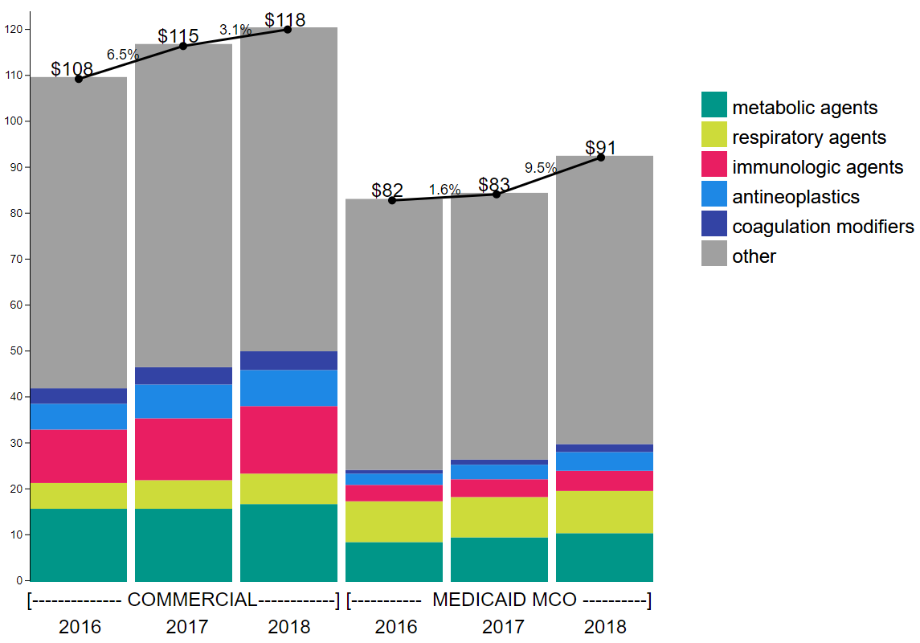
Total Cost, Top 5 Drug Classes in color (of 18 classes)

Slide 24
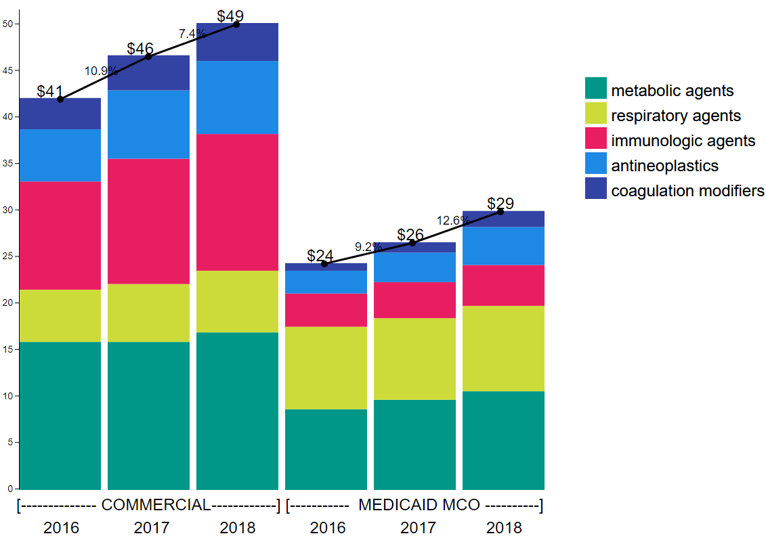
Total Cost: Top 5 Drug Classes

Slide 25
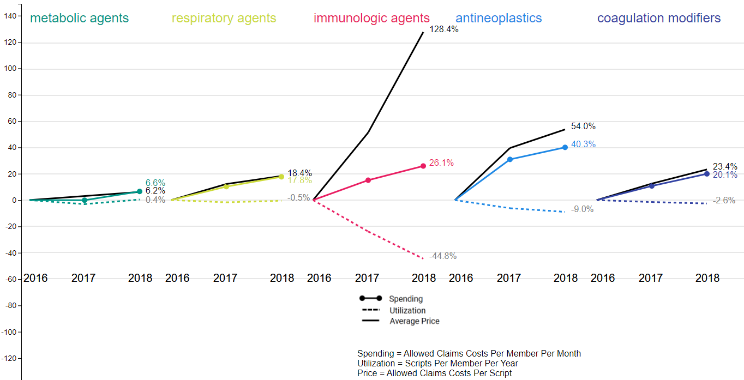
Commercial Top 5 Classes: Utilization vs. Price
Price increases are dramatic

Slide 26
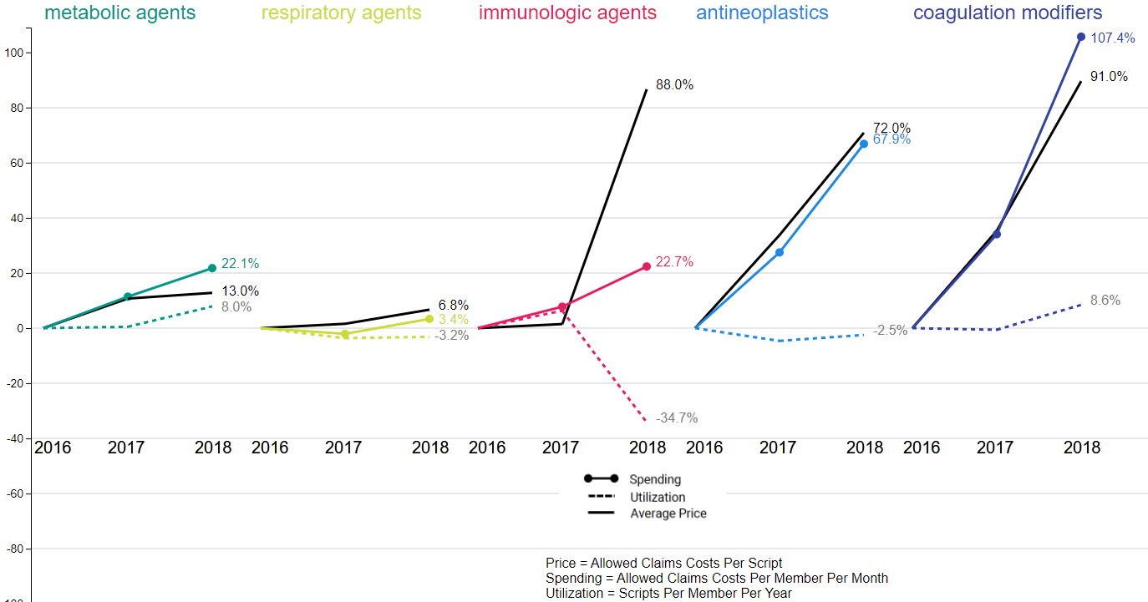
Medicaid MCO Top 5 Classes: Utilization vs. Price
Price increases are dramatic

Slide 27
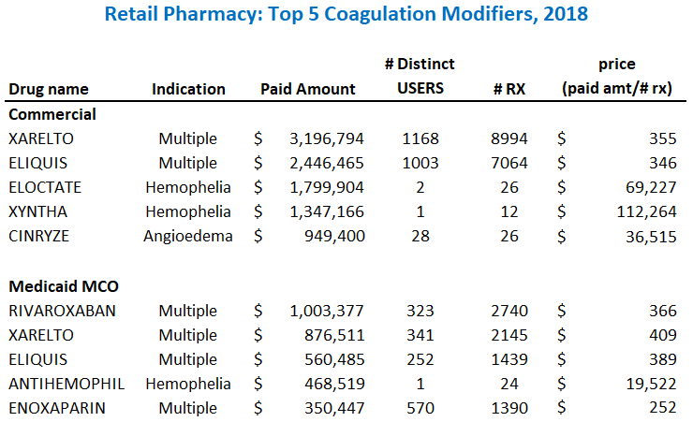

Slide 28
Some drugs are moderately expensive per dose, but used by relatively large numbers of patients

Slide 29
Other drugs are extremely expensive and used by very few patients

Slide 30
Medical Pharmacy: Deeper Dive

Slide 31
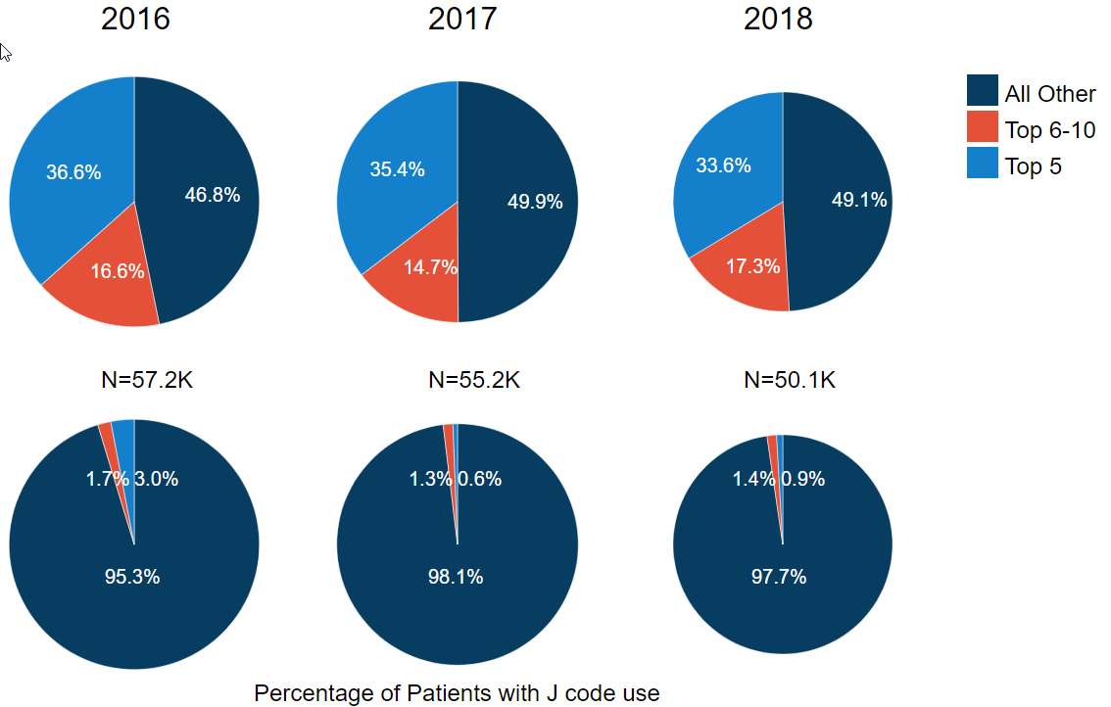
Commercial
% of Medical Pharmacy Spend: Top 10 Medications
More than half of the spending is on the top 10 drugs

Slide 32
Commercial
% of Medical Pharmacy Spend: Top 10 Medications
Small % of beneficiaries use these top 10 medications

Slide 33
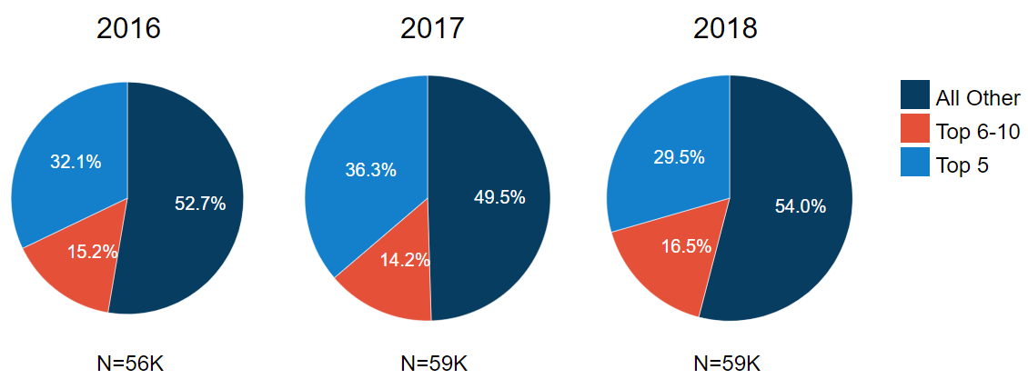
Medicaid MCO
% of Medical Pharmacy Spend: Top 10 Medications
Just less than half of the spending is on the top 10 drugs

Slide 34
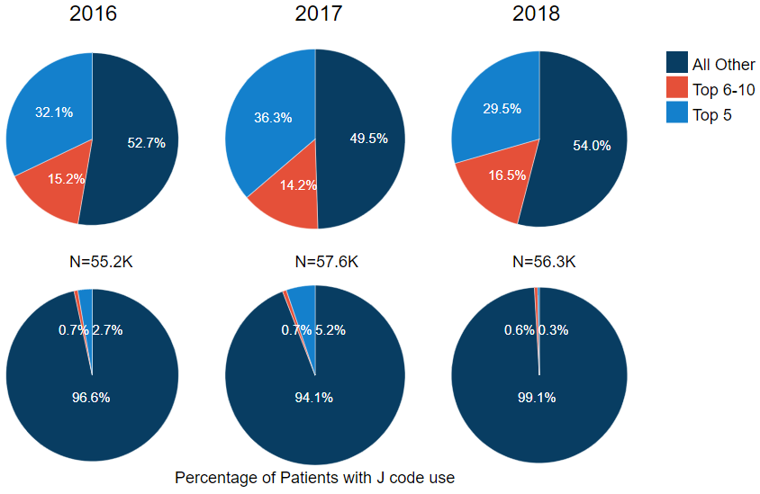
Medicaid MCO
% of Medical Pharmacy Spend: Top 10 Medications
Small % of beneficiaries use these top 10 medications

Slide 35
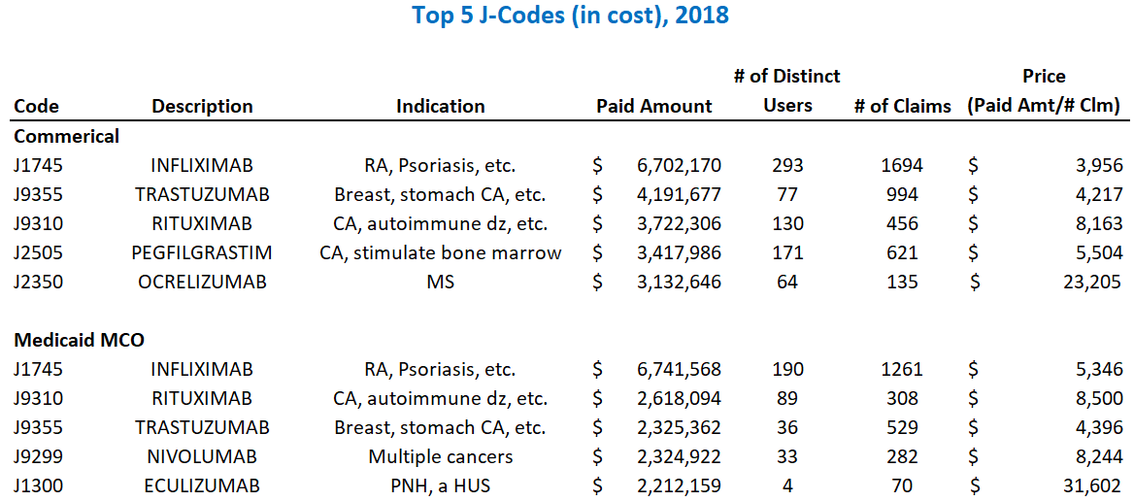

Slide 36
Medical Pharmacy
Dramatic price increases
Large portion of medical pharmacy spend is on a small number of very expensive drugs used by a few beneficiaries

Slide 37
Conclusions

Slide 38
Data Considerations
Commercial data does not include claims from self-insured employers who elected not to submit, and claims from BCBS MA
Total cost data excludes non-claims-based payments
Data excludes manufacturer rebates, which vary in magnitude from 10% to 20% of total pharmacy costs
If we adjusted for rebates, it would reduce the costs that we show

Slide 39
Conclusions
Pharmaceutical costs are an important contributor to both costs and trends in costs
Medical pharmacy is an important component of total pharmacy costs and should be monitored closely
Price, not utilization, is what is driving cost increases
Interventions to control pharmaceutical prices are needed

Slide 40
Policy options to address pharmacy spending
As a reminder, our data use strategy outlines the importance of reviewing findings of analyses to identify possible actions to address identified opportunities.
Policy solutions could include collaborative quality improvement activity, use of regulatory levers, introduction of legislation, among other options.
During the public meeting, Trish Riley recommended the following strategies:
Assess penalties on manufacturers identified in annual ICER report as having a drug with an unsupported price increase
Develop an international reference rate using Canadian prices for a list of the 250 drugs costing the state the most
Panelists reacted to these proposals and recommended additional potential policy options to address pharmacy spending.
We will review these recommendations and then ask you for your recommendation for actions to address rising pharmacy spending.

Slide 41
Option #1: Penalties for Unsupported Price Increases
Background:
The Institute for Clinical and Economic Review (ICER) produces an annual report identifying the drugs with unsupported price increases outpacing 2x medical inflation that are the greatest drivers of net spending
Unsupported price increases = unjustified by new clinical data
What:
State tax authority is used to assess penalties on manufacturers identified in annual ICER report as having a drug with an unsupported price increase
Penalties = 80% of excess revenues (i.e., revenue from unsupported portion of price increase)
Manufacturers must report information on total sales revenue in the state to the Tax Assessor to determine the penalty owed
Impact: Because ICER’s analysis targets drugs with the greatest impact on net spending, penalties can result in millions in revenue for a state -- revenue that the Model Act specifies must be used to offset costs to consumers

Slide 42
Option #2: International Reference Rates
Why:
Foreign countries pay a fraction of what Americans pay for prescription drugs
Rate setting is a common approach in the health care sector – one that can be extended to setting rates for prescription drugs
International prices offer a fair, easy-to-implement approach to rate setting
What:
Develop a list of the 250 drugs costing the state the most
The state references Canadian prices
The lowest price becomes the international reference rate for payers in the state
Impact: This model act can greatly lower prescription drug spending in a state - without running afoul of patent law through price setting.

Slide 43
Panel reactions and recommendations
Panelists expressed interest in further examining:
ICER analyses of drugs with unsupported price increases
Lessons learned from the Rhode Island opioid tax when considering taxing drugs with unsupported price increases
Senator DiPalma’s legislation to create an assessment on payers to help pay for high cost specialty drugs; these would be purchased by the State through negotiations with manufacturers
Prohibition of coupons or ensuring that all, including the uninsured, can access coupons
Overall, the issue is complicated and there is room for action through legislation, regulation, and employer choice.
But in taking action it is important to consider potential unintended consequences.

Slide 44
Panel reactions and recommendations
Specific considerations include:
Clinical Feasibility: Levers may be different for older drugs versus newer drugs that are still under patent protection
Accessibility: It is important to consider what impact these policies may have on access to ensure that there is not an impact on access for Rhode Islanders (as seen with the opioid tax)
Self-funded Plans: Make sure policies don’t encourage markets to move to self-funded plans through voluntary inclusion; consider opportunities to link access to lower prices with self-funded plan data submission to the APCD (Gobeille?)
Uninsured: Any policies created need to help the uninsured as well as those covered by insurance
Impact on Consumers: Should reference prices be used, any legislation should consumers from paying the difference

Slide 45
Discussion
Does the Steering Committee wish to act to advance either of Trish Riley’s strategies, or other ideas discussed by the panel?
Are there other pharmacy strategies of interest to Steering Committee members?
What is the Steering Committee’s recommendation for specific next steps to address rising pharmacy spending?

Slide 46
Value-based payment

Slide 47
Methods to slow cost growth
The primary objective of the Cost Trends project is to slow health care cost growth and thereby improve affordability for consumers, employers and state government.
One method the Steering Committee has adopted to support cost growth target attainment is to mine APCD data to identify cost drivers and cost growth drivers, and then devise strategies to address them.
A second potential approach is to identify and advance broad-based strategies that may impact overall cost growth without targeting one contributor in particular.
Advanced valued-based payment is one such strategy the co-chairs have suggested.

Slide 48
Value-based payment
Advanced value-based payment models are defined here to mean arrangements with:
a prospectively defined budget with retrospective reconciliation and meaningful shared risk or a prospectively defined budget with prospective payment, and
financial consequences for quality,
These VBP models can align delivery system financial incentives with slowed cost growth and motivate substantial changes in care delivery.
For this reason, OHIC’s Affordability Standards have targeted increased adoption of value-based payment (aka alternative payment models).
For the same reason, Oregon’s equivalent of this Steering Committee has prioritized its collaborative work to further adoption of advanced VBP models.

Slide 49
OHIC Affordability Standards (selected text)
Health insurers shall take such actions as necessary to have fifty percent (50%) of insured medical payments made through an alternative payment model by January 1, 2021, and annually thereafter.
The Commissioner shall issue a policy and guidelines manual by January 1 of each year that specifies the types of payments and payment models which may be credited toward the fifty percent (50%) target.
By January 2021, health insurers shall take such actions as necessary to have thirty percent (30%) of Rhode Island resident commercial insured covered lives attributed to a risk-sharing contract or global capitation contract.
Risk-sharing contracts with ten thousand (10,000) or more attributed lives shall meet the Minimum Downside Risk requirements of this § 4.10(D)(2)(d) of this Part.

Slide 50
OHIC Affordability Standards (selected text)
By January 1, 2021, at least ten percent (10%) of insured Rhode Island resident covered lives shall be attributed to a prospectively paid primary care alternative payment model.
Health insurers with thirty thousand (30,000) or more covered lives
shall develop and implement new specialist alternative payment model contracts, and/or
expand existing alternative payment model contracts with clinical professionals in the following specialties:
Orthopedics;
Gastroenterology;
Cardiology;
Behavioral health; and
Maternity, Endocrinology, or other clinical specialties selected by the health insurer.
For each specialty, the health insurer shall develop or expand at least two (2) contracts.

Slide 51
Oregon VBP principles (selected text)
Advanced value-based payment models are a critical strategy to contain costs to meet the established health care cost growth target. The appropriate advanced value-based payment models may look different across the state, but implementation should be guided by these principles.
Providers, particularly those paid on a fee-for-service basis, face unique challenges due to the ongoing COVID-19 pandemic. Increasing the use of advanced value-based payment models will help stabilize Oregon’s health system.
Prospective budget-based and quality-linked payment, where a provider is paid up front for a population of patients and a predefined set of services, should be the primary payment model utilized wherever feasible
Payers should have the following percentage of their payments to primary care practices and general acute care hospitals made under advanced value-based payment models, (HCP-LAN 3B and higher) in the following time periods:
25% by 2022
50% by 2023
70% by 2024

Slide 52
Recommended course of action
OHIC has established clear directive to commercial insurers for expanded use of value-based payment for fully insured business.
Does the Steering Committee believe that it should take any collective action in this direction to support future cost growth target attainment?

Slide 53
Plan for upcoming meetings

Slide 54
Brown performs analytics to evaluate cost and cost growth drivers
Cost Trends Project Team reviews analysis and provides feedback to Brown
Brown revises analysis to reflect Cost Trends Project Team feedback
Brown presents findings to the Steering Committee
OHIC, EOHHS and the Governor’s Office publish findings and planned strategies
OHIC, EOHHS and the Governor’s Office review recommendations internally and follow up with Steering Committee, as needed
Steering Committee make recommendations on how to address findings
Governor’s Office, OHIC, EOHHS, other Executive Branch agencies, employers, payers and providers take both independent and collaborative action as a result of the findings and strategies
Development of performance metrics to assess progress
Brown task
KEY
Project Team or State task
Steering Committee task

Slide 55
Next two meetings
The co-chairs recommend that project spend 2021 focusing on analyses on areas identified as cost drivers to focus on what’s driving the costs and actions that can be taken by payers, providers and policy makers.
Meeting | Agenda
December (12/7) | Follow-up to pharmacy spending strategy discussion Targeted analyses of professional spending by insurer and ACO Payer and provider size for public reporting of 2019 results
February (date TBD) | Presentation of 2019 cost trend performance against target Continued discussion of professional spending analysis and discussion of implications for action

Slide 56
2021 meeting frequency
We now have cost driver and cost growth driver to inform discussion of project and policy opportunities for the state.
The co-chairs think it may make sense to increase the frequency of meetings to discuss these options but want to be sensitive to the time asked of Steering Committee members.
Does the Steering Committee support moving to a monthly meeting schedule in 2021, or does it wish to retain a bimonthly meeting schedule?

Slide 57
Public comment

Slide 58
Next steps

Slide 59
Upcoming meeting
Steering Committee Meeting
When: December 7th from 9:00 am – 11:00 am
Topics:
Follow-up to pharmacy spending strategy discussion
Targeted analyses of professional spending by market, insurer and ACO
Plans for public reporting of 2019 results

