Slide 1

Strengthening the Direct Care Workforce in Your State: A Profile of The Direct Care Workforce Policy and Action Guide
Kate McEvoy
Program Officer
Milbank Memorial Fund
May 20, 2022

Slide 2
The Milbank Memorial Fund
Milbank is an over 100-year-old endowed operating foundation that focuses on nonpartisan analysis, collaboration and communication, with an emphasis on state health policy
Our aim is to improve population health by connecting state leaders with trustworthy evidence and experience
Along with work on value-based payment approaches in primary care and state-based cost growth benchmarks, Milbank has more recently been focusing on state policy and practice related to healthy aging

Slide 3
The Widening Gap Between the Direct Care Workforce and Consumer Demand for LTSS
What’s at the root of this problem?
An aging population. By 2030, one in five people in the US will be aged 65 or older.
Needs of people with disabilities. While use of technology and adaptation of environments has helped to address needs, the direct workforce remains a fulcrum point of support.
Diminishing availability of informal care. Economic constraints, changing social dynamics and physical distance among family members are all affecting the capacity of family caregivers to provide needed care.

Slide 4
Underlying Challenges
Racial disparities: Disparities are prevalent for both the substantially BIPOC workforce and for people who receive services.
Stark, long-standing realities laid bare by the pandemic:
  Low wages and lack of fringe benefits (e.g., paid sick time)
  Lack of affordable health care and vehicles for retirement savings
  Little capacity to exert organized political influence
  Lack of clarity/closure around designation as “essential workers”
  Lack of portability of existing certifications across care settings
  Lack of literacy and attention among regulatory agencies around non-licensed home-based and self-directed care
  Absence of standing mechanisms to distribute guidance and PPE

Slide 5


Our theory of change:
Improving the overall economic security of the low-income women who provide direct long-term services and supports will benefit them, advance culture change, expand the pool of available workers, reduce turnover, and contribute to improved quality of care.
States have a range of available administrative, funding, policy and regulatory levers that can be applied in locally relevant ways. ARPA funds reflect a meaningful short-term enhancement to these options.

Slide 6

The Direct Care Workforce Policy and Action Guide
Milbank partnered with the Center for Health Care Strategies to prepare an applied toolkit for state use that acknowledges that:
  The current DCW crisis is multi-dimensional and requires:
    Definition of the problem, through both data and lived experience of those who do the work
    Engagement and active partnering among the involved actors
    Development of a platform for advice, comment, advocacy and sharing of expertise
    Use of an array of levers to improve the overall economic security of the direct care workforce
  Coalitions of state officials, DCWs, as well as private advocacy and other organizations, are uniquely situated to craft state-specific solutions

Slide 7
Today’s Speakers
Courtney Roman, Senior Program Office at the Center for Health Care Strategies
Julia Figueira-McDonough, Consultant to the Blue Shield California Foundation
Clare Luz, IMPART Alliance/Michigan State University
Please post your questions in the chat box and we will address in the Q&A after the presentations.

Slide 8
Direct Care Workforce Policy & Action Guide
Strengthening the Direct Care Workforce in Your State
Courtney Roman, Senior Program Officer, Center for Health Care Strategies
May 20, 2022
Made possible through support from the Milbank Memorial Fund and the Michigan Health Endowment Fund

Slide 9
Who are Direct Care Workers (DCWs)?
There are approximately 4.5 million DCWs across the country
Provide essential services through behavioral health, community mental health, and long-term care systems to support individuals with intellectual/developmental disabilities (I/DD) and older adults in a range of settings, including their own homes
Majority paid through Medicaid, but also Medicare, private insurance, directly by clients, and other funding streams.
Notes:
Thanks so much, Kate. Hello everyone. I’m looking forward to sharing highlights from a new resource that was just released---the Direct Care Workforce Policy & Action Guide. CHCS, IMPART Alliance, and the Milbank Memorial Fund, published this piece with support from the Milbank Memorial Fund and the Michigan Health Endowment Fund. But, before we go through that, I wanted to first spend a few moments level-setting on what we mean by “direct care workers” for the purposes of this discussion today as well as in our Guide.
The term Direct Care Workers (DCWs) refers to individuals who provide essential services through behavioral health, community mental health, and long-term care systems to support individuals with intellectual/developmental disabilities and older adults in a range of care settings and their own homes. Estimates suggest there are around 4.5 million DCWs in the US.
Most DCWs are paid through Medicaid but their services may also be covered by private insurance, Medicare, or directly by their clients. Most also have a core set of responsibilities centered around assisting with hands-on personal care, activities of daily living, rehabilitation, and habilitation.

Slide 10
The Direct Care Workforce Shortage
An aging society and an extremely challenging and unsupported job have led to an unprecedented (though predicted) direct care workforce shortage in our country:
  Estimates suggest that the national turnover rate for DCWs is between 40-60%, home care agencies report in excess of 80%.
  Estimates suggest a shortage of 151,000 DCWs by 2030 and 355,000 by 2040.
Source: PHI. Available at: http://phinational.org/policy-research/key-facts-faq/
Notes:
So, when it comes to the direct care workforce here in the US—we have a major problem. The combination of an aging society and an extremely challenging and unsupported job have led to the current situation where we find ourselves:
Estimates suggest that the national turnover rate for DCWs is between 40-60%, home care agencies report in excess of 80%.
While exact numbers are challenging to calculate, some estimates suggest there will be a shortage of 151,000 DCWs by 2030 and 355,000 by 2040.
Yet, the need for home- and community-based services continues to climb as more and more individuals wish to receive care in their homes.

Slide 11
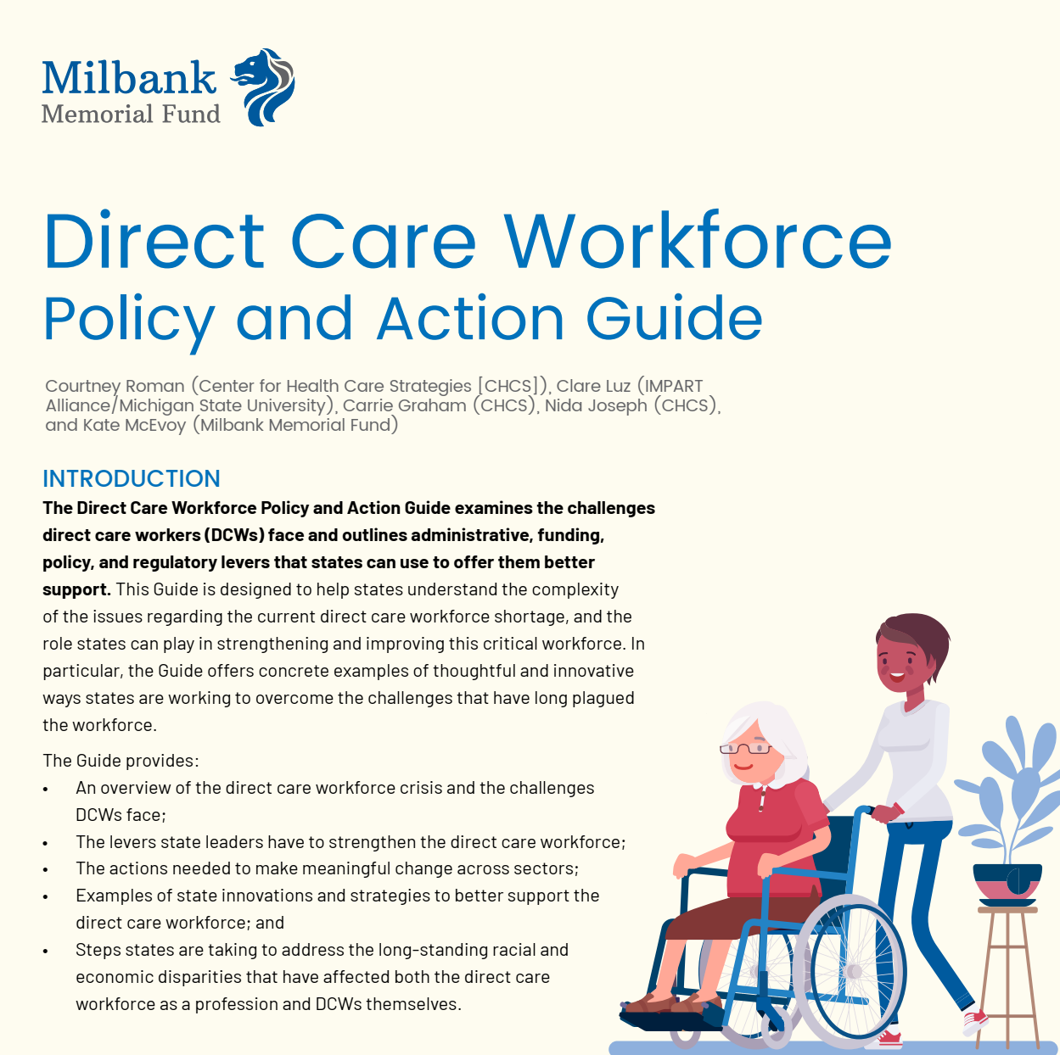
Direct Care Workforce Policy & Action Guide
Developed with support from the Milbank Memorial Fund and Michigan Health Endowment; authored by CHCS, IMPART Alliance, and Milbank:
The Guide includes:
  Overview of the direct care workforce crisis;
  Levers for state leaders to use to strengthen the direct care workforce;
  Action steps to create meaningful change across sectors;
  Examples of state innovations and strategies to better support DCWs;
  Ideas to address racial/ethnic and income disparities experienced by DCWs.
Notes:
So, how can states best move forward? CHCS has developed a Guide specifically designed for state leaders who are committed to strengthening the direct care workforce and looking for ways to broaden existing efforts or even just get started. It’s meant to help states understand the complexity of the issues regarding the current direct care workforce shortage, and the role they can play in strengthening and improving this critical workforce.
The Guide was officially released yesterday and includes:
Overview of the direct care workforce crisis;
Levers for state leaders to use to strengthen the direct care workforce;
Action steps to create meaningful change across sectors;
Examples of state innovations to better support DCWs; and finally….
Ideas to address racial/ethnic and income disparities experienced by DCWs.
Let me tell you more about what I mean by this….

Slide 12
Direct Care Workforce through an Equity Lens
DIRECT CARE WORKFORCE REALITIES
FOCUS IN THE GUIDE
DCWs are mostly women, disproportionately women of color, and immigrants (2.8 million)
DCWs of color earn less than white DCWs. Latina DCWs earn the lowest wages of any group of DCWs
47% qualify for publicly funded programs (SNAP and Medicaid), but many still face economic insecurity
84% do not have access to an employer-sponsored retirement benefit
Call out the inequities faced by the direct care workforce
Highlight states that are starting to address disparities
Illuminate a pathway for all states to do so
Notes:
On the left side of this slide, you will see some of the profound inequities that are within the direct care workforce. DCWs are mostly women, disproportionally women of color, and immigrants. Some estimates suggest more than half (2.8 million) of DCWs are people of color. In terms of wages, Latina DCWs earn the lowest of any group (right around $18,000 annually). These desperately low wages mean that 47% of the direct care workforce qualifies for publicly funded programs, such as SNAP and Medicaid. Further exacerbating the financial crisis, the vast majority do not have access to an employer-sponsored retirement benefit.
In drafting the Guide, there was nothing more important to our team than identifying the inequities within and surrounding the direct care workforce, pulling those out, and highlighting states that are slowly chipping away at these deeply rooted disparities. There isn’t one perfect answer, but you will find the Guide offers concrete examples throughout of states that are making changes, and our aim was to offer other states an opportunity to see that that these important shifts CAN happen. I’ll share some of these examples in a few mins.

Slide 13
State Leadership is Essential to Strengthen the Direct Care Workforce
Levers available to state leadership:
LEVER | EXAMPLES
Administrative | Oversight Regulation Executive Orders
Funding | Medicare Medicaid General Funds American Rescue Plan Act funds CARES Act funds
Legislative | Passing laws that value and protect DCWs Ensuring accountability for implementation of strategies
Notes:
The Guide identifies 3 levers available to develop a coordinated approach to bolstering the direct care workforce, including:
Administrative (e.g., oversight, regulation, and use of Executive Orders);
Funding (e.g., Medicaid rate setting, use of state general funds, American Rescue Plan Act (ARPA) funds, Coronavirus Aid, Relief, and Economic Security (CARES) Act funds, and others; and
Legislative (i.e., passing laws that value and protect DCWs).
In addition to the levers, our team identified 4 key Action Areas to guide states in organizing their efforts.
In the next slides, I’m going to walk through each of these and offer state examples.

Slide 14
Action Area: Increase Wages/Benefits/Supports
Pay a living wage
EXAMPLE: New Jersey and California
Leverage collective bargaining
EXAMPLE: Connecticut
Notes:
The first action area is increasing wages/benefits/supports. Not surprisingly, solutions for better supporting DCWs usually start by focusing on raising wages. Offering higher wages is an essential way to draw new workers to the profession, reduce turnover, and improve DCWs’ economic security. This can sometimes feel like a daunting action to take on given that it’s not as straightforward to raise wages as one may think, but there are ways to effectively do this.
First, one strategy is to pay a living wage. Several states have set minimum wage requirements for DCWs funded through Medicaid while others have set it for entire sectors of the direct care workforce. For example, New Jersey legislation established a minimum wage for nursing facility certified nurse aides that is $3 higher than the statewide minimum wage. In terms of an equity example, in California, some agencies offer higher pay for DCWs who are bilingual and those who complete equity training.
A second strategy for raising wages is through collective bargaining. While not all states will be able to go route, some states have partnered with organized labor to establish bargaining rights for DCWs. For example, in Connecticut, collective bargaining for personal care assistants was first authorized by executive order, then implemented through an enabling statute—leading to higher wages, paid sick time, and dedicated training funds.

Slide 15
Action Area: Support Professionalization of the Workforce
Use a core competencies approach to credentialling
EXAMPLE: Arizona
Provide stipends tied to training
EXAMPLE: Rhode Island and California
Notes:
Next is supporting professionalization of the direct care workforce. For many years, stakeholders and advocates have been calling for this, particularly through developing the hallmarks of any profession: competency standards, training and skills building, credentials, and career pathways that lead to higher wages and greater respect.
One strategy states use is a core competencies approach to credentialling. For example, Arizona has enacted uniform training requirements that ensure a baseline level of skill and credentials for all personal care aides, including family caregivers, across all Medicaid long-term care programs.
A second strategy to highlight is providing stipends that are tied to training. For example, Rhode Island College developed a 30-hour Behavioral Health Certificate Training program specifically for DCWs. The training is at no cost to DCWs, and offers them a stipend and a credential, upon completion. An equity focused example: In California, an adult day center offers all DCW staff a monthly stipend of $400 that can be applied toward health insurance, car insurance, or other personal needs.

Slide 16
Action Area: Elevate the Social Value of DCWs
Shift the public narrative
EXAMPLE: Indiana and Colorado
Prioritize DCWs’ safety, well-being, and health
EXAMPLE: Virginia and New Mexico
Notes:
The third Action Area is to elevate the social value of DCWs—and this could not be more important. A concerted cultural shift is needed across the broader health care system and the public in general, where DCWs are valued for the skilled work they perform as health care professionals. Deeply rooted culture change takes time, but there are concrete steps states can take to help change the perception of DCWs.
First, shift the public narrative. State leaders and stakeholders need to be talking about the direct care workforce differently at every opportunity, whether that’s at career fairs, high school apprenticeships, through public awareness campaigns, etc. Additionally, there is an absolute, non-negotiable need to hear directly from DCWs on how they think of their positions and work. Drawing on DCWs’ stories and lived experience can be a powerful influence on public opinion and policy. For example, the Indiana Family and Social Services Administration created a Direct Support Workforce Advisory Board, choosing 17 DCWs to represent a variety of settings, regions, backgrounds, and populations. In Colorado, the state is using significant portions of their American Rescue Plan Act funds to invest in public awareness campaigns. The goal is to reframe the DCW position, raise awareness, and communicate the value of the work.
A second strategy is to prioritize DCWs’ safety, well-being, and health. State leaders should ensure DCWs are considered “essential workers”, and thus help ensure their eligibility for PPE, sick leave, and paid time off that other health care professionals regularly receive.
For example, Virginia’s legislature passed a paid sick leave law at the height of the COVID-19 pandemic that covers all DCWs.
An equity example in New Mexico: A DCW training agency offers care recipient- and DCW-focused training that is linguistically and culturally appropriate. To best support the majority female trainees, Encuentro provides free in-house childcare.

Slide 17
Action Area: Improve Data, Monitoring, and Evaluation for the Direct Care Workforce
Track the data involved in the workforce shortage
EXAMPLE: Texas
Evaluate existing DCW efforts
EXAMPLE: New York
Notes:
Finally, the last Action Area is to improve data, monitoring, and evaluation for the direct care workforce. One of the biggest gaps in data for the direct care workforce are race, gender, sexual orientation and gender identity, immigration status, and income. By improving collection of these DCW data points, states will be better able to understand the demographics of the direct care workforce.
For example, the Texas Health and Human Services Commission recognized in 2018 that they were not adequately measuring the scope of direct care workforce challenges and needed to improve data collection. So, the agency added new questions about worker turnover, retention, and compensation to its existing provider surveys to help guide Medicaid policymaking and workforce planning in the state.
And, lastly, evaluating existing direct care workforce improvement efforts is important. For example, the New York State Office for the Aging engaged Cornell University and the City University of New York to examine the economic impact of increasing wages for DCWs on individuals and the community at large and reducing their reliance on public assistance programs.
As I mentioned earlier, the Guide was released yesterday and contains numerous other examples and strategies for states to draw from. And now, I will turn things over to Julia to discuss ongoing efforts to strengthen the direct care workforce in California.

Slide 18
Coming Together for
California’s Direct Care Workforce
Julia Figueira-McDonough
Consultant to the Blue Shield of California Foundation

Slide 19
California, the Golden State
Most populous state: 39.35 M residents
Most diverse state – racially, ethnically & linguistically
Highest state GDP: $3,120,386,000
FY 2022-23 Proposed Budget: $300.7 B (Surplus: $97.5 B)
Progressive Medicaid policies & programs
  In-Home Supportive Services
  Medi-Cal expansion to cover all undocumented residents by 2024
  CalAIM
Notes:
IHSS unique among states: 570,000 Independent Providers, the majority of whom provide consumer-directed care – meaning the recipient chooses her caregiver and directs her work
CalAIM: CA Advancingn & Innovating Medi-Cal, 5 year initiative (that will add new programs and significantly reform existing ones, striving to better coordinate fragmented health & social services, prioritizing care for people with especially complex needs, including seniors and people living with disabilities
received CMS approval in Dec. 2021, 5 year initiative (waiver demonstration project) through 2026, (that will add new programs and significantly reform existing ones, striving to better coordinate fragmented health & social services, prioritizing care for people with especially complex needs, including seniors and people living with disabilities

Slide 20
Also California
Highest poverty level in the nation: 15.4%
  Extreme income inequality: 2nd in nation
  Exorbitant cost of living: 3rd in nation, housing costs 2x national average
High Medicaid usage rate: 1 in 3
  Disproportionately higher among communities of color
Rapidly aging population: 19%, 8.4 M > 65 by 2030
  Overall & younger population declining

Slide 21
Direct Care Workforce Equity Landscape
80% Women
47% Immigrant
51% Public Assistance
Notes:
The makeup of the DCW in CA is consistent with what we see across the country , reflecting both the legacy and current reality of racism that has historically devalued direct care work and those who perform it, and our state’s particular demographics.
NOTE: both Black and API workers are represented in the DCW at approximately 2x their representation in the overall CA population.

Slide 22
LTSS as Statewide Priority
Long Term Care Insurance Task Force
LTSS Feasibility Study
2022 Proposed Legislation to create LTSS Benefits Board, LTSS Benefits Trust Fund, & LTSS Benefits Program
Notes:
LTC Insurance Task Force: created in 2020, housed in the Dept of Insurance, tasked with producing a Feasibility Report and recs to Insurance Commissioner & Legislature for establishing a statewide LTC insurance benefit, and an actuarial report by 2024
LTSS Feasibility study: 2019, $ 1 M to DHCS for essentially the same thing; contracted with Milliman, a national actuarial consulting firm, who produced a report based on a model for a LTC insurance benefit for workers based on a payroll deduction
2022 Legislation stalled, but coalition that brought if forward continues to rework it with hopes of moving it forward next year

Slide 23
Direct Care Workforce as Statewide Priority
Future Health Workforce Commission
  Universal Homecare Worker proposal
Future of Work Commission
  Priority Recommendation #2: Eliminate Working Poverty
  Focus on care sector
Master Plan for Aging
  Bold Goal #4 – Caregiving That Works
  Target: 1 M high-quality caregiving jobs by 2030
Notes:
Future Health Workforce Commission: proposed to establish & scale a universal home care worker family of jobs with career ladders and associated training

Slide 24
California Health & Human Services Agency
Department of Social Services
Department of Aging
Department of Health
Care Services
Department of Developmental Services
Department of Health Care Access & Information
Department of Public Health
Department of Managed Health Care
Department of Rehabilitation
Department of Community Services & Development
Director of Child
Support Services
Emergency Medical Services Authority
Department of State Hospitals
Notes:
HHS accounts for over 30% of the overall state budget. With good reason, given its wide purview. Among its responsibilities is the administration of all publicly funded LTSS. It houses 12 departments – those in lighter blue at the top of the list are the departments in charge of most Medicaid LTSS provided in the state, in every setting – home, community, and congregate institutional care.

Slide 25
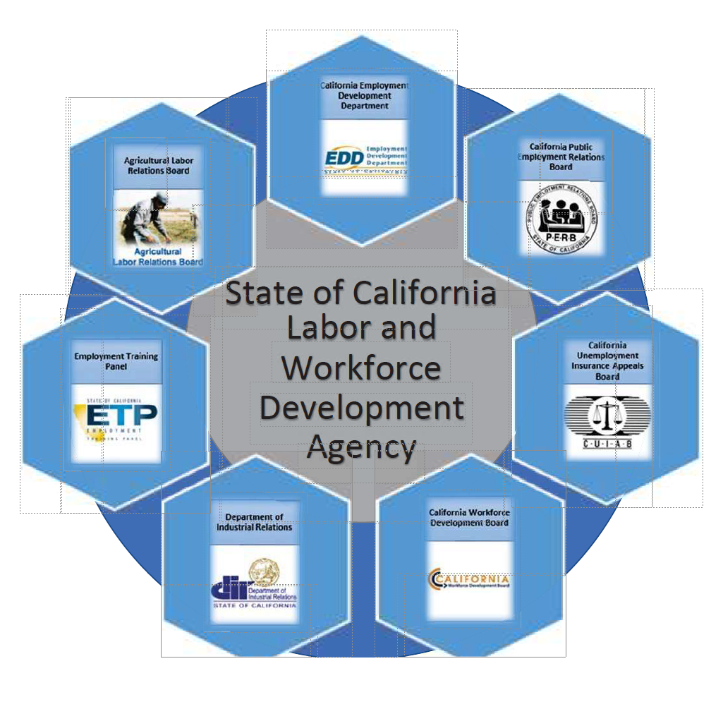
Notes:
By contrast, the Labor Agency accounts for just under 1% of the state budget.
7 Departments,. (including the Labor & Workforce Development Board, and the Department of Industrial Relations, whose divisions enforce minimum wage and hour and health and safety laws)
The Labor Agency is charged with regulating working conditions and promoting workforce development in all settings and sectors,
The direct care sector is, as in the rest of the country, one of the fasted growing and poorest paid in the state, making it a priority for the Labor Agency.
Despite the Labor Agency’s broad enforcement responsibilities, it does not have the power or the funding to directly increase wages, and is not directly involved in the administration or delivery of LTSS.
Which brings us to … the importance of collaboration!

Slide 26
Collaboration Is Key
Between CalHHS & CLWDA
Between various departments within CalHHS & CLWDA
Between state agencies & stakeholders
Notes:
While HHS’ primary focus has been on the person receiving or consuming care, the Labor Agency’s is on the person delivering that care. Recognizing the crucial connection between quality jobs and quality care, the two agencies have prioritized strengthening their partnership.

Slide 27
Start Small
What: Catalog & share current FY DCW investments
Why: Internal coordination & stakeholder engagement
How: Additional resources through philanthropic support
Notes:
VALUE ADDED

Slide 28
The Nitty-Gritty
Identify key partner(s)
Build partnership with California Department of Aging to create tools and corral participation
Monthly inter- and intra-agency DCW meetings to level-set, choose priorities, and plan presentation
Assemble Google spreadsheet
Synthesize data
Create visuals
Outreach

Slide 29
Summary of DCW Investments FY 21-22
TOTAL
$946.4 Million

Slide 30
What we have accomplished
Provided baseline for strategic planning between HHS departments and between HHS & LWDA
Facilitated stakeholder engagement
Planning meetings transitioned into quarterly internal HHS/LWDA DCW strategy meetings
Paved the way for current HHS/LWDA collaboration on FY 22-23 budget, $1.4 B Health Workforce for All

Slide 31
What we have yet to do
Raise wages
Provide benefits
Standardize and centralize training and certification
Notes:
Current and proposed DCW investments are mostly for training, some amount for stipends related to training and care work done during the height of the pandemic, but not for permanent wage increases – based on temporary ARPA funds that expire in 2024
Related to wages b/c of benefits cliff – (see proposed CMS rule to modify 42 CFR 447 to enable states to make payments to 3rd parties for benefits & training)
Currently we have a patchwork of requirements, regulation, certification and training, managed by multiple departments – works against building a sustainable pipeline. Toward a more accessible, coordinated, professionalized system

Slide 32
Building toward structural change
Direct Care Workforce Solutions Table
Notes:
Specific recommendation in the Master Plan for Aging: to address workforce supply challenges and opportunities, assessing feasibility of successful programs in other states, to produce a blueprint for sustainable direct care workforce development that improves working conditions and wages, care and health outcomes.
For more on what such a table, task force or advisory could look like and what it could accomplish, I’ll turn it over to Prof. Clare Luz of Michigan State University, College of Osteopathic Medicine, and the IMPART Alliance.

Slide 33


Michigan’s Statewide Initiatives
to Expand and Elevate the
Direct Care Workforce
Clare Luz, PhD
College of Osteopathic Medicine
Michigan State University & IMPART Alliance

Slide 34

The Stark Truth
Michigan currently needs approximately 196,000 skilled, compassionate DCWs.
36,000 more people than are working in these Michigan jobs today
PHI National https://phinational.org/
No qualified workforce = no HCBC

Slide 35

Tremendous drive & momentum to make significant changes regarding the direct care workforce at the state level

Slide 36

2021-23 Michigan State Plan on Aging:
The Direct Care Workforce Is a Priority
Change Practice through Collaboration
  Increase the number of qualified and supportive multicultural direct care workers
  Support opportunities to increase wages
  Improve retention
  Elevate this workforce by promoting its collective value

Slide 37
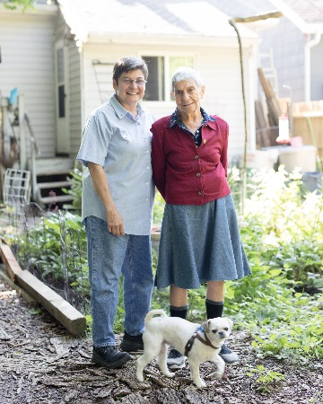
State Plan on Aging Specific Aims
  Develop statewide competencies for all DCWs, inclusive of CNAs, DSPs, HHAs, HHPs, and independent caregivers
  Develop education/curricula guidelines that
  map to the competencies
  Develop basic, intermediate, and advanced
  career pathways.
  Implement a statewide media campaign
  promoting DCWs and DCW trainings

Slide 38

Michigan Department of Health and Human Services Statewide
Advisory Council
Provide insight and direction into development of policies, programs and procedures to address the state DCW shortage.
Advise MDHHS on current & emerging DCW issues
Identify short-term and long-term opportunities to address the DCW shortage
Serve as subject-matter experts to inform initiatives
Leverage organizational resources to advocate for MDHHS-supported legislation
Initial Workgroups
  Competency, Education, Credentialing, Career Paths
  Communication and Mental Health
  Personal Protective Equipment

Slide 39

Competency, Education, Credentialing, Career Pathways Workgroup
Goal – Professionalize the DCW Workforce
  Competency guidelines/standards
  Professional and ethical standards
  Education and training guidelines
  Competency based, person-centered
  training models with test-out options,
  reciprocity, flexibility, portability
  Certification/credentialing
  Career pathways
  Aligns with the 2021–2023 Michigan State Plan on Aging

Slide 40

Essential Jobs, Essential Care (EJEC): State-Based Policy Advocacy Initiative
IMPART Alliance & PHI Partnership
  Policy reform in 3 areas: Wages/Benefits, Professionalization, Data
  Establish the IMPART Alliance statewide DCW Coalition to help drive policy
  Coalition and Policy (CAP) Committee
  Workgroups: Communication, Stories, Data

Slide 41

Other Collaborations & Initiatives
Legislative Care Caucus
Michigan Caring Majority
Ally Organizations
Wage Coalition
DCW Association
Proposal to MDHHS to establish a statewide DCW training and credentialing infrastructure
Michigan Industry Collaborative Model grant from the Michigan Department of Labor & Economic Development
Media campaign to reframe
the DCW workforce

Slide 42

Successes
Premium pay for DCWs (COVID response): Legislature and Governor made the $2.35/hour increase permanent – it was included in the FY 2022 approved budget
  Competency guidelines adopted
Code of ethics and professional standards adopted
Curricula, Credentials, Career Pathways in progress
Training infrastructure proposal in the House budget
PPE/vaccine policy briefs — PPE supplies and vaccine FAQs
Michigan Care Career DCW/Employer online platform under development

Slide 43
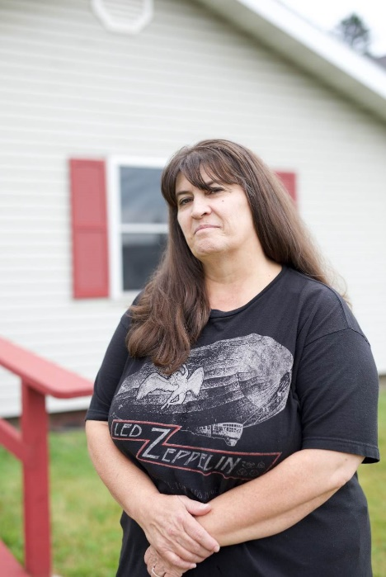
Key Components of Success
Statewide leadership — cutting across sectors, programs, settings, payors, populations
Inclusive of all stakeholders
Building relationships based on respect, transparency, trust, collaboration vs. competition
Recognition of interrelatedness of solutions
Finding common ground and goals
Common definition of DCW
Advocacy on behalf of all DCWs
Neutral convener
Commitment, passion, patience
and persistence

Slide 44
What’s Next?
Living wages/benefits with COLA, overtime, paid time off, etc.
Raising Medicaid cap
Professional and reimbursement codes for DCWs
Quality standards built into contracts
Affordable, accessible training
A data infrastructure
Tackling the underlying causes of the shortage: racism, sexism, ageism
Advocating for reforms and solutions that provide economic security for DCWs and competent, compassionate care for individuals needing support

Slide 45

Thank You
Contact Information
Clare C. Luz, PhD
IMPART Alliance
Michigan State University
luz@msu.edu
www.impartalliance.org
impart@msu.edu

