Slide 1

Health Care Is Becoming Increasingly Expensive for Connecticut Residents
Since 2000, Connecticut worker contributions to employer-sponsored insurance premiums have grown two and a half times faster than personal income.
Source: Medical Expenditure Survey, Tables D.1 and D.2 for various years & US Bureau of Economic Analysis

Slide 2
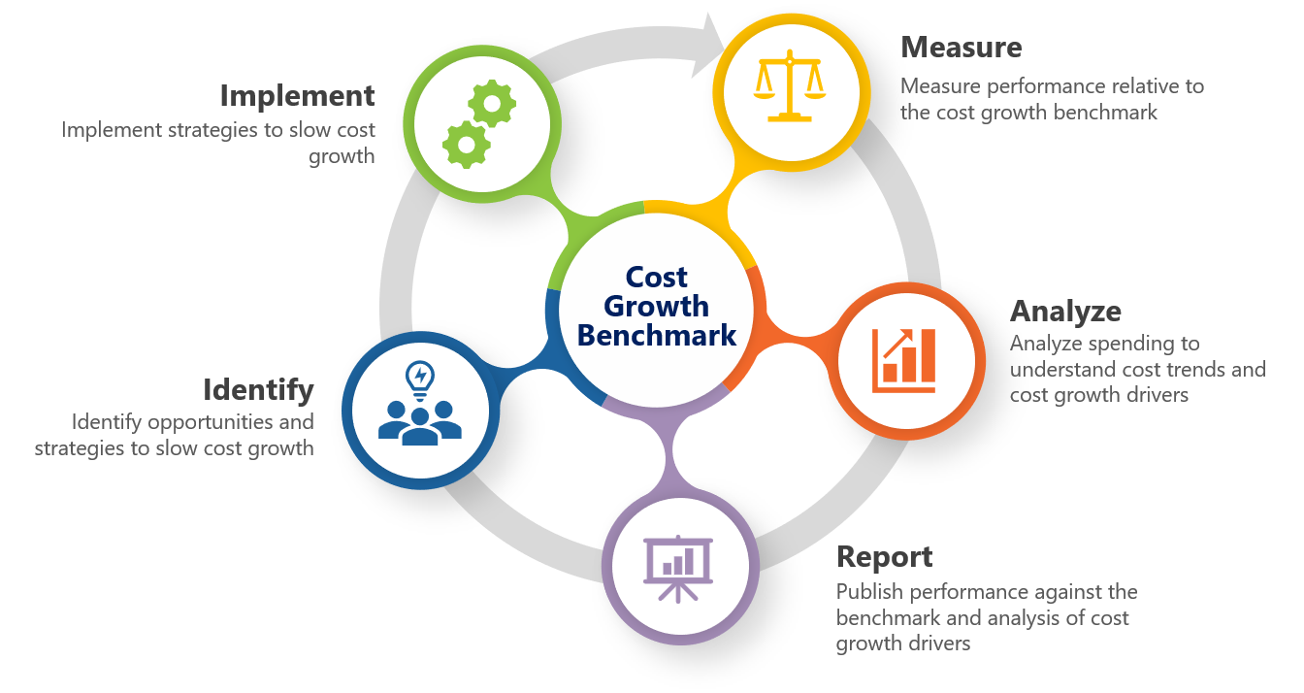
Setting a Health Care Cost Growth Benchmark, or Target, Will Help Connecticut Contain
Health Care Spending
Source: Washington State Health Care Authority

Slide 3
Connecticut’s Health Care Cost Growth Target
Aims to Align Health Cost Growth with Economic and Income Growth
Connecticut, in collaboration with its employers, insurers, and health providers, has set a state annual per capita cost growth target of:
3.4% for 2021
3.1% for 2022
2.9% for 2023–2025.

Slide 4
A Health Care Cost Growth Target Followed by Data-Driven Action Could Make Health Care More Affordable for Everyone
Containing health care costs, especially in the wake of the COVID-19 pandemic, is critical to ensuring access to affordable health care and the financial well-being of our residents, employers, and state government.
CT
OR
NV
NJ
WA

