Slide 1
The Affordability Problem: Healthcare Spending in Connecticut
March 24, 2021

Slide 2
Healthcare Affordability is a Major Problem in Connecticut for Two Simple Reasons
Healthcare costs are among the highest in the country.
Healthcare costs are growing much faster than personal income.
It’s a bad problem - and it gets worse
year after year after year.
Notes:
Why did the Governor establish these benchmarks and targets?

Slide 3
Connecticut spends more on healthcare than almost any state
Personal healthcare spending, per capita, by state, 2009 and 2014
S8,740
$6,892
$9,859
$8,045
Source: Centers for Medicare and Medicaid Services, State Health Expenditure Accounts, 2009 and 2014
Notes:
Why did the Governor establish these benchmarks and targets?

Slide 4
Healthcare cost growth is exorbitant
…two and a half times
Since 2000, Connecticut worker contributions to employer-sponsored insurance premiums have grown...
Worker contributions to premiums (MEPS IC, CT)
faster than personal income
Family premiums (MEPS IC, CT)
Personal income in CT, per capita (BEA)
Source: Medical Expenditure Survey, Tables D.1 and D.2 for various years

Slide 5
Commercial medical spending per member per month increased 15% from 2015 to 2018
Spending grew 4.9% per year, excluding retail pharmacy (retail pharmacy spending growth rates in other states have been high).
Payer | Spending per member per month (PMPM) |  |  |  | Annual change (%) |  |  | Total change (%)
 | 2015 | 2016 | 2017 | 2018 | 2016 | 2017 | 2018
All payer | $377.66 | $408.23 | $421.97 | $435.55 | 8.1 | 3.4 | 3.2 | 15.3
Notes:
1 - Includes CT fully insured population and state employee health plan
2 - Limited to CT residents under age 65
3 - Spending includes patient cost sharing
4 - Much higher trend in first year than next two
5 - From 2015-18, PMPM spending increased for every large commercial payer and state employees
6 – Average annual wage growth in CT during this period was 1.47%

Slide 6
Out-of-pocket (OOP) spending increased much faster than total spending
From 2015 to 2018, OOP spending increased 26% compared to overall spending which increased 15.3%
This reflects changes in a) employer decisions on plan design, and b) employee plan selection, as employers and employees try to cope with high costs.
Payer | OOP Spending for covered medical services (PMPM) |  |  |  | Annual OOP change (%) |  |  | Annual PMPM change (%) |  |  | Total change (%)
 | 2015 | 2016 | 2017 | 2018 | 2016 | 2017 | 2018 | 2016 | 2017 | 2018 | OOP | PMPM
All payer | $44.21 | $47.75 | $53.94 | $55.70 | 8.0 | 13.0 | 3.3 | 8.1 | 3.4 | 3.2 | 26.0 | 15.3
Notes:
OOP PMPM is calculated as sum(copays + deductibles + coinsurance)/sum(member months).
Percentage change in “PMPM” columns is calculated as the change in total PMPM, including insurance payments and out-of-pocket payments.

Slide 7
Office of Health Strategy Efforts to Improve Affordability

Slide 8
What is Affordable Healthcare?
Healthcare is affordable in Connecticut if a family can reliably secure it to maintain good health and treat illnesses and injuries when they occur without sacrificing the ability to meet all other basic needs including housing, food, transportation, childcare, taxes, and personal expenses or without sinking into debilitating debt.
Notes:
NOTE TO RDW: Could we look at adding a stock image of sorts to this to take up some additional space?
THANKS

Slide 9
Connecticut’s Executive Order #5
1
Cost Growth
Benchmark
Recommendations for a cost growth benchmark that covers all payers and all populations for 2021-2025.
2
Primary Care
Spend Target
Recommendations for getting to a 10% primary care spend as a share of total healthcare expenditures by CY 2025, applied to all payers and populations.
3
Data Use
Strategy
A complementary strategy that leverages the state’s APCD, and potentially other sources, to analyze cost and cost growth drivers, and more.
4
Quality
Benchmarks
Recommendations for quality benchmarks applied to all public and private payers, effective 2022.

Slide 10
Selected Cost Drivers and Cost Growth Drivers in Connecticut

Slide 11
Understanding is a Prerequisite to Correcting
The Healthcare Cost Growth Benchmark is intended to serve as a beacon towards which all parties which have some measure of influence on spending – the state, payers, employers and providers – can strive.
Concrete corrective action, however, requires understanding of why health care spending is high, how it varies across the state, and what is driving spending growth.

Slide 12
The Centrality of the Data Use Strategy
Understanding healthcare spending requires data analysis. CT’s All-Payer Claims Database, combined with other data resources, can be utilized to gain necessary insight.
Armed with this insight, OHS can convene stakeholders to collaborate on strategies to address spending growth to meet the benchmark.
During the fall and winter of 2020 OHS directed a contractor to perform an initial analysis. While much more analytic work remains to be performed in 2021 and beyond, we currently have insight into a few factors that have been driving spending and spending growth.

Slide 13
Spotlight on Three Cost & Cost Growth Drivers
While there is still much to learn through additional analysis, it is clear that at least three factors are having a substantive impact on commercial healthcare spending and its growth:
Retail pharmacy spending
Hospital spending
Chronic illness prevalence
OHS lacks comparable insight for populations served by Medicaid and Medicare but plans to obtain it in the future.

Slide 14
2021 Retail Pharmacy Impact on Commercial Health Insurance Rates
Retail pharmacy represents almost 25% of total commercial health insurance premium
Annual trend of 10% - 12%
P.A. 18-41 data

Slide 15
Commercial Hospital Spending Grew 6.9% Per Year on Average, 2015-2018
Service Category | 2015 |  | 2018 |  | Average annual change (%) | Total change (%) | Change in category as percent of total change
 | PMPM | % | PMPM | %
All services | $377.65 | 100.0 | $435.55 | 100.0 | 4.9 | 15.3 | 100.0
Professional | $170.03 | 45.0 | $184.24 | 42.3 | 2.7 | 8.4 | 24.5
Inpatient acute | $77.58 | 20.5 | $94.34 | 21.7 | 6.8 | 21.6 | 29.0
Outpatient - not ER | $73.86 | 19.6 | $90.41 | 20.8 | 7.0 | 22.4 | 28.6
Outpatient – ER | $50.62 | 13.4 | $61.77 | 14.2 | 7.0 | 22.0 | 19.2
Other | $5.55 | 1.5 | $4.79 | 1.1 | -4.7 | -13.7 | -1.3
Notes:
Categories of services derived from the CT APCD Data Dictionary claim type detail. Results are not age/gender-adjusted
ER = emergency room; PMPM = per member per month
Notes:
Bailit Health observations:
It is important to note that pharmacy spending is excluded from this analysis. If included, it would represent 25% of spending or more.
The high annual growth rate in hospital spending jumps out.
In comparison, RI trend for 2017-18 using insurer-reported (not APCD) data showed IP hospital trend of -2% and OP hospital trend of 5%. (RI caps annual hospital rate increases by regulation.)

Slide 16
Spending Per Unit Drove Spending Growth; Service Utilization Declined or Grew Slightly
Service Category | 2018 Volume | 2018 Spending per unit | Percent change in spending per unit |  |  |  | 3-year percent change in volume
 |  |  | 2016 | 2017 | 2018 | Total 3-year
Inpatient acute stay | 36,164 | $25,636 | 9.8 | 7.4 | 7.2 | 26.4 | -4.1
Outpatient – ER | 356,647 | $1,702 | 9.4 | 5.5 | 6.7 | 23.1 | -1.1
Outpatient – not ER | 688,207 | $1,291 | 3.7 | 4.6 | 10.5 | 19.8 | 1.9
Professional | 8,471,604 | $214 | 0.8 | 1.7 | 1.0 | 3.6 | 4.4
Notes:
Changes in spending per unit are affected by both changes in service mix and changes in service-level prices.
Categories of services derived from the CT APCD Data Dictionary claim type detail.
Includes CT residents under age 65.
Results are not age/gender-adjusted.
Inpatient stay units defined as discharges, which can include multiple claims. Other category of service units defined as individual claims.
ER = emergency room; PMPM = per member per month

Slide 17
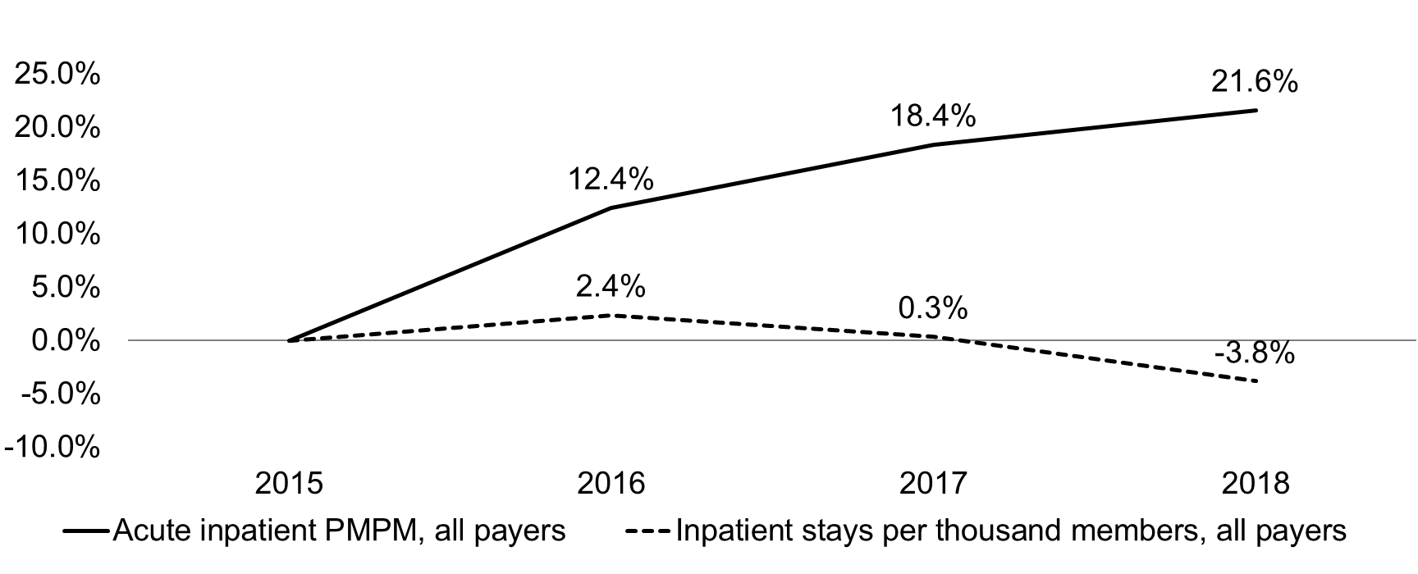
Acute Inpatient PMPM Spending Grew 22 Percent While Hospital Admissions Declined
Note: Percentage change for all years is relative to 2015.

Slide 18
Chronic Illnesses Were Common and Associated with Far-Above-Average Spending
Condition | 2018
 | Members with condition | % | PMPY for members with this condition
All members | 455,780 | 100.0 | $6,151
Hyperlipidemia | 73,081 | 16.0 | $11,842
Hypertension | 70,419 | 15.5 | $13,739
Rheumatoid Arthritis/Osteoarthritis | 67,943 | 14.9 | $13,866
Depression | 50,979 | 11.2 | $13,501
Diabetes | 28,608 | 6.3 | $14,197
Anemia | 26,723 | 5.9 | $25,355
Acquired Hypothyroidism | 25,918 | 5.7 | $12,911
Glaucoma | 18,035 | 4.0 | $9,004
Chronic Kidney Disease | 17,732 | 3.9 | $24,029
Asthma | 17,500 | 3.8 | $16,887
One or more of 27 chronic conditions | 218,598 | 48.0 | $10,336
Two or more of 27 chronic conditions | 115,855 | 25.4 | $14,379
Notes: This slide shows the 10 most common conditions. PMPY calculated as total costs for members with the condition divided by all members continuously enrolled from January 1, 2017 through December 31, 2018.

Slide 19
People with One Chronic Condition Often Had One or More Additional Conditions
Condition A (Rank) | Condition B (Rank) | Percent of Total Population with A & B | Percent of People with Condition A who had Condition B
Hyperlipidimia (1) | Hypertension (2) | 8.2 | 51.1
Hyperlipidimia (1) | Rheumatoid Arthritis (3) | 4.6 | 28.5
Hyperlipidimia (1) | Depression (4) | 2.5 | 15.7
Hyperlipidimia (1) | Diabetes (6) | 3.7 | 23.3
Hypertension (2) | Rheumatoid Arthritis (3) | 4.7 | 30.2
Hypertension (2) | Depression (4) | 2.3 | 15.2
Hypertension (2) | Diabetes (6) | 3.8 | 24.3
Hypertension (2) | Chronic Kidney Disease (9) | 2.2 | 14.5
Rheumatoid Arthritis (3) | Depression (4) | 2.6 | 17.7
Diabetes (6) | Chronic Kidney Disease (9) | 2.4 | 37.8
Any chronic condition | Any other chronic condition | 25.4 | 53.0
Notes: This slide shows the 10 most common pairs of 25 chronic conditions. Rank indicates the relative prevalence of the condition with 1 being most common.

Slide 20
Make Your Voice Heard!
You are invited to submit questions about today’s forum.
You are invited to submit suggestions regarding how efforts to improve healthcare affordability should proceed.
To do so, please email OHS at Krista.Moore@ct.gov

