Slide 1

Reimagining Nursing Homes in the Wake of COVID-19
A virtual conversation with Terry Fulmer and Christopher Koller moderated by Noam Levey of the Los Angeles Times

Slide 2
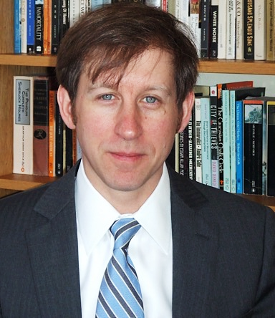
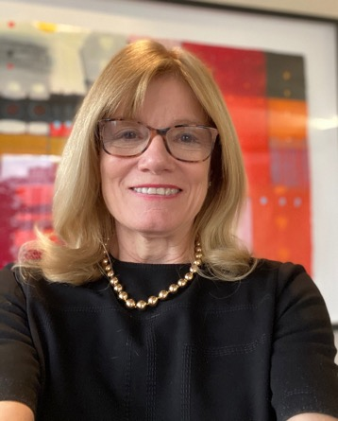
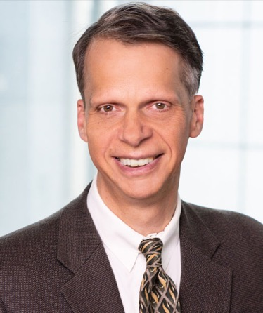
Noam Levey
Los Angeles Times
Terry Fulmer
President
The John A. Hartford
Foundation
Christopher Koller President
Milbank Memorial Fund

Slide 3
The John A. Hartford Foundation Mission and Priorities
Dedicated to Improving the Care of Older Adults
Age-Friendly
Health Systems
Priority Areas:
Serious
Illness
&
End of Life
Family
Caregiving

Slide 4

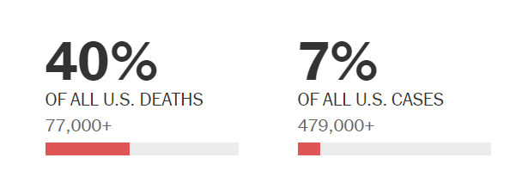
COVID-19 and Nursing Homes
Less than 0.5% of the total U.S. population (~1.5 million people) live in nursing homes
Yet, as of Sept 2020, nursing homes account for:

Slide 5
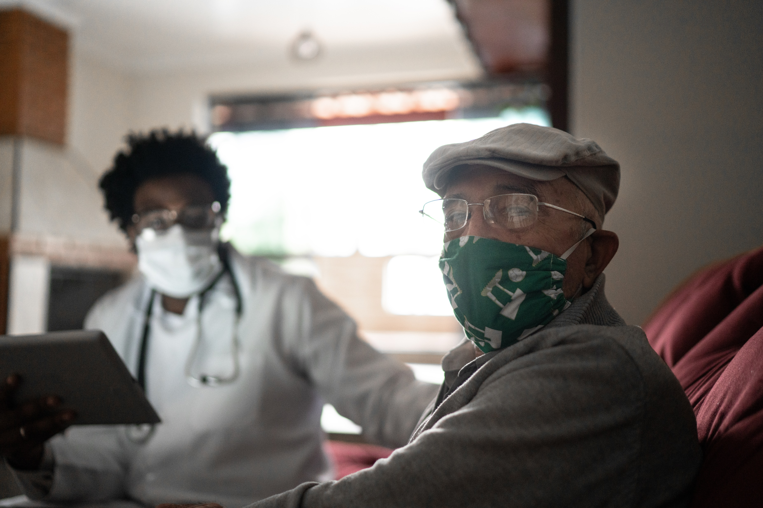
COVID-19 and Nursing Homes
Biggest issues:
Staffing
Infection prevention control
PPE
Social isolation
Racial/ethnic disparities
“America’s nursing homes are not designed, operated, or funded to deal effectively with infectious disease epidemics, and their staff are often too few in number and inadequately paid, protected, and trained.” – NAM Perspective

Slide 6
COVID-19 and Nursing Homes
The COVID-19 disaster presents an opportunity to reimagine the role of nursing homes.

Slide 7
COVID-19 and Nursing Homes
We can redesign physical and operating models to accommodate future pandemics
“Unpacking” strategies can better match services provided and care settings with the needs of specific groups:
  Homogenous group placement - hospice, memory centers
  Smaller facilities - Green Houses
  Nursing home alternatives - PACE day centers
  Short-stay rehabilitation patients in “extended care wings” of hospitals

Slide 8
COVID-19 and Nursing Homes
Will need action by all stakeholders:
Medicare and Medicaid policy reform
Investment in change by industry
Research on redesign and financing
Advocacy on behalf of residents and families
Funding from philanthropy and public sector
Follow-through on Coronavirus Commission’s 27 recommendations

Slide 9

COVID-19 and Nursing Homes - JAHF Actions
Urgently: funding the National Nursing Home Huddles led by Institute for Healthcare Improvement as a part of our Age-Friendly Health Systems movement
  Evolved into Nursing Home ECHO: COVID-19 Action Network Conversation Series funded by AHRQ
Emergently: funding the National Academies of Sciences, Engineering and Medicine to launch a study on nursing home safety and quality post-COVID-19
Emergently: funding the FrameWorks Institute to examine how to reframe the nursing home narrative

Slide 10
The Milbank Memorial Fund
The Milbank Memorial Fund is an endowed operating foundation that works to improve population health by connecting leaders and decision-makers with the best available evidence and experience.
We advance our mission by:
Identifying, informing, and inspiring current and future state health policy leaders to enhance their effectiveness
Working with state health policy decision makers on issues they identify as important, particularly in areas related to primary care transformation, sustainable health care costs, and aging
Publishing high-quality, evidence-based publications and The Milbank Quarterly, a peer-reviewed journal of population health and health policy

Slide 11
Unpacking Nursing Homes and Reducing Future Demand Will Require Strengthening Community-Based Services
Reimagining Nursing Homes in the Wake of COVID-19

Slide 12
Strengthening Community-Based Services
Medicaid is the main payer for long-term services and supports (LTSS), the core of community-based services
State Medicaid programs innovating on how to pay for and operate LTSS
  See our Strengthening Medicaid LTSS Toolkit
Community-based services should include support for family and unpaid caregivers

Slide 13
Support for Family Caregiving
The 2018 Recognize, Assist, Include, Support, and Engage (RAISE) Family Caregivers Act established a national family caregiving strategy
But states have led the way. Washington, Hawaii, Maine, Minnesota, and Tennessee were highlighted in a Hartford-Milbank report by Johns Hopkins researchers last year because of their unique policies and programs
  The Kupuna Caregivers in Hawaii provides working family caregivers with a daily subsidy to be applied toward adult day services
Reimagining Nursing Homes in the Wake of COVID-19

Slide 14
PACE (Program of All-Inclusive Care for the Elderly)
An integrated provider-sponsored health plan that offers nursing home-level care in day centers to people age 55 and over
  During COVID, many patients receive services at home
PACE serves over 51,000 participants in 31 states
Primarily funded through capitated payments from Medicare and Medicaid, which allows for flexibility

Slide 15
Other Initiatives to Strengthen Community-Based Services
Master Plans on Aging, advanced by The SCAN Foundation, are blueprints that guide restructuring of state and local policy, programs, and funding geared toward aging well in the community
Community Aging in Place—Advancing Better Living for Elders (CAPABLE) program, running in 15 states, teams a nurse, an occupational therapist, and a handy worker to address the home environment and help older adults improve their safety and independence
Support and Services at Home (SASH) in Vermont coordinates social-service agencies, community health providers, and nonprofit housing organizations

Slide 16

Slides and a recording of this session will be provided.
  Chris Koller
  CKoller@milbank.org
  www.milbank.org
  Terry Fulmer
  Terry.Fulmer@johnahartford.org
  www.johnahartford.org
REIMAGING NURSING HOMES IN THE WAKE OF COVID-19

